Slide 1
Oklahoma Science, Technology, Engineering, and Mathematics Mentorship Program

Slide 2
What is the OSTEMMP?
The Oklahoma STEM Mentorship Program is an educational outreach connecting networking professionals from OU, OSU, OneNet, and other institutions with students in the technology field.
It is part of an NSF grant to enhance Oklahoma’s educational and research capability through network improvements.
http://www.oscer.ou.edu/ostemmp.php
2

Slide 3
Job Shadowing
The goal:
IDENTIFY, DEVELOP and RECRUIT Talent
Activities include:
Presentations to students throughout OK
Job shadowing opportunities (on-site & virtual)
http://www.oscer.ou.edu/ostemmp.php
3

Slide 4
Job Shadowing
On-Site
Schedule a time with us to see what we do!
Virtual
e-mail us at kthomas1@ou.edu or (OU IT Community Experience Academic Team)
http://www.oscer.ou.edu/ostemmp.php
4

Slide 5
Other Opportunities/Resources
Jobs at OU
http://jobs.ou.edu
Jobs at OneNet
http://www.okhighered.org/job-opportunities/
http://www.oscer.ou.edu/ostemmp.php
5

Slide 6
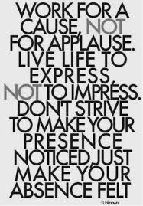
About This Presentation
What do I do in the IT field?
Lessons learned for getting this job.
Recommendations for keeping the job.
Being successful in this field.
http://www.oscer.ou.edu/ostemmp.php
6

Slide 7
Kim Thomas – Sr. Technology Strategist
As Senior Technology Strategist with the University of Oklahoma IT, Academic North, Kim focuses on building and maintaining partnerships between OU IT and the Academic North Colleges. Kim has been recognized for her exceptional leadership, self motivation and her ability to communicate effectively with people of diverse backgrounds.
“Our primary mission is to build our team to be a strategic partner with the Academic North Colleges by offering our insight and expertise to streamline processes and technology, while partnering with other areas of the campus that are dealing with technology challenges.”
Before coming to OU IT in August of 2013, Kim worked as a results-driven leader, with extensive experience implementing technologies and processes in IT and enterprise environments. Her experience includes software implementation consulting, portfolio and project management, quality assurance and testing, business analysis, and process improvement.

Slide 8
Traits of an IT
Traits of an IT Person
Active Listener Self Starter
Strategic Thinker
Motivator
Organization Skills
Persistence
Communications
Ask Questions
Adaptable
Positive
Creative
Leadership Facilitator
Referee- Conflict Resolution
Multi-tasker
Willingness to Learn
http://www.oscer.ou.edu/ostemmp.php 7

Slide 9
Meet the staff
Kim Thomas – Senior Technology Strategist
Grant Butler – Technology Strategist (MCEE)
Lynnetta Eyachabbe – Technology Strategist (COE)
Peter Tran – Technology Support Specialist
Nicholas Wright – Technology Support Specialist
Justin Miller – Technology Support Specialist

Slide 10
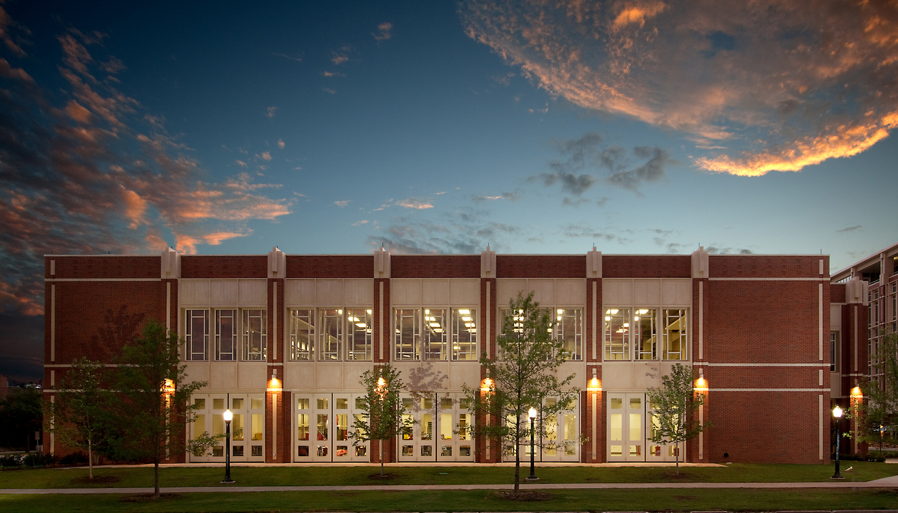
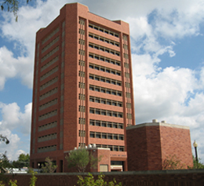
Coverage buildings

Slide 11
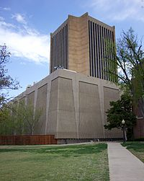
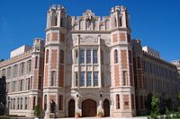
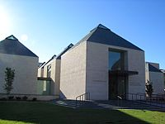
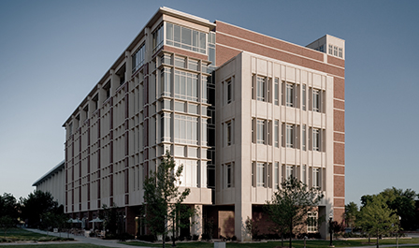
Coverage buildings

Slide 12
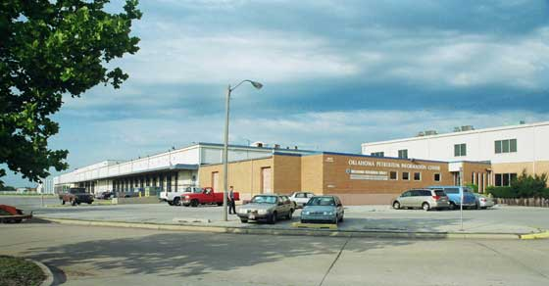
Coverage buildings

Slide 13
My Journey
http://www.oscer.ou.edu/ostemmp.php 8

Slide 14
Kim Thomas – Sr Technolgy Stratgiest
Graduated with a BS in Finance in 1992 – University of Central Oklahoma
Began my career at Hertz moved to IT as Business Analyst – Project Manager
Worked for Fleming as a QA Manager – Project Manager
Worked for TCI Solutions, Retalix and Park City Group as an Implementation Manager
Worked for Sonic Corporation – Director as Project Management Office
Worked for Devon Energy = Manager of QA & Testing / SAP Implementation
http://www.oscer.ou.edu/ostemmp.php 9

Slide 15
So, What is it Like to be Me?
http://www.oscer.ou.edu/ostemmp.php
15

Slide 16
A Day in My Life…
Prioritize!
Know what is important
Don’t let the “immediate” overshadow the “important”
Delegate!
Know when to ask for help
Build a circle of trust
Give credit where it is due
http://www.oscer.ou.edu/ostemmp.php
16

Slide 17
A Day in My Life…
Get to know your customer
Get out from behind the desk
Don’t be afraid to drop in on someone
Follow up on issues
Overcome fears
Step out of the “comfort zone”
Take charge when things are going wrong
Be accountable (it’s OK to be wrong)
http://www.oscer.ou.edu/ostemmp.php
17

Slide 18
A Day in My Life…
Be the trusted advisor
Subject matter expert in your field
Know both the “trees” as well as the “forest”
http://www.oscer.ou.edu/ostemmp.php
18

Slide 19
A Day in My Life…
Have fun!
Breaks can get you out of a rut (not too frequent…)
Make your office the place you enjoy being at.
Be that person everyone wants to be around
Lead by example!
http://www.oscer.ou.edu/ostemmp.php
19

Slide 20
The Resume…
A Brief Note About Resumes…
Keep it brief!
No more than 2 pages (3 at most).
You don’t need to write a novel, because we won’t read it.
Keep it relevant!
Tailor your resume to match the job you are targeting.
Leave out extraneous details. These will come out in the interview process.
Sell yourself…. Yourself!
Don’t let a recruiter/headhunter sell you.
http://www.oscer.ou.edu/ostemmp.php
20

Slide 21
Preparing yourself…
What you should do before then…
College diploma in a relevant field… this is worth up to 5 years of relevant experience!
Experience… internships during college can be applied toward this (kill two birds at the same time).
Certifications… start small, and work your way up. Do this during college, or even during high school.
Build relationships… sometimes, it isn’t WHAT you know, it’s WHO you know.
http://www.oscer.ou.edu/ostemmp.php
21

Slide 22
Preparing yourself…
What you should do…
Be positive.
Have a back-up plan.
Have someone else critique your resume.
Pass the interview.
Be honest during the interview.
Practice the interview
Thank the interviewer both in person, and later in writing.
http://www.oscer.ou.edu/ostemmp.php
22

Slide 23
Now, about that job…
What to look for…
Money isn’t everything. There are sometimes trade-offs for higher
salaries:
More hours
More travel
Fewer benefits
Reputation. Find a place that everyone is talking about. Ask the people that work there if it is worth it!
Family friendly environment. Flexible work hours can be important.
http://www.oscer.ou.edu/ostemmp.php
23

Slide 24
Now, about that job…
What to look for… (cont.)
Look at the “whole package”
Dress code?
Distance to work?
Free parking?
Starbucks (or pub) nearby?
Shared office space?
Time-off policy?
Condition of office?
Training and learning opportunities!
http://www.oscer.ou.edu/ostemmp.php
24

Slide 25
Now, about that job…
What to look for… (cont.)
Interview the interviewer.
Don’t be scared. This is a two-way partnership.
Ask for a guided tour.
Ask to meet your “team”.
Ask the interviewer how they like the job.
This is a long-term commitment!
Trust your instincts! If your gut says “no”, then turn down the job.
Keep that back out plan in place until the probationary period is over.
http://www.oscer.ou.edu/ostemmp.php
25

Slide 26
Congratulations! But now…
Suggestions for success…
Never compromise your morals.
Be honest… it’s hard to remember all of the lies you’ve told, and who you told them to.
Be there for other people… and they will be there for you.
Be positive! It’s contagious.
http://www.oscer.ou.edu/ostemmp.php
26

Slide 27
Congratulations! But now…
Suggestions for success… (cont.)
Don’t take things personally… in the grand scheme of things, it’s just a job!
Rule your destiny.
Step outside of your comfort zone. (ref. Office Space, the movie)
Nothing in your job is worth getting angry over.
Your customer is why you are where you are. Be there for them.
http://www.oscer.ou.edu/ostemmp.php
27

Slide 28
Be relevant…
Technical Stuff… (cont.)
Technology changes fast! Try to keep pace, and don’t wait for “futures”…

Slide 29
If you got ‘em, ask ‘em!

Slide 30
Evaluation Time!
Please take a moment to fill out the evaluations…
or NOT! The evaluations are completely optional!
No personal or personally identifiable data is collected.
Data is used by the grant providers to gauge success.

Slide 31
The End (about time too…)

