Slide 1
A Day in the Life of a
Web Development Professional
2012

Slide 2
Roadmap
Who Am I
OITMP
Types of Development
Development Process
Jobs

Slide 3
Who Am I
Job
Software Architect
104 ColdFusion Sites
30+ .Net Sites
6 iOS Applications (OU2GO, OU4YOU, Regent, IT App, IT DataCenter App, Sooner Jr)
Team Lead for IT Studio
Education
Bachelor of Science in Computer Science 2010
Working on MS in Management Information System

Slide 4
What is the OITMP?
The Oklahoma Information Technology Mentorship Program (OITMP) is an outreach initiative that connects networking professionals from Oklahoma institutions with students who are studying networks at Oklahoma academic institutions.
The OITMP is part of a National Science Foundation grant whose purpose is to boost Oklahoma’s education and research capability through network improvements

Slide 5
OITMP Goals
Official Goal: Expose Oklahoma security/networking students to the practical day-to-day life of security/networking professionals.
Hidden Secret Goal: Identify, develop and recruit talent!

Slide 6
Types of Development
Static Sites
HTML, CSS
Content does not change
Dynamic Sites
JavaScript, jQuery
Content can change
Coded Sites
On-The-Fly Compilation
PHP, ColdFusion, Grails
Pre-Compiled
.Net
Complex sites
Mobile Sites?

Slide 7
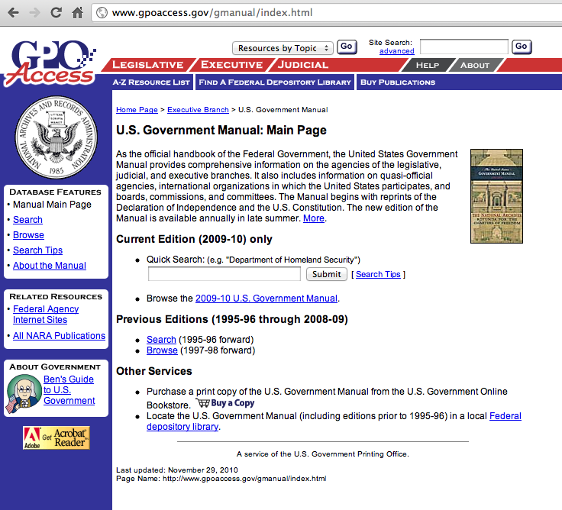
Types of Development
Static Sites

Slide 8
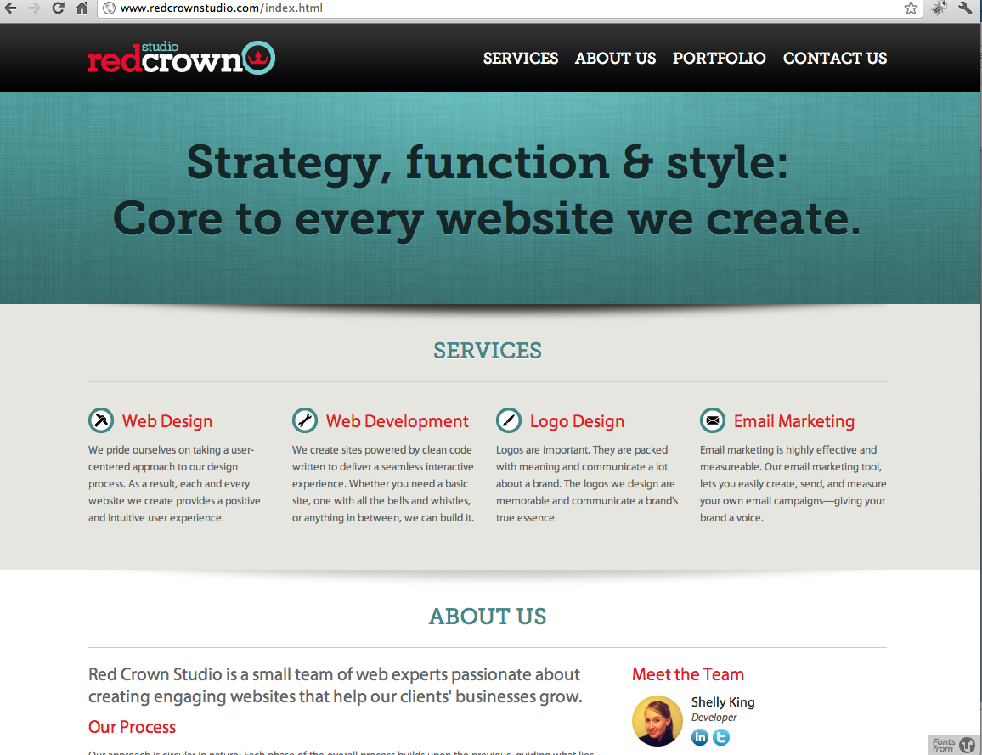
Types of Development
Dynamic Sites

Slide 9
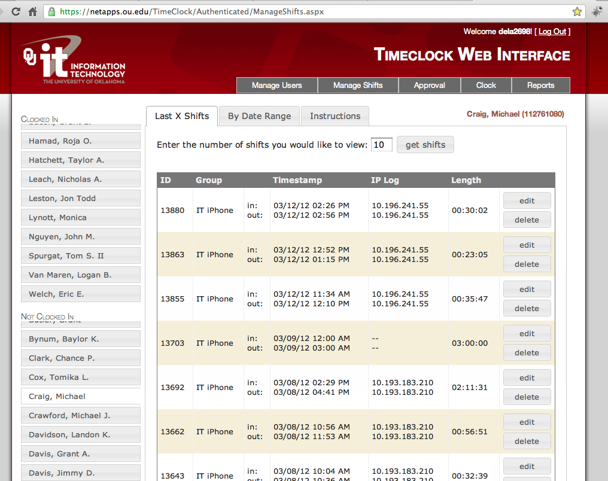
Types of Development
Coded Sites

Slide 10
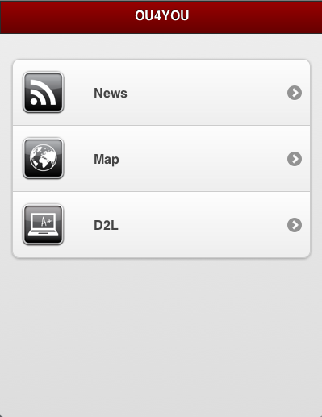
Mobile Development
Native Apps
Built Specifically for a particular OS
Available in that platforms application store
Mobile Web
Compatible with most Smartphones
Available from a url (ex: http://m.sears.com)

Slide 11
Development LifeCycle
New Development
Scheduled Maintenance
Enhancements
Emergency Fixes

Slide 12
New Development
Scope the Project
Gather details and requirements
Research
Does it make sense to build this project?
Create a timeline
What milestones are needed in this project?
What resources are available?
Start the Project

Slide 13
New Development Part 2
Design the layout
Start with Drawings
Prototype
Create a partially functional prototype
Product
Create the product
Test
Internal Testing
User Testing
Deployment
Release the product
More Testing

Slide 14
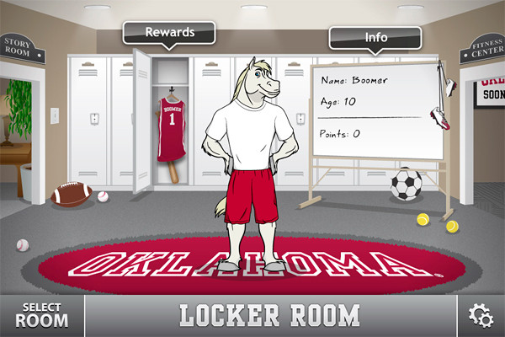
New Development: Example
Sooner Jr

Slide 15
Scheduled Maintenance
The world changes
Technology changes
Database Changes
Infrastructure Changes
Project
Depending on the scope of a change, it could follow a similar process to a new project.

Slide 16
Maintenance: Example
Oracle 9i to 10g Conversion
140+ ColdFusion sites
+

Slide 17
Enhancements
Now I need…
Customer needs change
Want more
Scope Creep
Project
Treated like a new project

Slide 18
Emergency Fixes
Coding for every possibility
Not Possible
The broken app
Where is the problem located? (The code, network, firewall, infrastructure, etc)
What is the quickest way to fix it?
What is the permanent fix?

Slide 19
Emergency Fixes: Example
OU4YOU
Gaylord News Site

Slide 20
Job
Where
Pure Web: Limited
Developer: Anywhere
Who wouldn’t want something made specifically for them?
Salary Range
40k – 150k

Slide 21
Job
What are they looking for?
Strong understanding of the building blocks
Experience / Projects
Something you can show them
Passion

Slide 22
Shadowing
Interested in seeing what development is like?

Slide 23
Contact Info
Gray Delacluyse
OU IT Software Architect
Gray.Delacluyse@ou.edu

