Slide 1
OITMP
OSU Institute of Technology
November 28, 2011
Geoff Wilson University of Oklahoma

Slide 2
A little about OITMP
The Oklahoma Information Technology Mentorship Program (OITMP) is an outreach initiative that connects networking professionals from Oklahoma institutions with students who are studying networks at Oklahoma academic institutions.
The OITMP is part of a National Science Foundation grant whose purpose is to boost Oklahoma’s education and research capability through network improvements.

Slide 3
Goals
Official Goal: Expose Oklahoma students to the practical day-to-day life of networking and security professionals.
Not So Secret Goal: Identify, develop and recruit talent!

Slide 4
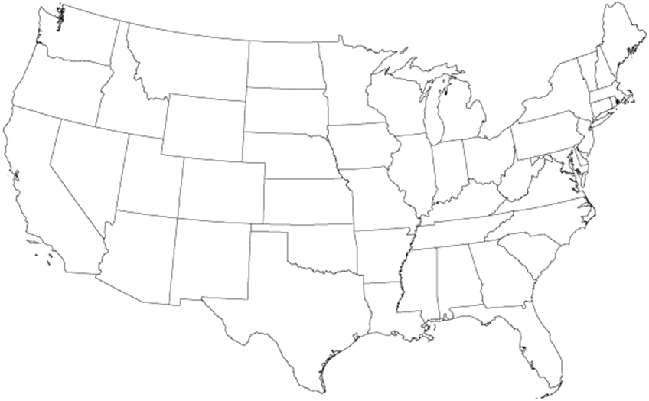
My Journey
’99-’03
BS in CS
Summa cum laude
GPS project
Cryptography

Slide 5
My Journey
’99-’03
‘03
Web application developer
Project voting system
Security Incident submission and tracking system
‘02

Slide 6
My Journey
‘03-’05
’99-’03
‘03
MS Information Security Technology & Management
CyberCorps
NATBLASTER
‘02

Slide 7
My Journey
‘03-’05
’99-’03
‘03
Policy gap assessment
NIST 800-53
Internal policies
‘04
‘02

Slide 8
My Journey
‘03-’05
’99-’03
‘03
FW Audit
FISCAM Audit
Designed, deployed pen testing lab
‘05-’06
‘04
‘02

Slide 9
My Journey
‘03-’05
‘06-’08
’99-’03
‘03
Tool development
Malware research
Vuln assessments
System administration
Security guidance
‘05-’06
‘04
‘02

Slide 10
My Journey
‘03-’05
‘06-’08
’99-’03
‘03
‘09-Pres
Working on CS PhD
Risk assessment
Incident response
Training & Awareness
Forensics
Software development
‘05-’06
‘04
‘02

Slide 11
What Have I Done?
Software development – ConocoPhillips, NSA, OU
Governance & Compliance – IHS, OU
Audit – HUD OIG
Risk assessment & Vulnerability assessment - OU
Vulnerability assessment – NSA, OU
Penetration testing - OU
Incident response - OU
Forensics & malware analysis – NSA, OU
Education & training - All
System administration – NSA, OU

Slide 12
What Have I Done?
Software development – ConocoPhillips, NSA, OU
Governance & Compliance – IHS, OU
Audit – HUD OIG
Risk & Vulnerability assessment – OU, NSA
Penetration testing - OU
Incident response - OU
Forensics & malware analysis – NSA, OU
Education & training - All
System administration – NSA, OU

Slide 13
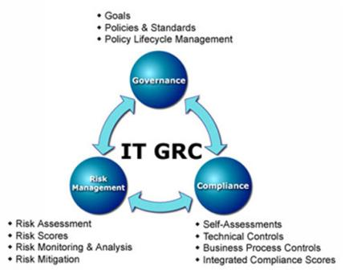
GRC
Design and deploy
Governance
policy and procedure
Risk Management
vulnerability assessment
penetration testing
secure architecture
Compliance
PCI
HIPAA
FERPA
FTC Red Flags

Slide 14
IT Audit
Audit and assess
Governance
policy and procedure
Risk Management
vulnerability assessment
penetration testing
secure architecture
Compliance
PCI
HIPAA
FERPA
FTC Red Flags

Slide 15
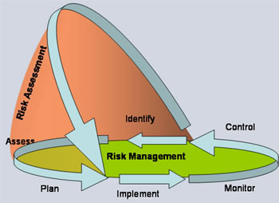
Risk Assessment
Identify risks through asset identification, threat analysis, vulnerability identification, business process analysis, control analysis
Estimate risk (qualitative or quantitative)

Slide 16
Vulnerability Assessment
Identify and quantify all vulnerabilities in a system
Report includes findings and recommended remediation
Use risk assessment methodology to prioritize vulnerabilities

Slide 17
Vulnerability Assessment Types
Perspective
Black Box – No insider knowledge, no source code
White Box (a.k.a. crystal box) – Insider knowledge, source code
Gray Box – Somewhere in between
Platform
Application VA
System VA
Non-credentialed (black box)
Credentialed (white box)
Network VA

Slide 18
Vulnerability Assessment Types
Automated
Can find many vulnerabilities, but will only find those vuln’s that it is programmed to find
Automated, so requires less time typically
Still have to interpret and validate results to remove false positives
Manual
Can find business logic flaws
Less false positives
More tedious, requires time
Requires skilled analysts

Slide 19
Penetration Testing
Simulate the activity of a malicious attacker
Often without cooperation or knowledge of broad IT staff
Can involve active exploitation of security vulnerabilities
Often includes social engineering
Findings and mitigation recommendations are delivered in a report

Slide 20
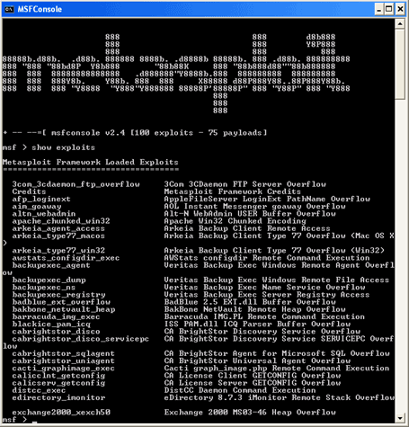
Vuln & Pen Testing Tools

Slide 21
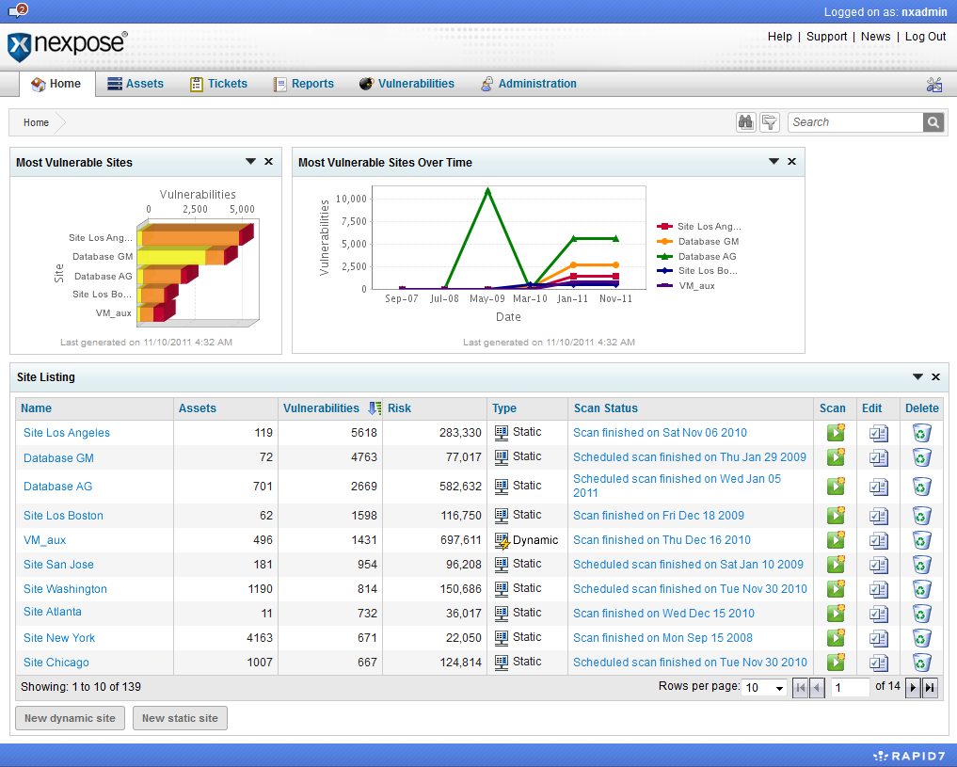
Vuln & Pen Testing Tools

Slide 22
Incident Response
Proactive
Reactive
Detection
Triage
Analysis or other Response
Fix /
Resolution
Lessons Learned Feed
Proactive Processes & Strategy
Feeds
Communication & Outreach Strategy
Notes:
What is often left out is that lessons learned should be derived
What’s the right balance?

Slide 23
Security Incidents at OU
Malware infections
Copyright infringement complaints
Systems misuse
Policy violations (HR, student code)
Account compromises
E-discovery
Stolen devices
Law enforcement investigations

Slide 24
Lifecycle of malware infection
Detection
Triage
Analysis or other Response
Fix /
Resolution
Malware infection alert
Examples
Hey Geoff, we’ve got a machine that looks like it’s infected. Can you take a look?
Symantec AV alert, “W32.Waledac.B 2011-01-20 09:55:58 c:\windows\temp\_ex-08.exe”
REN-ISAC alert

Slide 25
Lifecycle of malware infection
Detection
Triage
Analysis or other Response
Fix /
Resolution
Determine if escalation is required
Examples:
Look in security logs to see if machine has generated other alerts
Look up the virus common name (e.g. Waledac.B) in Microsoft Malware Encyclopedia and other knowledge bases to see if it is a known data stealer, rootkit, or backdoor Trojan.
Ask field tech to perform a secondary scan of machine and email results back
Notes:
Does the user have a job role where they come into contact with sensitive data?
Is the infection serious?

Slide 26
Lifecycle of malware infection
Detection
Triage
Analysis or other Response
Fix /
Resolution
Costly analysis
Notes:
We have a CFL at OU for intrusion analysis

Slide 27
Lifecycle of malware infection
Detection
Triage
Analysis or other Response
Fix /
Resolution
Rebuild (usually) or clean
Notes:
MBR infections require full disk wipe

Slide 28
Copyright Complaint Statistics

Slide 29
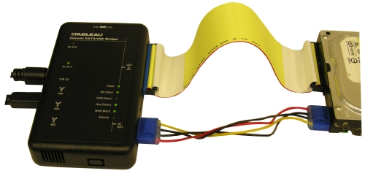
Forensics
Hard Drives
Memory Analysis
Mobile Devices
Email
Logs
Packet Traces

Slide 30
Training & Awareness
Date Given | Presentation | Audience
10/21/2011 | There’s a Party in Security and Everyone is Invited | Educause Annual
10/11/2011 | Introduction to Security Awareness Campaign | Campus IT Leaders
8/5/2011 | Lessons Learned from Incident Response | Incident Response Team
3/9/2011 | Information Security Awareness Training | Various
3/2/2011 | Information Security Update | Legal Counsel
1/11/2011 | Sandboxing and 3rd Party Patching Utilities | Campus IT Leaders
12/8/2010 | Malware Guest Lecture | CS Students
10/12/2010 | Removable Media Viruses | Campus IT Leaders
9/27/2010 | Security Incident Response | IT Field Services & Reps
9/14/2010 | Securing the University: Challenges and Opportunities, Incident Triage Procedures | Campus IT Leaders
8/14/2010 | Securing the University: Challenges and Opportunities | Deans & VPs
8/4/2010 | Security Awareness for Developers | IT Developers
7/13/2010 | Security Awareness for Developers | IT Developers
5/19/2010 | Emerging Threat Briefing | Various IT (workshop)

Slide 31
Finding the Right Job
Figure out what you want to do
Risk assessments?
Incident response?
Vulnerability research?
Profile individuals who have achieved what you want. What did they do? Reach out to them on LinkedIn
Be willing to take an entry level position with the right company & growth potential

Slide 32
Finding Your IT Job (cont’d)
Differentiate Yourself
College diploma in a relevant field
Worth up to 5 years of experience
Internships
Certifications (start small, and work your way up)
Extracurricular activities
Home lab
Local IT user organizations
Excel outside of your career
Success breeds success

Slide 33
Application Materials
I’ve reviewed ~500 resumes of recent graduates.
What successful candidates did:
Cover letter explaining why they are interested in the position and highlighting key resume items
Prompt thank you letters/emails after interviews
No spelling/grammatical mistakes
Customize application materials for the job
Limit non-relevant items (displays ability to edit)

Slide 34
Application Materials
What successful candidates did:
Manage whitespace
Have someone on the inside pass along your resume
Ask this person what the resume reviewer looks for
A few days after submitting resume, follow up with a phone call or email demonstrating interest in the job
Don’t try to use humor or sarcasm

Slide 35
Interviewing
Be prepared to answer difficult questions
What are your 5/10 year career goals and how would this job help you achieve those goals?
Tell me about yourself.
Here’s a difficult situation. How would you handle it?
It’s okay to take a minute to prepare a response to a tough question
Know your technical stuff
Come prepared with a printed list of questions for the interviewer

Slide 36
Interviewing
Ask for a business card
Do your homework. Know about the company
“I was reading on your website that your company does X…tell me more about this.”
Turn off your phone
Be relaxed
Be your professional self
Don’t be underdressed

Slide 37
Career Sustaining Recommendations
Always be learning
Build a strong foundation
Understand how business works
Understand how technology works
Learn how to be a good public speaker
Learn how to be articulate in communication
Network with fellow IT professionals
Be willing to learn new technologies

Slide 38
Career Sustaining Recommendations
Find a mentor (formal or informal) to help you
Understand organizations
Develop your perspective
Provide a sounding board for your ideas
Locate more job opportunities
Derive higher job satisfaction
Don’t always stay in your comfort zone
Practice public speaking skills
Develop time and project management skills

Slide 39
Career Sustaining Recommendations
Know the business
Have to know how technology is used
Learn how to get things accomplished within the business
Understand your customers
Be a team player
Build relationships
Become a trusted advisor

Slide 40
Thank you!
Geoff Wilson
ggwilson@ou.edu

