Slide 1
OITMP
Great Plains Tech Center
March 13, 2012
Chris Mallow, University of Oklahoma CSIRT

Slide 2
IT Security Professional

Slide 3
Infamous Incidents
A grad student at Cornell discovers a serious flaw in the UNIX mail program sendmail
He uses this knowledge to create a piece of malware that exploits this flaw, infects vulnerable systems, and spread to other systems
It also exploits flaws in other common programs as well as attacks against accounts with weak passwords
It gets wildly out of hand, infects 10% of the Internet and brings most connected organizations connected to their knees

Slide 4
Infamous Incidents (cont’d)
A sysadmin at a university uncovers an accounting error regarding use of computer time
He discovers an unauthorized user looking for classified military data who is exploiting weak passwords and unpatched system flaws across multiple platforms to compromise systems all over the Internet, including on US military bases, defense contractors, and university research systems
He coordinates with ISPs and LE to track the attacker’s usage and rough location across two continents, using system and network logs, as well as keystroke loggers
He sets up a honeypot system seeded with official-looking “classified” data, traps the attacker and traces the attacker to his source

Slide 5
Infamous Incidents (cont’d)
The Cornell grad student was Robert T. Morris
The “Morris Worm”
Early November, 1988
Damage estimates were between $10-100 million

Slide 6
Infamous Incidents (cont’d)
Clifford Stoll, an astronomer from Lawrence Berkeley National Lab
The Cuckoo’s Egg
August 1986 – 1988
East German spy hacking ring
Most of the techniques he used are still used today (with newer, better tools)

Slide 7
Back to the presentation
Who am I?
Chris Mallow
Currently work as a forensic analyst on the OU CSIRT
Fourteen years in IT
Twelve years in security and networking
Dot-coms/startups, banks, tech companies, consulting, state and Federal government
I have had two companies pulled out from under me

Slide 8
A little about OITMP
The Oklahoma Information Technology Mentorship Program (OITMP) is an outreach initiative that connects networking professionals from Oklahoma institutions with students who are studying networks at Oklahoma academic institutions.
The OITMP is part of a National Science Foundation grant whose purpose is to boost Oklahoma’s education and research capability through network improvements.

Slide 9
Goals
Official Goal: Expose Oklahoma students to the practical day-to-day life of networking and security professionals.
Hidden Secret Goal: Identify, develop and recruit talent!

Slide 10
What Do I Do?
What do I NOT do?
I am NOT a “hacker” or “cracker”
I play defense, not offense
I am not a “cowboy”

Slide 11
What Do I Do?
Proactive…
Network security
AAA
Controls
Cryptography
Security Engineering
And Reactive
Network monitoring
Intrusion detection and analysis
Investigations

Slide 12
What Do I Do?
The Exciting…
“Our systems have been hacked!!”
“We can’t get to the Internet!!”
“Our e-mail system is down!!”
“Tracking the wily hacker”
And The Mundane
Log review/console-watching
System health checks and configuration checks
Protocol baselines
Paperwork (policy creation, incident reports)

Slide 13
What is IT Security?
Access Control
Application Development Security
Business Continuity/ Disaster Recovery
Cryptography
Governance and Risk Management
Legal, Regulations, Investigations, and Compliance
Operations Security
Physical (Environmental) Security
Security Architecture
Network Security

Slide 14
Security Career Opportunities
SANS "20 Coolest Jobs In InfoSec" (Numbers correspond to the number on the list)
Incident Response/Analysis and Forensic Work (1,3,4,6,9,13,15)
Penetration Testing and Auditing (2,11,17)
Security Design and Architecture (5,10,14,20)
Security Administration and Operations (7,8,12)
Secure Application Development (18,19)
Security Research (2,3,6,11,16)

Slide 15
Incident Response
The rapid detection of adverse events to minimize loss and destruction, mitigate weaknesses that are exploited, and restore service.
Source: NIST SP800-61

Slide 16
Computer Investigations
In depth analysis using specialized tools
Hard drive
Memory
Log data
Mobile devices
Email

Slide 17
Computer Investigations

Slide 18
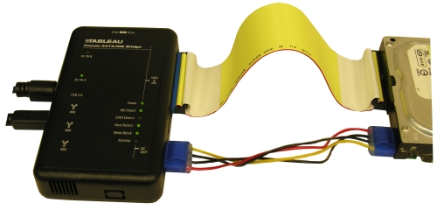
Computer Investigations
Hard drive analysis
Use hardware write-blocker
Make bit perfect image
Parse and categorize files
Index all data for keyword searches

Slide 19
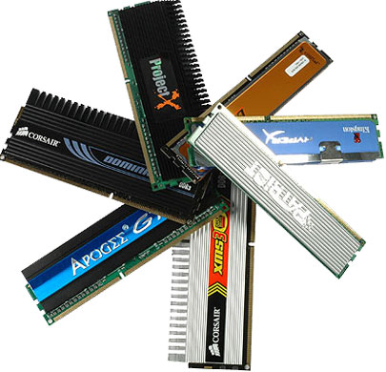
Computer Investigations
Memory analysis
Software to copy running memory
Running processes
Browser history
Chat logs
Passwords
Encryption keys

Slide 20
Computer Investigations
Cloud Forensics
Really just plain old log analysis
Network logs
DHCP
Firewall
Netflow
User activity logs
Authentications
Web server
Application

Slide 21
Computer Investigations
Mobile devices
SMS/MMS
Pictures/Video
Contacts
Email
Location history (GPS)
WIFI history
Browsing history

Slide 22
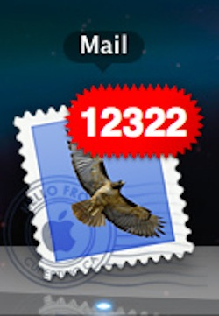
Computer Investigations
Electronic Mail
Header analysis
Keyword searches
Conversation analysis
Attachments

Slide 23
Computer Investigations
Last steps…
Document forensic process and findings
Must be able to demonstrate conclusions
Might have to testify
Be Thorough!
Post-incident analysis

Slide 24
What We See at OU
Copyright violations
~1-2 day (down from 15-20 per day)
System misuse
Password resets / Account usage
Policy violations
HR / Student Conduct Violations
Hacking / Malware
Data breaches
E-Discovery
Email analysis

Slide 25
Becoming a Professional
Technical aptitude
Logical thinking (i.e., troubleshooting)
FUNDAMENTALS
IT Fundamentals
Hardware
Operating systems
Networks
Applications
Databases
Security Fundamentals
CISSP’s Ten Domains

Slide 26
Becoming a Professional (cont’d)
Pop Quiz, Hot Shot…
What is the three-way handshake?
What is AAA? How about CIA?
What is the different between TCP and UDP?
Where do critical system logs live in Linux?
What three kinds of event logs do we have in Windows?
What are inodes?
What is a hash?
Tech screens and interviews

Slide 27
Becoming a Professional (cont’d)
Intangibles
Communication skills
Interpersonal skills and conflict resolution (teamwork)
Business understanding (maintaining the balance)
Environmental understanding
Passion
Drive to learn
Initiative (“moxie” or “spunk” or “enthusiasm”)
Flexibility/adaptability

Slide 28
Becoming a Professional (cont’d)
Intangibles
Ethics
Honesty
Integrity
Discretion
Work ethic
Fortitude
Willingness
Responsibility
The Ability to Handle and Learn from FAILURE

Slide 29
Finding Your IT Job
Where do you want to go?
Security? Database? Networking? SysAdmin?
Build your resume
Customize it for the position you’re applying for
Maximize what goes the direction you want
De-emphasize items that don’t help you
Demonstrate achievements, not responsibilities
Format and proof-read

Slide 30
Finding Your IT Job (cont’d)
Differentiate Yourself
College diploma in a relevant field
Worth up to 5 years of experience
Internships
Certifications (start small, and work your way up)
Extracurricular activities
Home lab
Local IT user organizations
Excel outside of your career
Success breeds success

Slide 31
Interviewing
Relax
Be positive
Be honest
Think about how you are presenting yourself
Connect with interviewer
Be generous with information about you
Ask smart questions
Spend time thinking about potential questions and answers

Slide 32
Starting Out
Starting out in a non-IT job
If it’s office work, computers WILL be involved
Find ways to reach your goal (extracurriculars, etc.)
Starting out in a low-end IT job
Pay your dues (on-call duty, night and weekend work)
Volunteer for anything (initiative)
Learn and grow
Find a mentor

Slide 33
Starting Out
Build credibility
DWYSYWD
Ask for advice
Foster trust
Show trust
Be honest
Clarify expectations
“What are your expectations for…”
Focus on small wins
Start with the intent of building long-term relationships

Slide 34
Thank you!
Chris Mallow
cmallow@ou.edu

