Slide 1
Oklahoma IT Mentorship Program
“A Day in the life of a Security Professional”
Cameron University
April 12, 2012
Tim Marley
IT Audit Manager

Slide 2
What is the OITMP?
The Oklahoma IT Mentorship Program (OITMP) is an outreach initiative that connects IT professionals from Oklahoma institutions with students who are studying IT at Oklahoma academic institutions.
The OITMP is part of a National Science Foundation grant whose purpose is to boost Oklahoma’s education and research capability through IT improvements.

Slide 3
OITMP Goal
Official Goal: Expose Oklahoma IT students to the practical day-to-day life of IT professionals.
Hidden Secret Goal: Identify, develop and recruit talent!

Slide 4
OITMP Activities
Presentations to students throughout Oklahoma:
Cameron University, Lawton
East Central University, Ada
Eastern Oklahoma County Technology Center, Choctaw
Eastern Oklahoma State College, Wilburton
Gordon Cooper Technology Center, Shawnee
Langston University, Langston
Oklahoma Christian University, OKC
Oklahoma City Community College, OKC
Oklahoma City University, OKC
Oklahoma Panhandle State University, Goodwell
Oklahoma School of Science and Mathematics, OKC
Oklahoma State University, OKC
Oklahoma State University, Stillwater
Oral Roberts University, Tulsa
Pontotoc Technology Center, Ada
Rose State College, Midwest City
Southern Nazarene University, Bethany
University of Central Oklahoma, Edmond
University of Oklahoma, Norman
University of Oklahoma, Tulsa
Job shadowing opportunities (on-site and virtual)

Slide 5
About Me
Tim Marley -
OU Internal Audit, IT Audit Manager (2011-present)
OU IT Security, Senior IT Compliance Assessor (2009-2011)
Harold’s, Network and Security Manager (2002-2009)
MNTC, Technical Instructor, Network and System Administration (1999-2002)
Family business, (1987–1999)
Education
BAcc (OU 1990)
SANS
PCI SSC
Certifications
Expired/out-of-date: A+, Network+, CCNA, CCAI, CITP, CPISM/A
Current: CPA, CISA, GSNA, CISSP, CISM, GPEN, PCI ISA, CIPP
My favorite quote:
“If you don’t like something, change it. If you can’t change it, change your attitude. Don’t complain.” -Maya Angelou

Slide 6
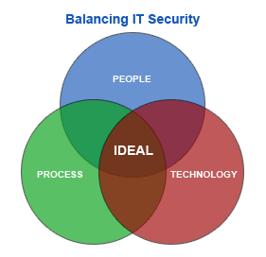
About OU
OU IT
Network services
Server/workstation administration
Customized design and architecture
IT security
CSIRT (reactive)
GRC (proactive)
Support 8000+ wireless users
Support 15000+ network users
Support ~25000 host devices
Support ~1300 wireless access points
Support ~850 security cameras
Support ~1250 network switches and routers
Over 200 physical and virtual servers

Slide 7
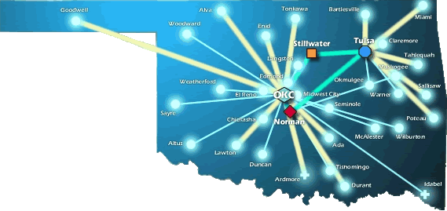
About OneNet
OneNet Services:
Support K-12 in Oklahoma
Support Higher Ed’s in Oklahoma
Support State Agencies
State-wide Optical Network (DWDM)
10-Gig Connectivity to Research and Education Networks
VoIP, VTC, E-Mail and Web Hosting Services

Slide 8
A Day-in-the-life of an IT security professional

Slide 9
So, what’s it like?
Is it like the movies?
Some of my favorites are Jurassic Park, Swordfish and War Games

Slide 10
So, what’s it like?
Is it like the movies?
Maybe Office Space?

Slide 11
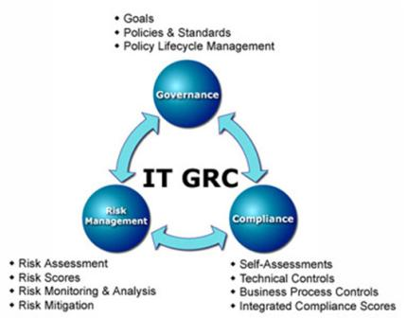
IT Security
Design and deploy
Governance
policy and procedure
Risk Management
vulnerability assessment
penetration testing
secure architecture
Compliance
PCI
HIPAA
FERPA
FTC Red Flags

Slide 12
Governance
Policy, procedure and guidelines
University Payment Card Security Policy for PCI-DSS
OU Norman Campus Payment Card Security Standard
OU Norman Campus Payment Card Security Definitions Document
OU Tulsa Campus Payment Card Security Standard Draft
OU Tulsa Campus Payment Card Security Definitions Document
Departments for this effort:
Information Technology
Bursar
Human Resources
Internal Audit
All 3 campuses
Do you know any specific requirements/extent of requirements IA would like for the volunteer scenario? If you’re not sure, I can take a stab at it and send you revisions for review and progressive elaboration and refinement.
For example, for such volunteer staff, are there specific consequences IA wants the business unit to hold those staff to, paralleling for example the consequences for paid staff of disciplinary action up to and including termination? If so, what consequences are to be listed?
Or is the preference to generically require the department to acceptably hold these volunteer staff accountable without specifying exact mechanism (e.g., indemnification, etc.)? Would this go so far as specifying for the business unit some specific terms the department must have volunteers consent to for example in a volunteering agreement?
I suspect for non-employees some aspects of what the university can actually reasonably do (both legally and practically) is somewhat different than for staff, although certainly specific terms can be incorporated into a volunteer agreement, etc., to help communicate expectations and obtain consent for required background checks, and processes can be designed to help detect deviations. Some of those details, however, might be best defined by each business unit instead of at the campus standard level.
In any case, I think the language around volunteer agreements and any indemnification would need special review and consideration by the Office of Legal Counsel.
If you have specific requirements/language, could you share it? If not, can you let me know the general approach (for example, comparing the approaches above) and extent IA is seeking so I can take a stab?

Slide 13
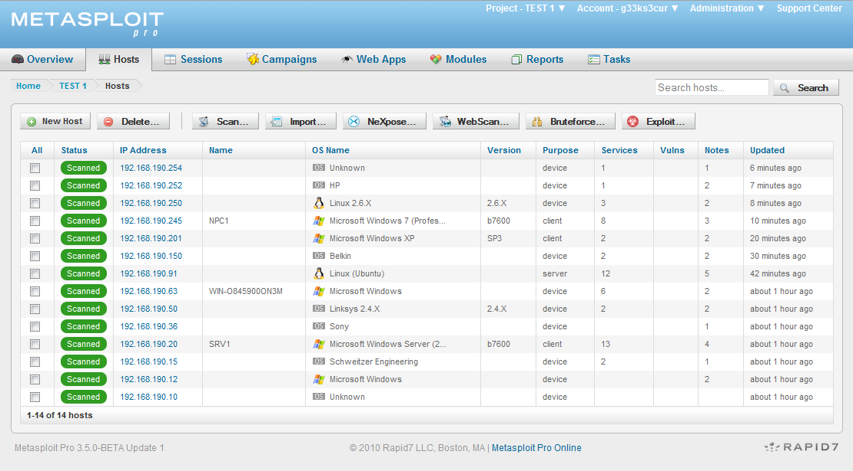
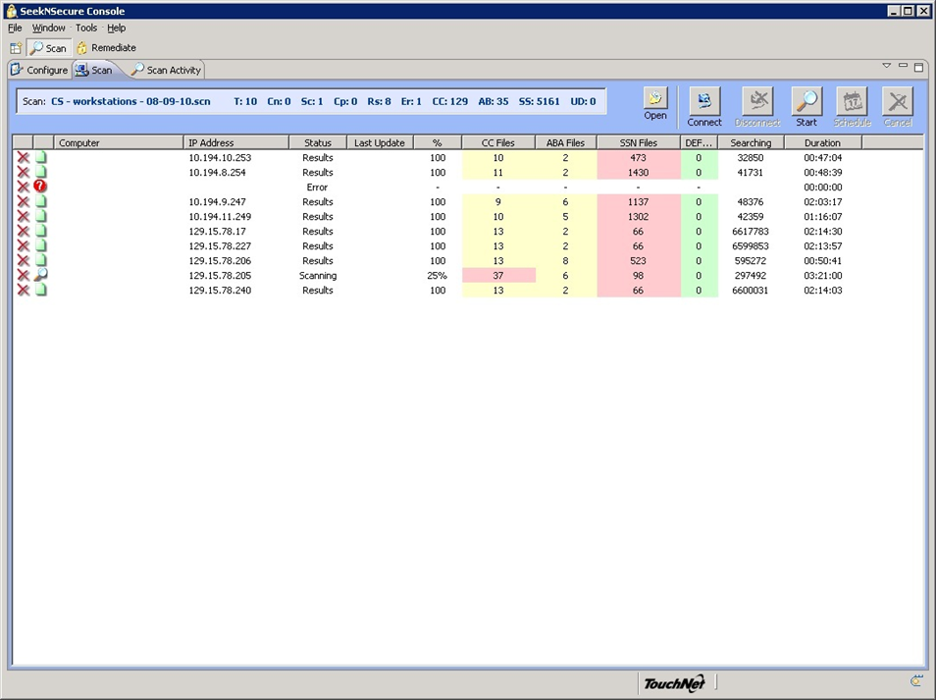
Risk Management
Vulnerability assessment
Rapid7 Nexpose
Nmap
SeekNSecure
Manual
Penetration testing
Metasploit Pro
Secure architecture
Visio
Discussions
Planning

Slide 14
Compliance
HIPAA/HITECH
FTC Red Flags
FERPA
PCI

Slide 15
Regulatory compliance
Federal Consumer Report Act (FCRA)
Fair and Accurate Credit Transaction Act (FACTA)
Gramm Leach Bliley (GLBA)
Health Insurance Portability and Accountability Act (HIPAA)
Health Information Technology for Economic and Clinical Health (HITECH) “HIPAA 2”
Federal Information Security Management Act (FISMA)
Family Educational Rights and Privacy Act (FERPA)
Children’s Online Privacy Protection Act (COPPA)
Payment Card Industry Digital Security Standards (PCI DSS)
Title 24, Chapter 8, § 161ff
Oklahoma Security Breach Notification Act
Title 74, Chapter 49, § 3113.1ff
State Government – Disclosure of Security Breach of Personal Computer Data

Slide 16
Internal Audit
Audit and assess controls
Governance
policy and procedure
Risk Management
risk assessment
vulnerability assessment
secure architecture
Compliance
PCI
HIPAA
FERPA
FTC Red Flags

Slide 17
Current projects
Build the IT audit program
IT Risk Assessment
SME for existing audits
Staff development
Support the transition
PCI
SNS
SME for existing work
Design/deploy TeamMate

Slide 18
A typical week

Slide 19
Strategies for Success

Slide 20
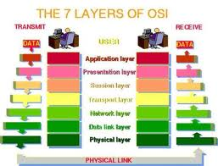
Learn and Grow
Certifications
Beware of paper tigers
Experience
You will make mistakes
Continuing education
Leave your comfort zone
Public speaking
Project management

Slide 21
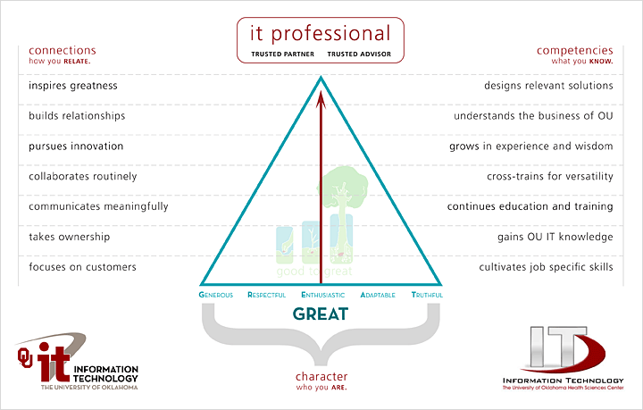
Be Balanced

Slide 22
Time Management
Time management is a key issue for IT professionals.
A few suggestions:
Make sure your goals are aligned with the business
Discuss priorities with your boss
Set realistic expectations (time & effort estimates)
Know who generates revenue and how they depend on you
Automate when possible
Delegate when possible

Slide 23
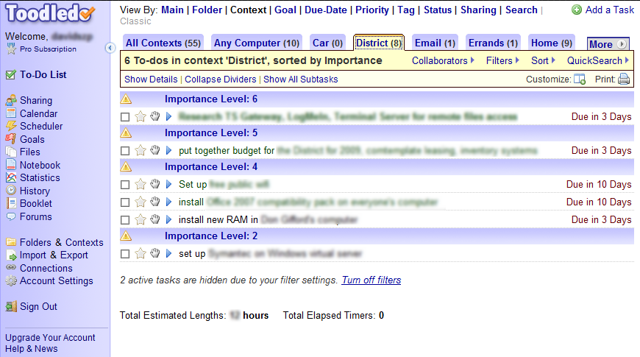
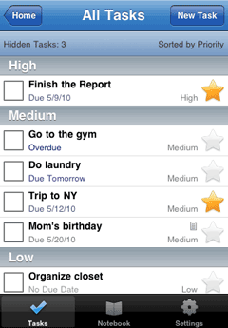
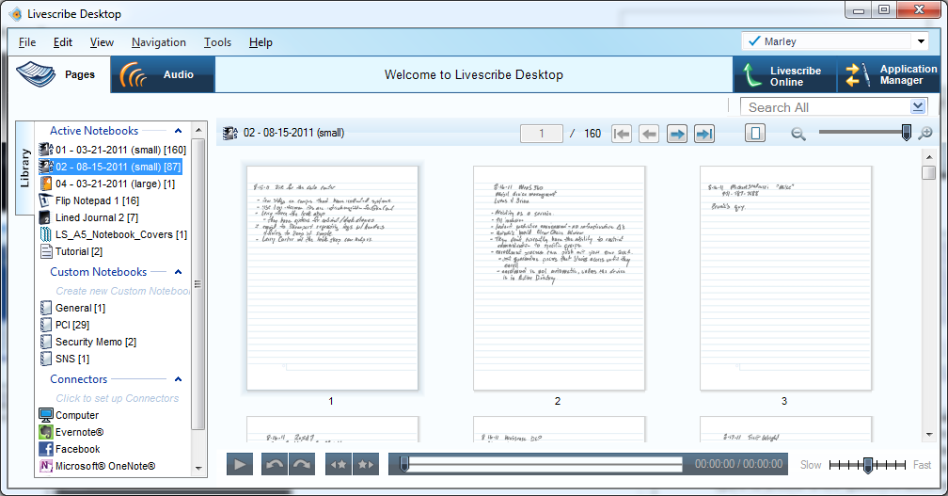
Organization
Tools
MS Outlook calendar
www.toodledo.com
Smart phone
Spreadsheet
Livescribe
Email folders
Local file folders

Slide 24
Know the Business
Knowing the technology isn’t enough
To make meaningful contributions to your organization, you have to understand the business
Your ability to get things done will be limited by your knowledge of business processes
Requires spending time with customers, peers, leadership, etc.
Ask questions

Slide 25
Put Customers First
Recognize that without customers, you don’t have a job
Make sure you leave things better than you found them
Make sure the customer is satisfied before claiming victory
Don’t cast blame on the customer
Use language your customer can understand
Make it easy for people to reach you for follow-up
Trusted advisor

Slide 26
Be a Team Player
Be a good teammate
Get involved
Pitch-in and be helpful
Build relationships
Say “we” and “us” and work as “we” and “us”
Give credit for success / take credit for mistakes

Slide 27
Practice Self-Responsibility
Take responsibility for yourself
Don’t guess or assume anything
Be prepared for problems before they stare you in the face
Take responsibility when things go wrong
Do more work than is expected of you
Compete fair and square
Be on time
Get to know people in your business
Fit in
Have a sense of humor, but don’t kid around
Take a stand on big issues, not everything
Don’t dismiss or underestimate anyone
Deliver on your promises
Don’t whine and don’t complain
Do good work and innovate, but don’t be a perfectionist
Listen
“25 Things to Say to the Interviewer, to Get the Job You Want”, Dexter Hawk

Slide 28
Find a Mentor
Find a mentor (formal or informal)
Mentors can help you
Understand the organization
Develop your perspective
Provide a sounding board for your ideas
Mentoring can also improve your career prospects
Higher compensation
More job opportunities
Higher job satisfaction

Slide 29
Finding a Job

Slide 30
Differentiate Yourself
These things are great…
College diploma in a relevant field… this is worth up to 5 years of relevant experience!
Experience… internships during college can be applied toward this (kill two birds at the same time).
Certifications… start small, and work your way up.
Extra curricular activities…they say something about who you are (use common sense)

Slide 31
Know Your Values
What is important to you?
Understand how your values impact your job prospects – location, industry, work/life balance, etc.
Make sure your values are congruent with the organization where you go to work
Find out what the company’s reputation is (internal & external)
Trust your gut
If you get a bad vibe from a company, turn down the job

Slide 32
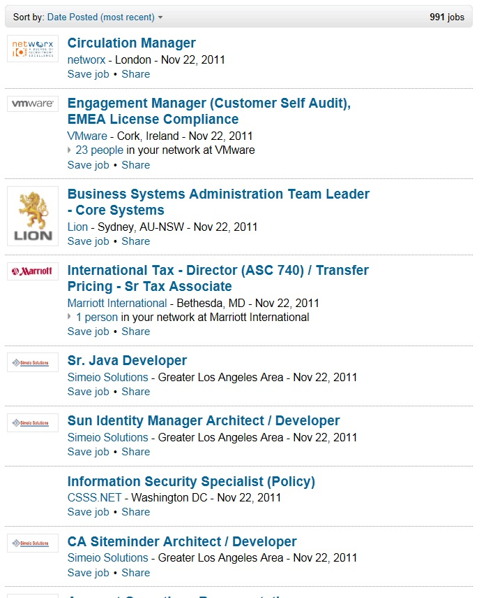
Job Search
Target individual organizations – check their websites
Build relationships with your instructors and peers
Career Services, job fairs, etc. here
Network (with people)! Don’t pass up opportunities on campus to meet alumni, donors, guest speakers, etc.
LinkedIn (groups)
Online search engines
Know what your parameters are – location, salary requirement, area of interest, benefits, etc.
Local newspapers

Slide 33
Your Resume
What to look for in a resume… (the basics)
Certifications
Experience
College degree
Organization
What to look for in a resume… (under the hood)
Someone who doesn’t change jobs every 1 to 2 years (probably won’t last long)
Someone who understands the “lingo”
Someone who knows how to keep it “brief” but “relevant”

Slide 34
Your Resume
A Brief Note About Resumes…
Use “targeted” resumes
Customize to the position you are applying for
Include a cover letter
Make it easy to read and error free
Format should focus attention where you want it
Proof read it
Proof read it, again
Have someone you trust critique it
What impression does your resume make?

Slide 35
A Word About Certifications
Certifications have different value to different individuals, but are often the “way to get your foot in the door”
Security-specific
ISC²
CISSP
ISACA
CISA
CISM
CRISC
CGEIT
SANS
GSEC
GSNA
GCIH
GPEN
Cisco
CCNA Security
CCNP Security
CCIE Security
Other
CCIP
PCI QSA
PCI ISA
C|EH

Slide 36
Interviewing
Be honest
Relax
Be positive
Think about how you are presenting yourself
Connect with interviewer
Be generous with information about you
Ask smart questions
Spend time thinking about potential questions and answers before the interview

Slide 37
OU opportunities

Slide 38
Job Shadowing/Opportunities
On-Site
Schedule a time with us to see what we do!
E-mail the project leader, Henry Neeman (hneeman@ou.edu) to set up a time.
Virtual
E-mail us at security@ou.edu
Facebook: oknetworkmentor@groups.facebook.com
IT Internships at OU
Contact Jennifer Pike (jpike@ou.edu)
Internal Audit Internships at OU
Contact Larry Arthur (larthur@ou.edu)
Jobs at OU
http://jobs.ou.edu

Slide 39
Contact Information
Tim Marley
660 Parrington Oval, Room 212
Norman, Oklahoma 73019
Office 405.325.5418
tim.marley@ou.edu
Twitter: @timmarley

