Slide 1




Oklahoma IT Mentorship Program
Tim Marley
IT Audit Manager, Internal Audit
University of Oklahoma, Cameron and Rogers State University
OSU-OKC November 22, 2011

Slide 2
What is the OITMP?
The Oklahoma IT Mentorship Program (OITMP) is an outreach initiative that connects IT professionals from Oklahoma institutions with students who are studying IT at Oklahoma academic institutions.
The OITMP is part of a National Science Foundation grant whose purpose is to boost Oklahoma’s education and research capability through IT improvements.

Slide 3

OITMP Goal
Official Goal: Expose Oklahoma IT students to the practical day-to-day life of IT professionals.
Hidden Secret Goal: Identify, develop and recruit talent!

Slide 4
OITMP Activities
Presentations to students throughout Oklahoma:
  Cameron University, Lawton
  East Central University, Ada
  Eastern Oklahoma County Technology Center, Choctaw
  Eastern Oklahoma State College, Wilburton
  Gordon Cooper Technology Center, Shawnee
  Langston University, Langston
  Oklahoma Christian University, OKC
  Oklahoma City Community College, OKC
  Oklahoma City University, OKC
  Oklahoma Panhandle State University, Goodwell
  Oklahoma School of Science and Mathematics, OKC
  Oklahoma State University, OKC
  Oklahoma State University, Stillwater
  Oral Roberts University, Tulsa
  Pontotoc Technology Center, Ada
  Rose State College, Midwest City
  Southern Nazarene University, Bethany
  University of Central Oklahoma, Edmond
  University of Oklahoma, Norman
  University of Oklahoma, Tulsa
Job shadowing opportunities (on-site and virtual)

Slide 5
About Me
Tim Marley -
  Family business, (1987 – 1999)
    MS-DOS 3.3 – MS Windows NT 4.0, MS Access Database design, Networking (Lantastic)
  MNTC, Technical Instructor, Network and System Administration (1999-2002)
    A+, Network+, Novell 5.1, MS NT 4.0, MS Windows 2000, CCNA
  Harold’s, Network and Security Manager (2002-2009)
  OU IT Security, Senior IT Compliance Assessor (2009-2011)
  OU Internal Audit, IT Audit Manager (2011-present)
  Education
    BAcc (OU 1990)
    Certifications
      CPA, CISA, GSNA, CISSP, CISM, GPEN, PCI ISA, CIPP
  My favorite quote:
    “If you don’t like something, change it. If you can’t change it, change your attitude. Don’t complain.”
    -Maya Angelou

Slide 6
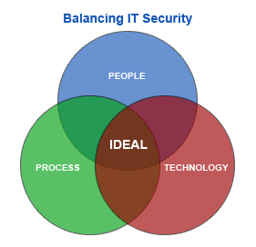
About OU
OU IT
  Network services
  Server/workstation administration
  Customized design and architecture
  IT security
    CSIRT (reactive)
    GRC (proactive)
  Support 8000+ wireless users
  Support 15000+ network users
  Support ~25000 host devices
  Support ~1300 wireless access points
  Support ~850 security cameras
  Support ~1250 network switches and routers
  Over 200 physical and virtual servers

Slide 7
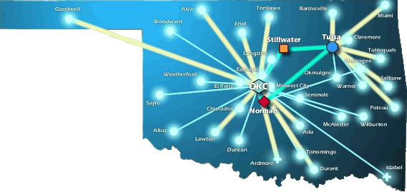
About OneNet
OneNet Services:
  Support K-12 in Oklahoma
  Support Higher Ed’s in Oklahoma
  Support State Agencies
  State-wide Optical Network (DWDM)
  10-Gig Connectivity to Research and Education Networks
  VoIP, VTC, E-Mail and Web Hosting Services

Slide 8
A Day-in-the-life of an IT security professional

Slide 9



So, what’s it like?
Is it like the movies?
  Some of my favorites are Jurassic Park, Swordfish and WarGames

Slide 10

So, what’s it like?
Is it like the movies?
  Maybe Office Space?

Slide 11
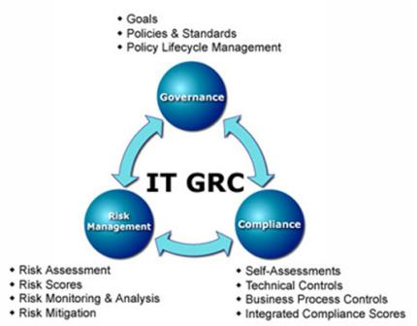
IT Security
Design and deploy
  Governance
    policy and procedure
  Risk Management
    vulnerability assessment
    penetration testing
    secure architecture
  Compliance
    PCI
    HIPAA
    FERPA
    FTC Red Flags

Slide 12
Governance
Policy, procedure and guidelines
  University Payment Card Security Policy for PCI-DSS
  OU Norman Campus Payment Card Security Standard
  OU Norman Campus Payment Card Security Definitions Document
  OU Tulsa Campus Payment Card Security Standard Draft
  OU Tulsa Campus Payment Card Security Definitions Document
  Departments for this effort:
    Information Technology
    Bursar
    Human Resources
    Internal Audit
    All 3 campuses
Do you know any specific requirements/extent of requirements IA would like for the volunteer scenario? If you’re not sure, I can take a stab at it and send you revisions for review and progressive elaboration and refinement.
For example, for such volunteer staff, are there specific consequences IA wants the business unit to hold those staff to, paralleling for example the consequences for paid staff of disciplinary action up to and including termination? If so, what consequences are to be listed?
Or is the preference to generically require the department to acceptably hold these volunteer staff accountable without specifying exact mechanism (e.g., indemnification, etc.)? Would this go so far as specifying for the business unit some specific terms the department must have volunteers consent to for example in a volunteering agreement?
I suspect for non-employees some aspects of what the university can actually reasonably do (both legally and practically) is somewhat different than for staff, although certainly specific terms can be incorporated into a volunteer agreement, etc., to help communicate expectations and obtain consent for required background checks, and processes can be designed to help detect deviations. Some of those details, however, might be best defined by each business unit instead of at the campus standard level.
In any case, I think the language around volunteer agreements and any indemnification would need special review and consideration by the Office of Legal Counsel.
If you have specific requirements/language, could you share it? If not, can you let me know the general approach (for example, comparing the approaches above) and extent IA is seeking so I can take a stab?

Slide 13
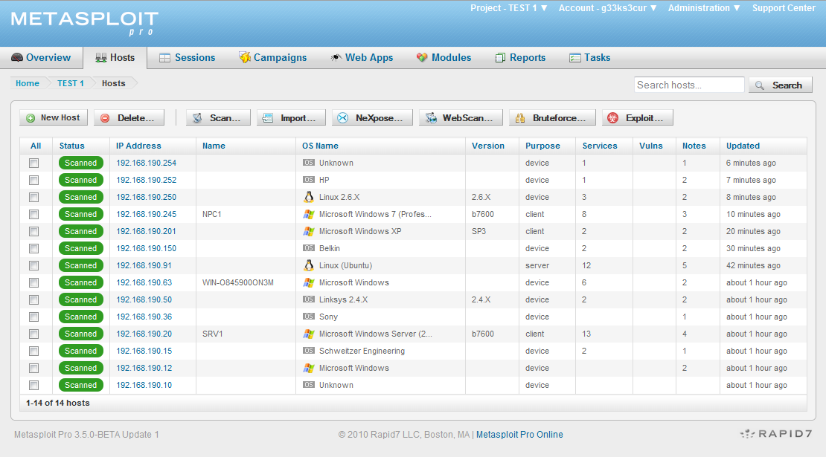
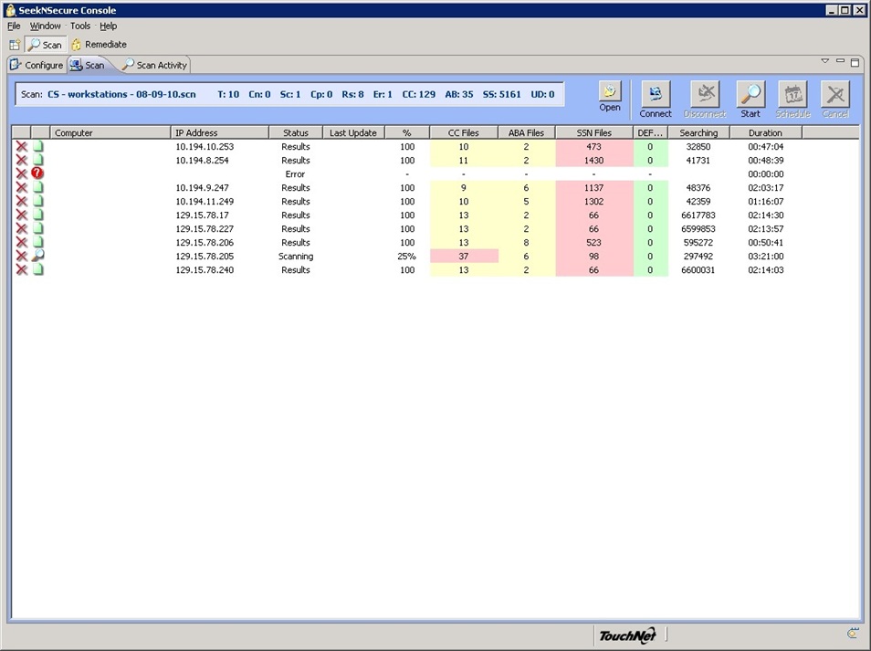
Risk Management
Vulnerability assessment
  Rapid7 Nexpose
  Nmap
  SeekNSecure
  Manual
Penetration testing
  Metasploit Pro
Secure architecture
  Visio
  Discussions
  Planning

Slide 14

Compliance
HIPAA/HITECH
FTC Red Flags
FERPA
PCI

Slide 15





Regulatory compliance
Federal Consumer Report Act (FCRA)
  Fair and Accurate Credit Transaction Act (FACTA)
Gramm Leach Bliley (GLBA)
Health Insurance Portability and Accountability Act (HIPAA)
  Health Information Technology for Economic and Clinical Health (HITECH) “HIPAA 2”
Federal Information Security Management Act (FISMA)
Family Educational Rights and Privacy Act (FERPA)
Children’s Online Privacy Protection Act (COPPA)
Payment Card Industry Digital Security Standards (PCI DSS)
Title 24, Chapter 8, § 161ff
  Oklahoma Security Breach Notification Act
Title 74, Chapter 49, § 3113.1ff
  State Government – Disclosure of Security Breach of Personal Computer Data

Slide 16
Internal Audit
Audit and assess
  Governance
    policy and procedure
  Risk Management
    vulnerability assessment
    penetration testing
    secure architecture
  Compliance
    PCI
    HIPAA
    FERPA
    FTC Red Flags

Slide 17

Current projects
Build the IT audit program
  IT Risk Assessment
  SME for existing audits
  Staff development
Support the transition
  PCI
  SNS
  SME for existing work
Design/deploy EWP

Slide 18
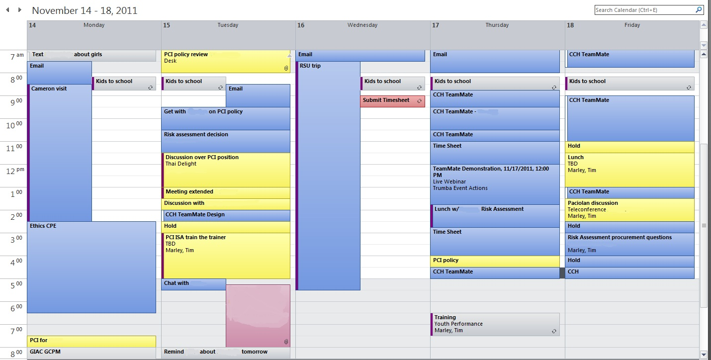
Last week

Slide 19
Strategies for Success

Slide 20
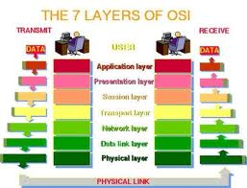
Learn and Grow
Certifications
  Beware of paper tigers
Experience
You will make mistakes
Continuing education
Leave your comfort zone
Public speaking
Project management

Slide 21
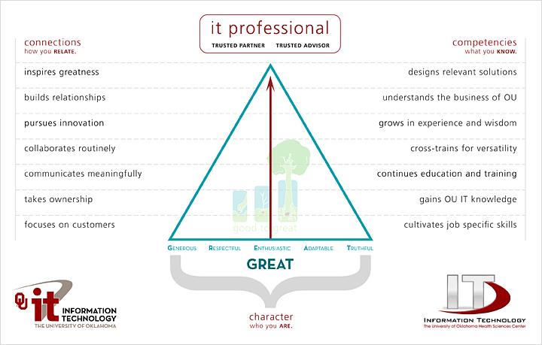
Be Balanced

Slide 22
Time Management
Time management is a key issue for IT professionals.
A few suggestions:
  Make sure your goals are aligned with the business
  Discuss priorities with your boss
  Set realistic expectations (time & effort estimates)
  Know who generates revenue and how they depend on you
  Automate when possible
  Delegate when possible

Slide 23
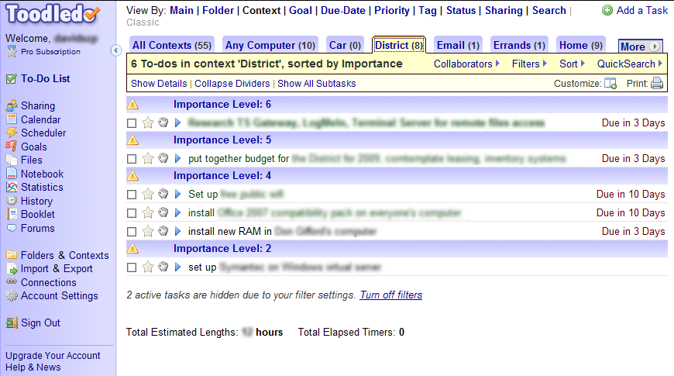
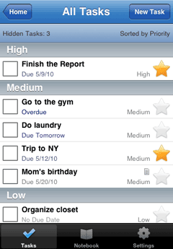
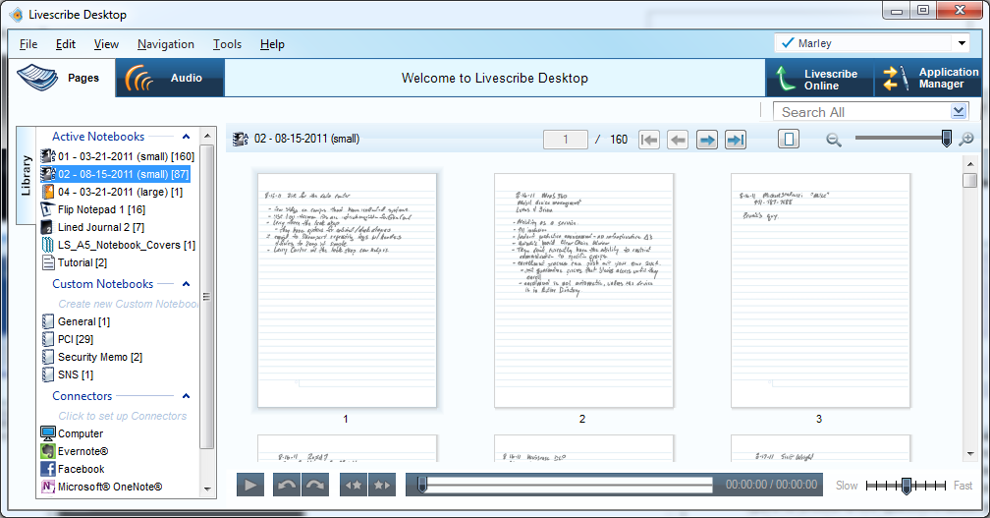
Organization
Tools
  MS Outlook calendar
  www.toodledo.com
  Smart phone
  Spreadsheet
  Livescribe
  Email folders
  Local file folders

Slide 24
Know the Business
Knowing the technology isn’t enough
To make meaningful contributions to your organization, you have to understand the business
Your ability to get things done will be limited by your knowledge of business processes
Requires spending time with customers, peers, leadership, etc.
Ask questions

Slide 25

Put Customers First
Recognize that without customers, you don’t have a job
Make sure you leave things better than you found them
Make sure the customer is satisfied before claiming victory
Don’t cast blame on the customer
Use language your customer can understand
Make it easy for people to reach you for follow-up
Trusted advisor

Slide 26

Be a Team Player
Be a good teammate
  Get involved
  Pitch-in and be helpful
  Build relationships
  Say “we” and “us” and work as “we” and “us”
  Give credit for success / take credit for mistakes

Slide 27
Practice Self-Responsibility
Take responsibility for yourself
  Don’t guess or assume anything
  Be prepared for problems before they stare you in the face
  Take responsibility when things go wrong
  Do more work than is expected of you
  Compete fair and square
  Be on time
  Get to know people in your business
  Fit in
  Have a sense of humor, but don’t kid around
  Take a stand on big issues, not everything
  Don’t dismiss or underestimate anyone
  Deliver on your promises
  Don’t whine and don’t complain
  Do good work and innovate, but don’t be a perfectionist
  Listen
  “25 Things to Say to the Interviewer, to Get the Job You Want”, Dexter Hawk

Slide 28
Find a Mentor
Find a mentor (formal or informal)
Mentors can help you
  Understand the organization
  Develop your perspective
  Provide a sounding board for your ideas
Mentoring can also improve your career prospects
  Higher compensation
  More job opportunities
  Higher job satisfaction

Slide 29
Finding a Job

Slide 30
Differentiate Yourself
These things are great…
  College diploma in a relevant field… this is worth up to 5 years of relevant experience!
  Experience… internships during college can be applied toward this (kill two birds at the same time).
  Certifications… start small, and work your way up.
  Extra curricular activities…they say something about who you are (use common sense)

Slide 31
Know Your Values
What is important to you?
Understand how your values impact your job prospects – location, industry, work/life balance, etc.
Make sure your values are congruent with the organization where you go to work
Find out what the company’s reputation is (internal & external)
Trust your gut
  If you get a bad vibe from a company, turn down the job

Slide 32
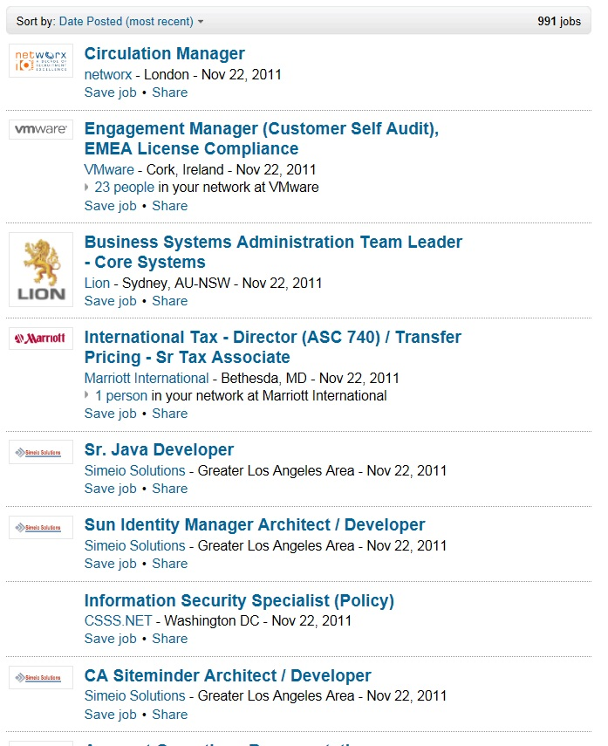
Job Search
Target individual organizations – check their websites
Build relationships with your instructors and peers
Career Services, job fairs, etc. here
Network (with people)! Don’t pass up opportunities on campus to meet alumni, donors, guest speakers, etc.
  LinkedIn (groups)
Online search engines
Know what your parameters are – location, salary requirement, area of interest, benefits, etc.
Local newspapers

Slide 33
Your Resume
What to look for in a resume… (the basics)
  Certifications
  Experience
  College degree
  Organization
What to look for in a resume… (under the hood)
  Someone who doesn’t change jobs every 1 to 2 years (probably won’t last long)
  Someone who understands the “lingo”
  Someone who knows how to keep it “brief” but “relevant”

Slide 34
Your Resume
A Brief Note About Resumes…
  Use “targeted” resumes
    Customize to the position you are applying for
    Include a cover letter
  Make it easy to read and error free
    Format should focus attention where you want it
    Proof read it
    Proof read it, again
  Have someone you trust critique it
    What impression does your resume make?

Slide 35

A Word About Certifications
Certifications have different value to different individuals, but are often the “way to get your foot in the door”
Security-specific
  ISC²
    CISSP
  ISACA
    CISA
    CISM
    CRISC
    CGEIT
  SANS
    GSEC
    GSNA
    GCIH
    GPEN
  Cisco
    CCNA Security
    CCNP Security
    CCIE Security
  Other
    CCIP
    PCI QSA
    PCI ISA
    C|EH

Slide 36
Interviewing
Be honest
Relax
Be positive
Think about how you are presenting yourself
Connect with interviewer
Be generous with information about you
Ask smart questions
Spend time thinking about potential questions and answers before the interview

Slide 37
OU opportunities

Slide 38
Job Shadowing/Opportunities
On-Site
  Schedule a time with us to see what we do!
  E-mail the project leader, Henry Neeman (hneeman@ou.edu) to set up a time.
Virtual
  E-mail us at security@ou.edu
  Facebook: oknetworkmentor@groups.facebook.com
IT Internships at OU
  Contact Jennifer Pike (jpike@ou.edu)
Internal Audit Internships at OU
  Contact Larry Arthur (larthur@ou.edu)
Jobs at OU
  http://jobs.ou.edu

Slide 39
Contact Information
Tim Marley
660 Parrington Oval, Room 212
Norman, Oklahoma 73019
Office 405.325.5418
tim.marley@ou.edu
Twitter: @timmarley

