Slide 1
OSTEMMP
Oklahoma Baptist University
October 10, 2014
Jeff Wall, Student Systems Lead
University of Oklahoma

Slide 2
A Little About OSTEMMP
The OneOklahoma Science, Technology, Engineering & Mathematics Mentorship Program (OSTEMMP) is an outreach initiative that connects technical professionals from Oklahoma institutions with students involved in these fields of study at Oklahoma academic institutions.
The OSTEMMP is part of a National Science Foundation grant whose purpose is to boost Oklahoma’s education and research capability through network improvements.

Slide 3
Goals
Official Goal: Expose Oklahoma students to the practical day-to-day life of a software development professional.
Not So Secret Goal: Identify, develop and recruit talent!
Job Shadowing: Observe the job in action.

Slide 4
Career Progression
Typical Career Path
High School
College
Career

Slide 5
Career Progression
Typical Career Path
High School
College
Career
My Career Path
High School
College

Slide 6
Career Progression
The Beginning (1985)
Completely unprepared for college
Decided to enlist in the Air Force
In-processed (Fresno, CA) (August)
Basic Training (Lackland AFB, TX) (August)
Job selection day (choose career based on very old films)
Chose communications, versus programming
Technical Training (Keesler AFB, MI) (October)

Slide 7

Career Progression
5th Combat Communications Group (1986 – 1989)
Warner Robins AFB, GA
Small arms, big trucks, tents, and MREs
All communications, not much computing
dBase II, dBase III
Takeaways:
Teamwork
Performance is rewarded

Slide 8

Career Progression
2119th Communications Squadron (1989 - 1993)
RAF Uxbridge, UK
UK-wide architectural purview
Joint projects (Air Force, Army, etc.)
C on AT&T 3B2, C and Pascal on PC
Takeaways:
Fault isolation within massively complex systems
The advantages of having the right boss

Slide 9

Career Progression
Communications Systems Center, OL-B (1993 - 1996)
Tinker AFB, OK
Pascal – TRAMCON project
“Shredout school”, Keesler AFB (Ada, Assembler, etc.)
Oracle 7 PL/SQL, MS Access 2.0, ETL for WWOLS-R
Takeaways:
It’s hard to transition from customer to developer
Having been a customer first can be powerful

Slide 10

Career Progression
Defense Information Systems Agency (1996 - 2001)
Reston, VA
Oracle 8i PL/SQL & DBA, MS Access 97 for WWOLS-R
ColdFusion 4.0
Inter-agency cooperation
Takeaways:
You have to know what you don’t know
It’s okay if your team members are smarter than you

Slide 11

Career Progression
University of Oklahoma (2001 - Present)
Norman, OK
Oracle 11g PL/SQL, Appworx/UC4/Atomic
IBM Cognos, Pro*C, Grails, .Net
Oracle DBA, Oracle BPEL/SOA
Takeaways (thus far):
Management is doing things right; leadership is doing the right things (Peter Drucker)
Boomer Sooner?

Slide 12
Previous Roles at OU
Lead Oracle DBA
Myself and one other DBA
Database Team Lead
Myself, two DBAs, and two developers
Data/Third-Party Apps Team Lead
Myself, two DBAs, three developers, and three application managers

Slide 13
Current Role/Responsibilities
Broadband title: IT Architect
Current role: Student Systems Lead
Provides leadership & management for student system support teams
Acts as subject matter expert for student system and bolt-ons
Evaluates new technologies for potential integration with current infrastructure
Provides oversight for intra-team projects
Represents IT during interactions with functional departments
… develops software!

Slide 14

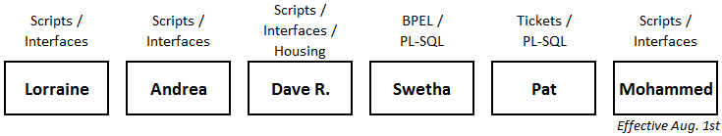
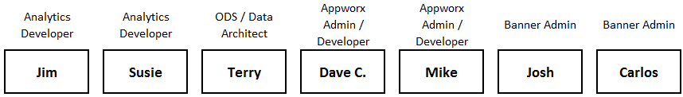
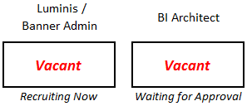
Current Team Lineup

Slide 15
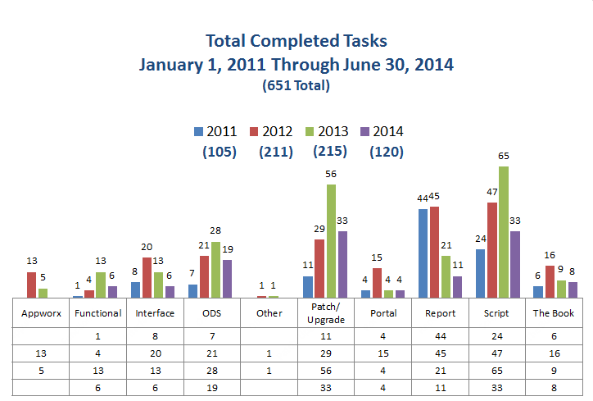
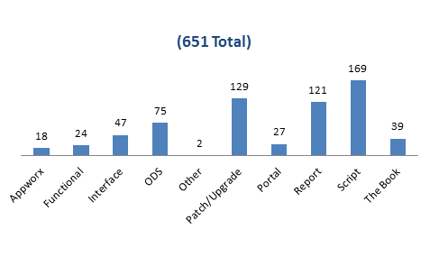
Work Throughput at a Glance

Slide 16
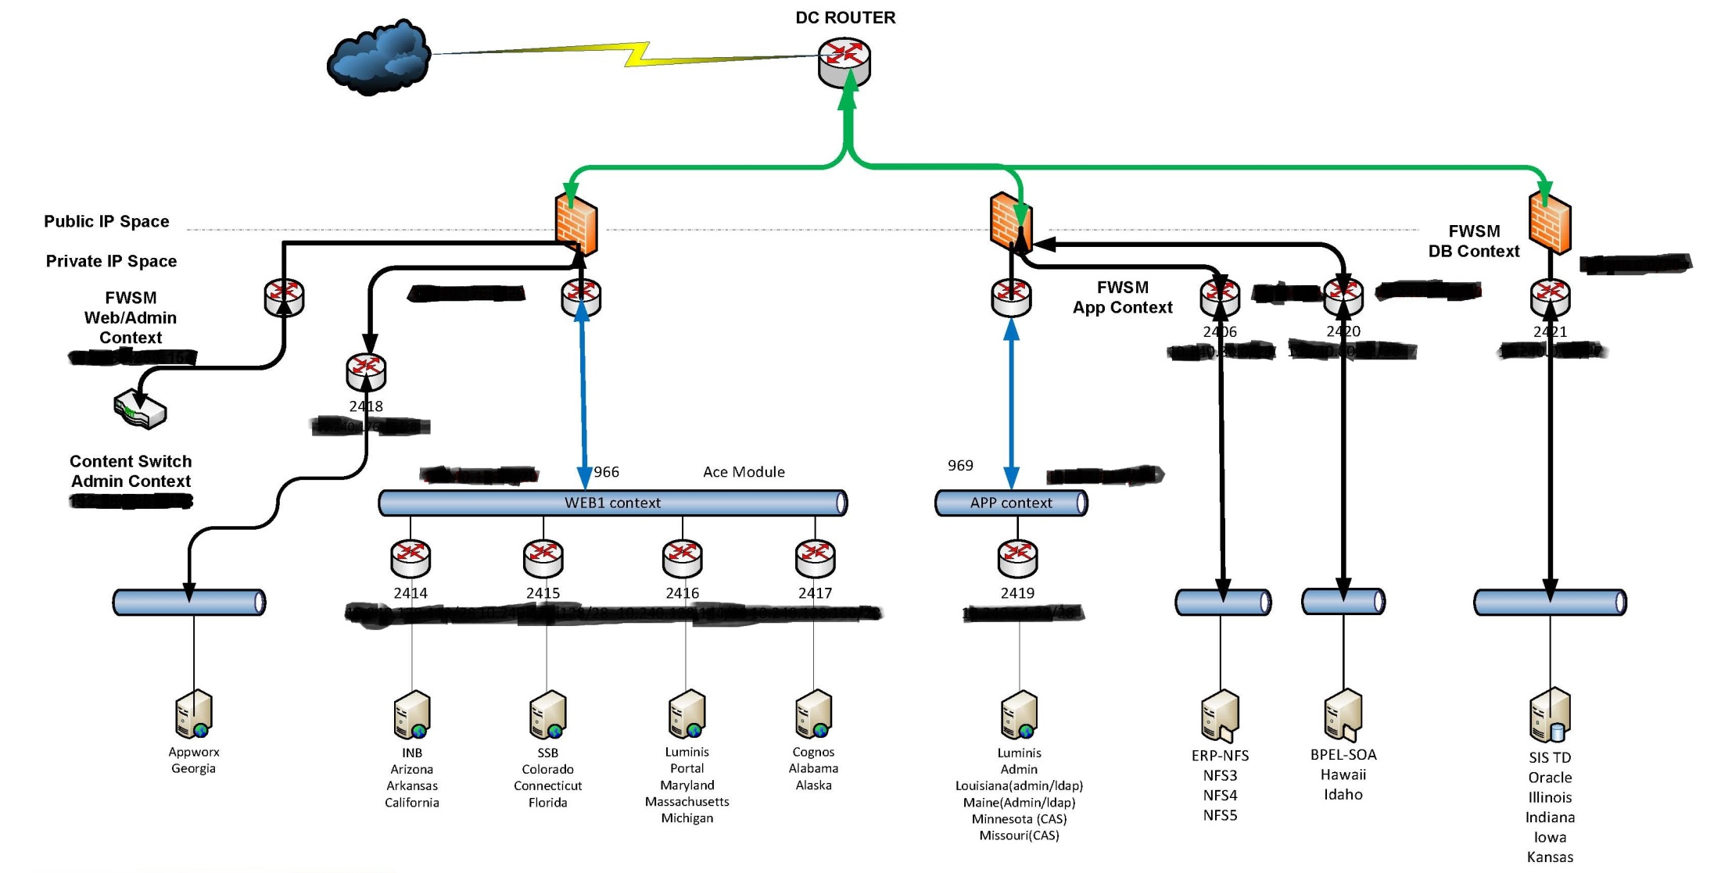
OU Student System Core

Slide 17
Oracle SQL and PL/SQL
SQL: Structured Query Language
A 4GL, with industry-accepted standards. Oracle “strives to comply” with parts 1, 2, 3, 4, 9, 10, 11, and 13 of ANSI/ISO/IEC 9075:2003 … and ANSI/ISO/IEC 9075-14:2006.
PL/SQL: Procedural Language/Structured Query Language
Oracle’s SQL extension, allowing for complex, reusable code objects which reside in the database. Modeled after Ada, but not strongly typed.

Slide 18
Applying PL/SQL
Excels at intra-database processing, such as populating data warehouse tables from transactional tables.
Very good at gathering/consolidating data – often used as back-end for web services, along with producing files for downstream consumption.
Not good at interacting with non-database systems and objects. Java Stored Procedures can narrow the gap, but not a popular option.

Slide 19
Benefits of OU Employment
  Leave accrual – start out accruing 18 hours per month, with a maximum accrual of 336 hours (42 days)
  Participation in the Oklahoma Teachers’ Retirement System (OTRS)
  50% tuition waiver (up to six hours per semester)
  Outstanding wellness and work/life balance programs
  Information Technology strongly emphasizes continuing education, both for sharpening skills and re-tooling (consider the impact of getting rid of our mainframe)

Slide 20
Application Materials
What successful candidates did:
  Cover letter explaining why they are interested in the position and highlighting key resume items
  Prompt thank you letters/emails after interviews
  No spelling/grammatical mistakes
  Customize application materials for the job
  Limit non-relevant items (displays ability to edit)

Slide 21
Application Materials
What successful candidates did:
  Manage whitespace
  Have someone on the inside pass along your resume
  Ask this person what the resume reviewer looks for
  A few days after submitting resume, follow up with a phone call or email demonstrating interest in the job
  Don’t try to use humor or sarcasm

Slide 22
Interviewing
Be prepared to answer difficult questions
  What are your career goals and how would this job help you achieve those goals?
  Tell me about yourself.
  Here’s a difficult situation. How would you handle it?
It’s okay to take a minute to prepare a response to a tough question
Know your technical stuff
Come prepared with a printed list of questions for the interviewer

Slide 23
Interviewing
Ask for a business card
Do your homework. Know about the company
“I was reading on your website that your company does X…tell me more about this.”
Mute your phone
Be relaxed
Be your professional self
Don’t be underdressed

Slide 24
Career Sustaining Recommendations
Always be learning
Build a strong foundation
Understand how business works
Understand how technology works
Learn how to be articulate in communication
Network with fellow IT professionals
Be willing to learn new technologies

Slide 25
Career Sustaining Recommendations
Find a mentor (formal or informal) to help you
  Understand the organization
  Develop your perspective
  Provide a sounding board for your ideas
  Locate more job opportunities
  Derive higher job satisfaction
Don’t always stay in your comfort zone
Practice public speaking skills
Develop time and project management skills

Slide 26
Career Sustaining Recommendations
Know the business
  Have to know how technology is used
  Learn how to get things accomplished within the business
Understand your customers
Be a team player
Build relationships
Become a trusted advisor

Slide 27

Finally!

Slide 28
Presentation Evaluations
Definitely not required, but very helpful for the OSTEMMP program. They’re completely anonymous!

Slide 29
Thank you!
Jeff Wall
jswall@ou.edu

