Slide 1
The Life of an IT Professional @
The National Weather Center

Slide 2
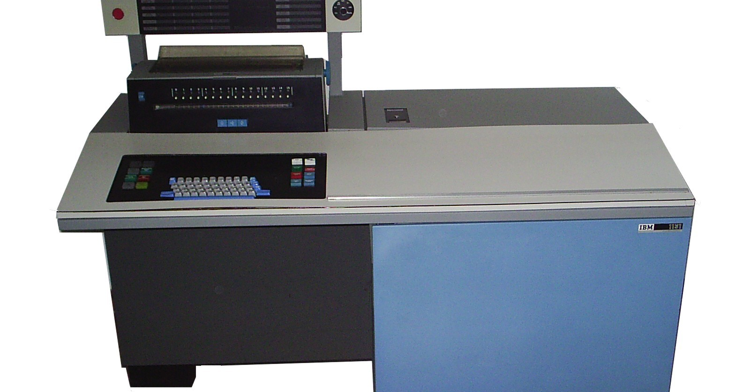
My CompSci Beginnings
Notes:
Warner was Twain’s collaborator on “The Gilded Age”
You have to imagine Steven Wright saying this with his dead-pan delivery.

Slide 3
About Me
Gary Skaggs:
  B.S. Vocal Music Education (ECU - 1976)
  Graduate Choral Conducting coursework (1977-1979)
  Undergraduate Meteorology coursework (1983 - 1985)
  National Severe Storms Laboratory (1989 - 2005)
  OU Information Technology (2005 – present)
  UNIX/CPM/Win/OS2/Linux/OS X
  Two Daughters – Two Granddaughters
  Amateur (Extra class) Radio Operator (digital)
  We have cats
  Golf/SCUBA/Racquetball/Audio

Slide 4
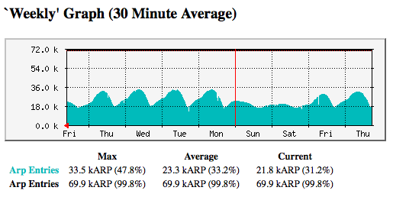
About Us
OU IT Network Services:
  Support 16000+ wireless users
  Support 15000+ “wired” users
  Support ~35000 host devices
  Support ~1500 wireless access points
  Support ~1000 security cameras
  Support ~1250 network switches and routers
  Support ~8000 telephony devices (VoIP and analog)
  Over 200 physical and virtual servers
  Migrating to a single datacenter that spans three cities
Notes:
Warner was Twain’s collaborator on “The Gilded Age”
You have to imagine Steven Wright saying this with his dead-pan delivery.

Slide 5
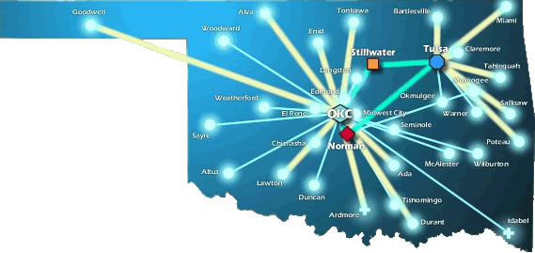
About Us
OneNet Services:
  Support K-12 in Oklahoma
  Support Higher Ed’s in Oklahoma
  Support State Agencies and Affiliates
  State-wide Optical Network (DWDM)
  10-Gig Connectivity to Research and Education Networks
  MPLS Service Offerings
  VoIP, VTC, E-Mail and Web Hosting Services
Notes:
Warner was Twain’s collaborator on “The Gilded Age”
You have to imagine Steven Wright saying this with his dead-pan delivery.

Slide 6
What is the OITMP?
The Oklahoma Information Technology Mentorship Program is an educational outreach connecting networking professionals from OU, OneNet, and other institutions with students in the technology field
It is part of an NSF grant to enhance Oklahoma’s educational and research capability through network improvements
The goal: identify, develop, and recruit talent
Activities include:
  Presentations to students throughout OK
  Job shadowing opportunities (on-site & virtual)
Notes:
Warner was Twain’s collaborator on “The Gilded Age”
You have to imagine Steven Wright saying this with his dead-pan delivery.

Slide 7
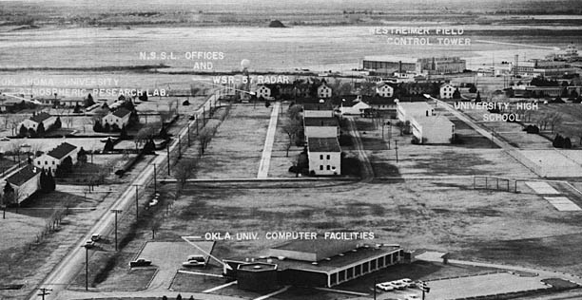
The “Old” Weather Center
Notes:
North Base – circa 1962
$500K (1960 dollars) computing system in Merrick (9600 sq ft)

Slide 8
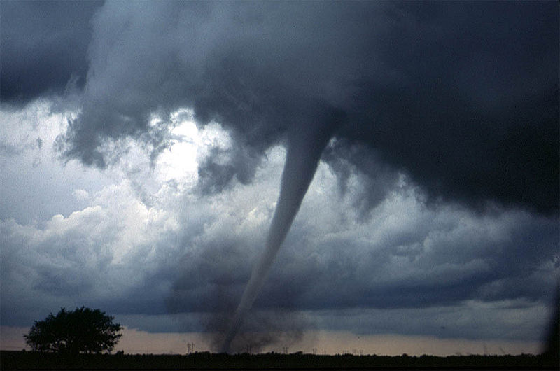
Synergy - Motivations
Notes:
Photo by Daphne Ladue, who at the time she took this, worked for me. This is near Anadarko and is the beginning of the Bridgecreek/Moore/Oklahoma City tornado on May 3, 1999.
And, yes, I have seen tornadoes. My first was when I was 5 near Ada.
In this case…

Slide 9
NWC Network Challenge
So, how did we get from “Go” to “Now”?

Slide 10
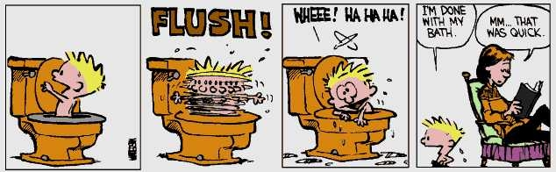
NWC Network Challenge
– if it were only this simple
Let’s talk about the easy stuff first…
Notes:
If it were only as simple as Calvin’s Bath!

Slide 11
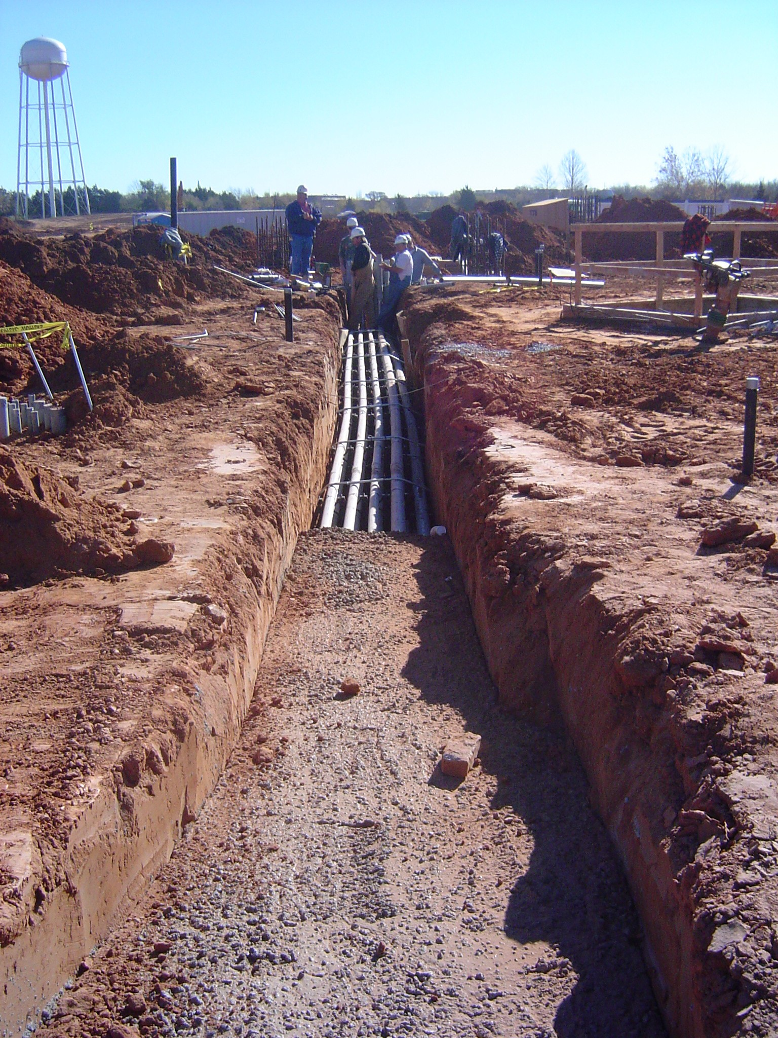
NWC Network Challenge
Notes:
Backhoe prevention
Hunting the Gray Water line story

Slide 12
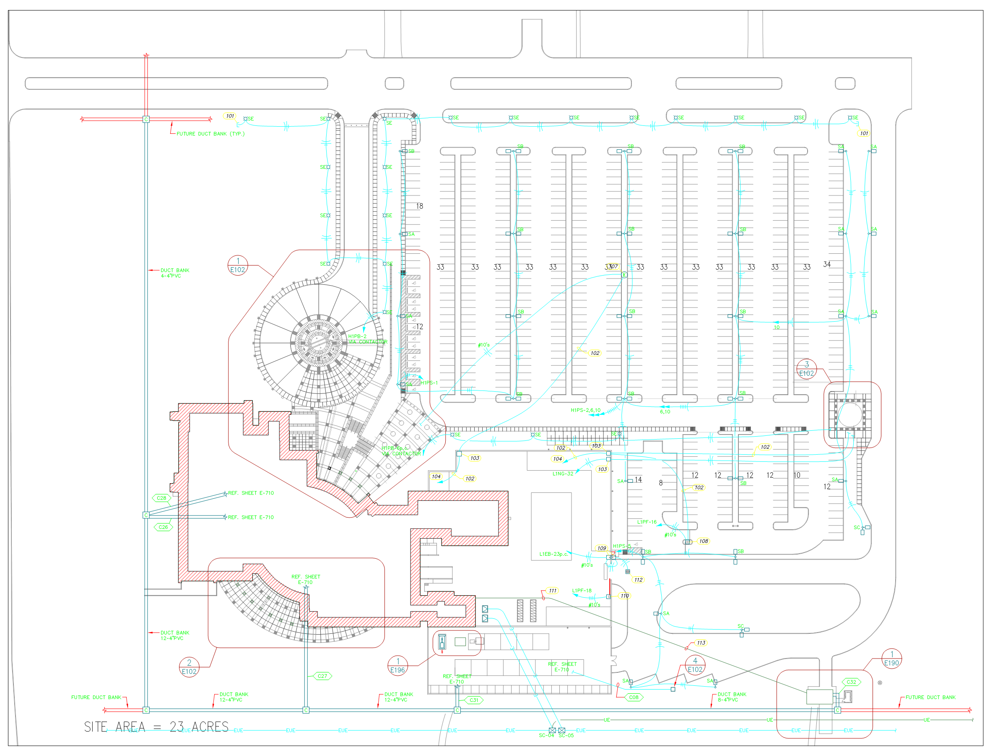
NWC Network Challenge
Notes:
Learning how to read plans.
Now that I think about it, my eyesight started going bad in about 2003, so I’ll blame my age-related Presbyopia on reading building plans.

Slide 13
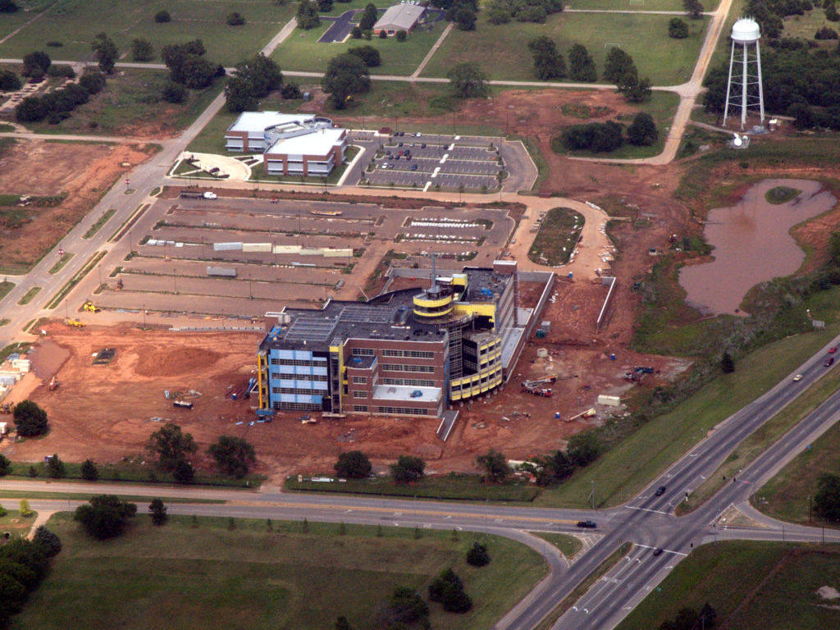
NWC Network Challenge
Notes:
Google Earth, photos, and plans are a great way to “see” the duct banks by visualizing off the bare earth pictures.

Slide 14
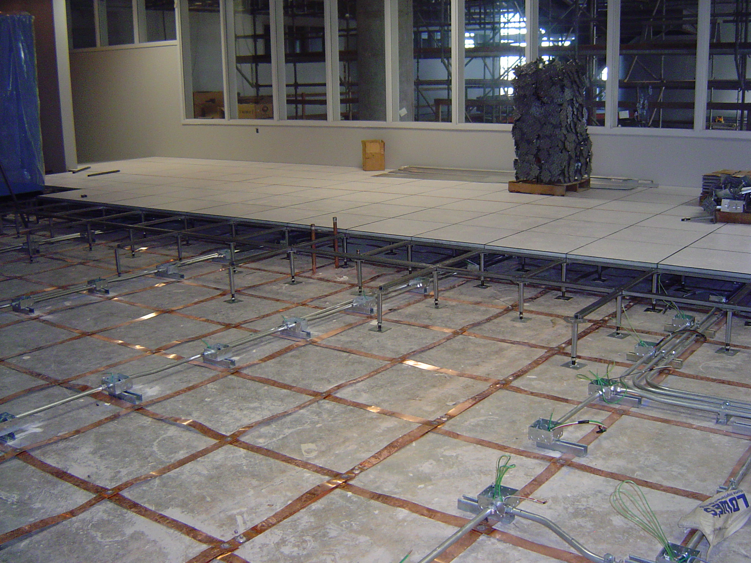
NWC Network Challenge
Notes:
I have an opinion of raised floors.

Slide 15
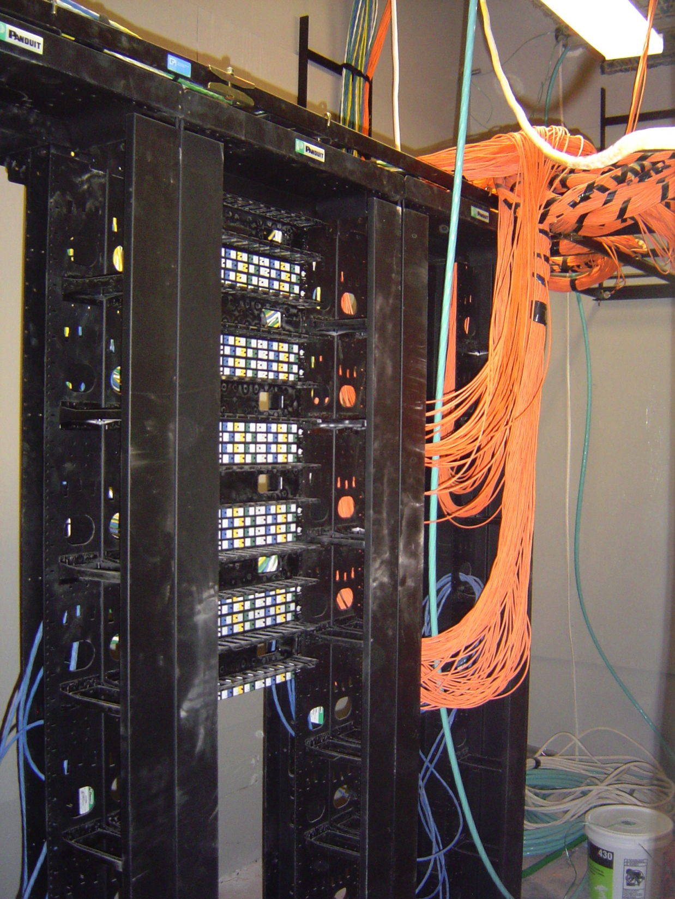
NWC Network Challenge
Notes:
Multimode Fiber terminations

Slide 16
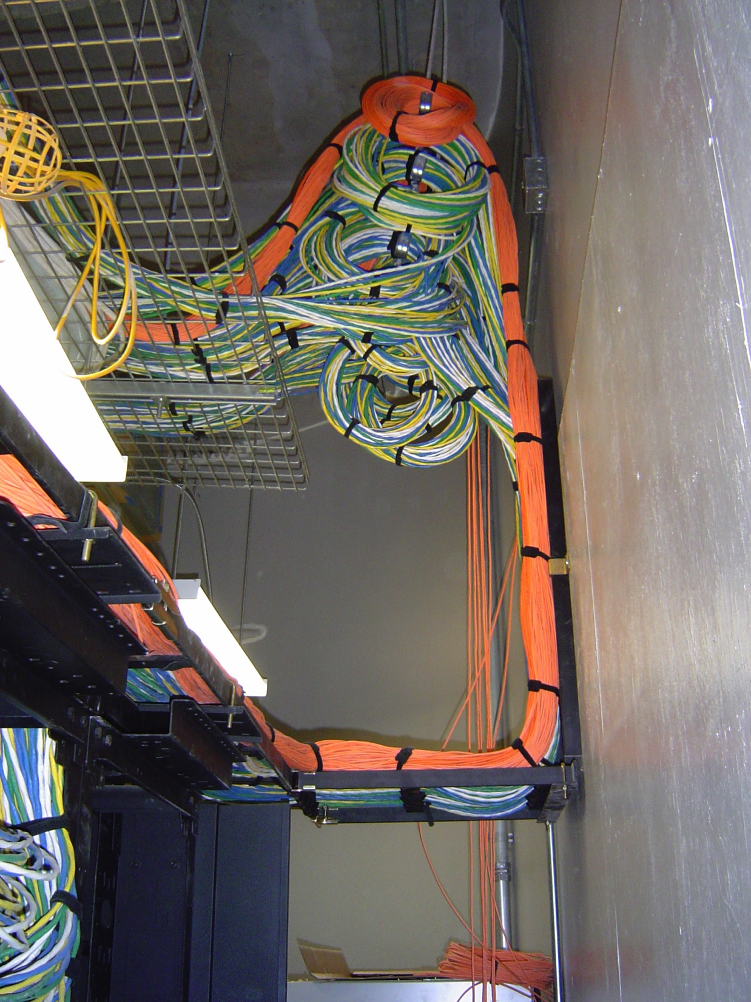
NWC Network Challenge
Notes:
Slack loops of speed bundle with fiber separated before getting to termination panels.
Subplot: learning how to work with contractors who do not get along

Slide 17
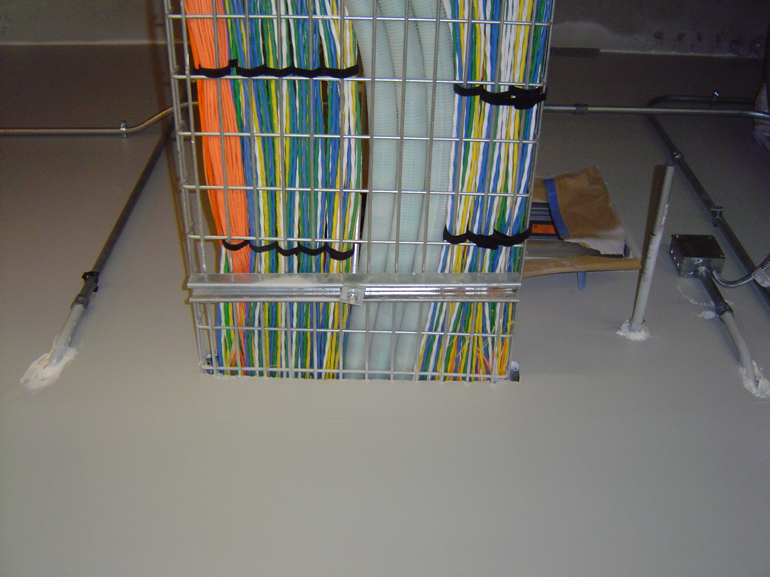
NWC Network Challenge
Notes:
24 inch cable tray. This was at completion. Imagine what it looks like now.

Slide 18
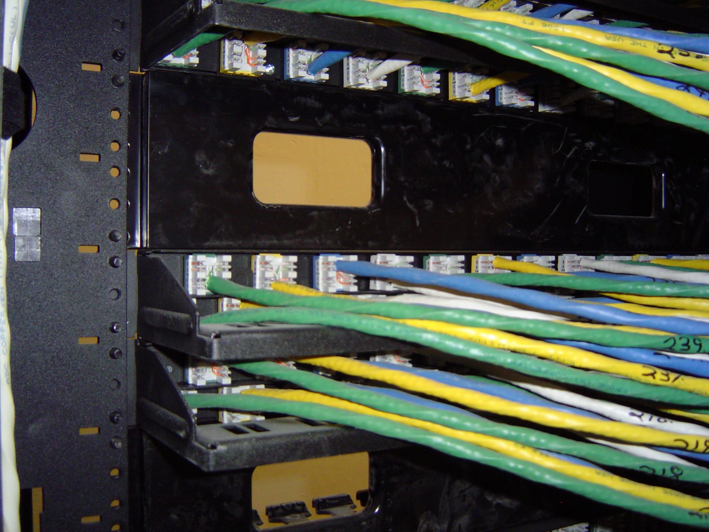
NWC Network Challenge
Notes:
We did receive as-builts from our infrastructure installation contractor overlaid on the building plans. About 99% accurate.

Slide 19
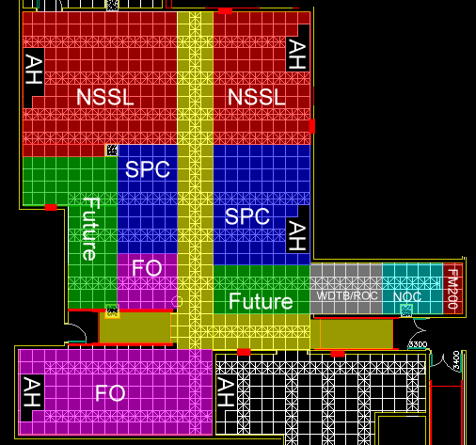
NWC Network Challenge
Notes:
Space Wars
We did use FM-200 (Dupont trade name) 1,1,1,2,3,3,3-Heptafluoropropane, also called heptafluoropropane, HFC-227 or HFC-227ea
Note how the underfloor cable trays are laid out and the locations of the Air Handlers. Guess how the occupants aligned their racks…

Slide 20
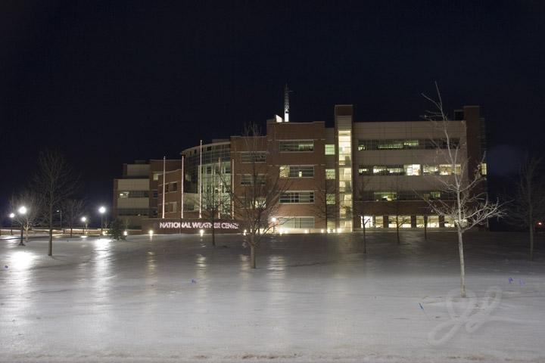
NWC Network Challenge
Notes:
First NWC Ice Storm photo taken by WDTB staffer Jim LaDue…

Slide 21
NWC Network Challenge
Multiple Distinct Entities – Single Network Architecture
Redundant External Paths
Tier 2+ Power Requirement
Hardware and cable plant as ‘future proof’ as possible
  10 GigE UTP + multiple fiber to each desktop
Multiple unique IT Security Domains
Notes:
These were the requirements given to us

Slide 22
NWC Network Challenge
Mandate from NOAA CIO
MOU between CIOs of NOAA and OU
Joint Governance
Deference to Federal IT Security Policies as required
There are Exceptions
  SPC
  WFO
What about wireless?
Notes:
NOAA CIO – Carl Staton, OU CIO – Dennis Aebersold
Same mandate being realized, minus the University Element, at the under-construction NOAA Pacific Region Center on Oahu. Turns out that our job was easier.
Hawaii Story here?

Slide 23
NWC Network Challenge
Balancing Requirements of Operations, Research, and a desire for Unity
  Common, Non-Critical Environment + Operational Environments
  NOAA + OU + Operational Environments
Funding
  Budgeted for one network pre 9/11
  Operations and Maintenance after move-in
Security Plan
Operations and Maintenance
  Admin and Management of Wireless, VLANs, Firewalls, IDS, Authentication, NOAAnet
Configuration Management
Notes:
What are the nuts and bolts of the challenges?
Three Operational Units-
Storm Prediction Center – NOAA/NCEP
Norman Forecast Office – NOAA/NWS/SRH
Oklahoma Mesonet – Oklahoma Climate Survey
Educational units – WDTB (mission) SoM (Teaching)
Research (NSSL, ARRC, CAPS, CIMMS)
Do password joke after “Security”. Note that NOAA now has 12 character requirements, 4 of 4, every 60 days, no “similarities” in passwords for 2 years.

Slide 24
NWC Network Challenge
Notes:
University Partners – more or less loosely affiliated around weather/climate and the University

Slide 25
NWC Network Challenge
Notes:
NOAA Partners -
One NOAA Research unit - NSSL.
4 NWS units, BUT from 3 different NWS organizations with 4 unique missions.

Slide 26
NWC Partner Organizations
Notes:
Well mixed

Slide 27
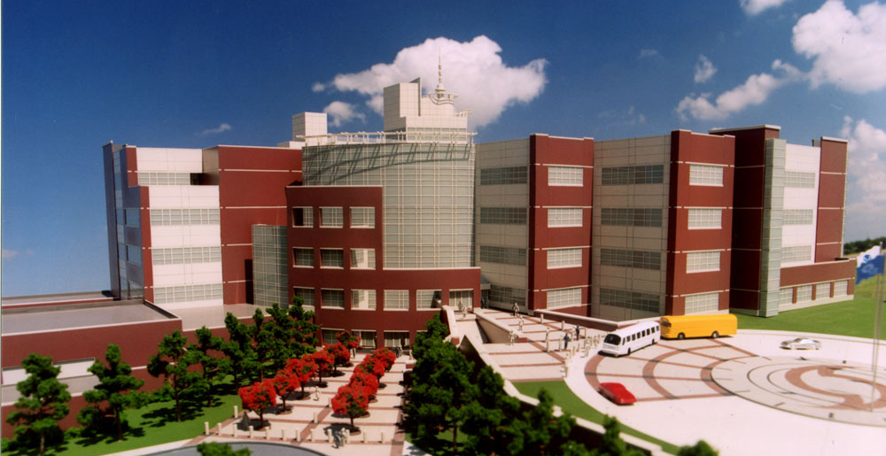
National Weather Center
Research Campus
University of Oklahoma, Norman
Notes:
Architecturally and design-wise the building itself and its infrastructure is cool and much of my life for the entire first 7 years of this Century was consumed by it, but the real story is The People.

Slide 28
Who Are These People?
The National Weather Center houses a unique confederation of University of Oklahoma, National Oceanic and Atmospheric Administration and state organizations that work together in partnership to improve understanding of events occurring in Earth’s atmosphere over a wide range of time and space scales.
Notes:
So just who are thesepeople and what is it that they do?
Formal statement from the NWC website

Slide 29
Who Are These People?
800 Faculty, Research Scientists, and Staff
  R&D, Education, Training, Operations and Service
  11 OU-related Organizations
  5 NOAA-related Organizations
280 Undergraduate and 100 Graduate Students
  World’s largest school of Meteorology
Notes:
A lot of people in the building
The environment of this building would not be the same without the students.
Furniture Story.
Student lounge – cleanliness, OWL, practice corner, labs

Slide 30
What do we “do”?
Educate future meteorology faculty
Educate future government/private forecasters and radar engineers
Educate future research scientists
Testbed for new weather and climate forecasting techniques
Testbed for the “Next”-next generation radars – Phased Array
Develop new weather and climate models
Train government forecasters in new techniques
Issue tornado, thunderstorm, fire, and flood watches and warnings
Support (HW/SW) current Federal weather radars worldwide
Research “all” severe weather and publish, publish, publish
Notes:
There are several of the building organizations which also host Post-Doctoral research staff – which is the jumping off point for many to academia or hard research. A few end up with Private Industry via this path.

Slide 31
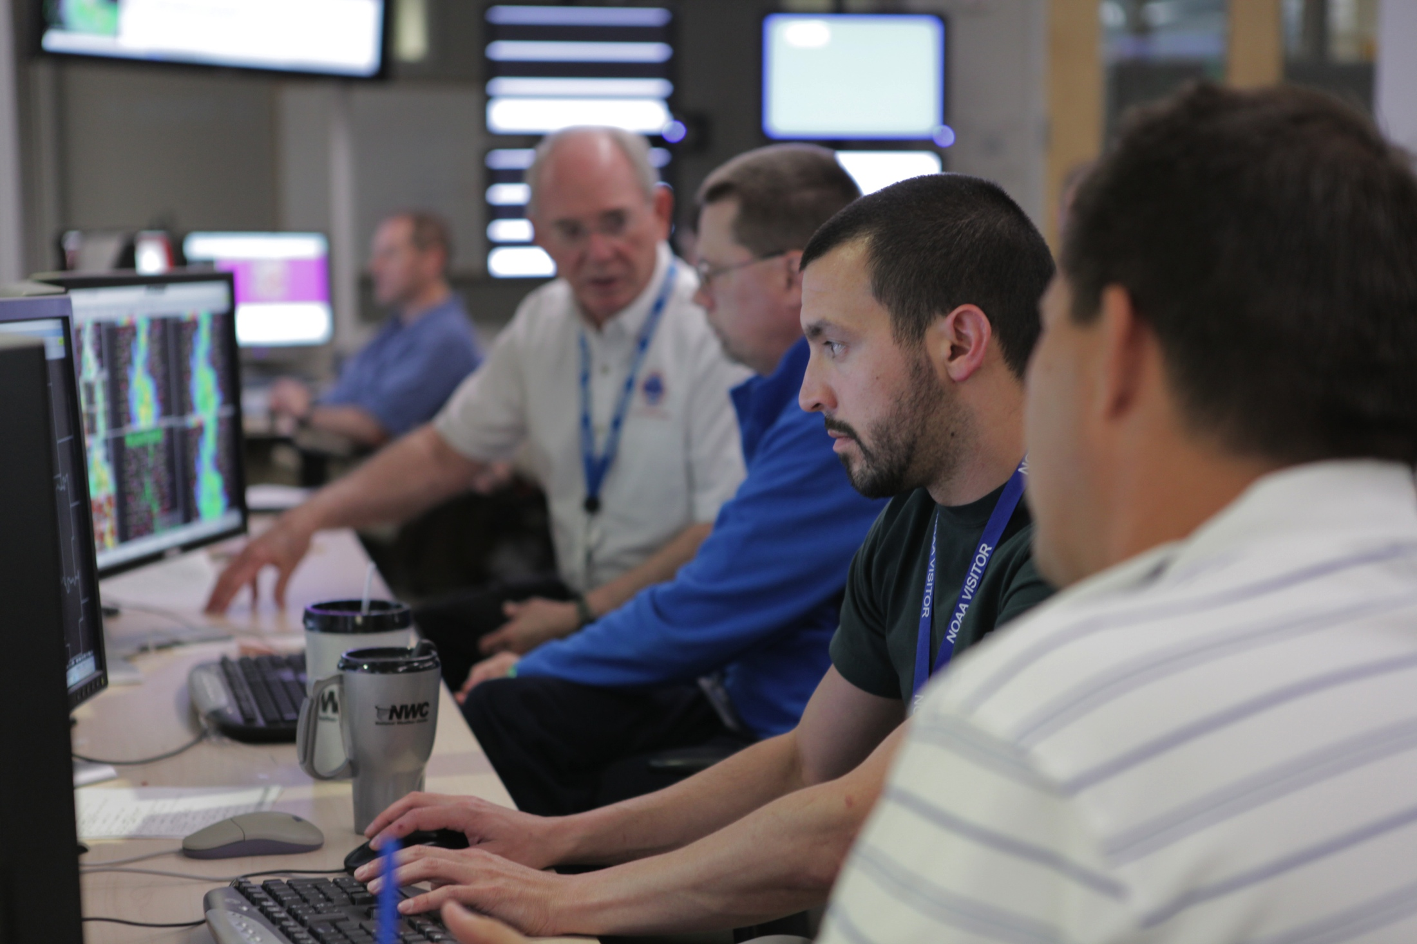
What are these people doing?
Notes:
This is WHY this building was built.
SPC Forecaster, WFO MIC, University Researcher, Visiting Scientist, CIMMS Meteorologist
HWT – Glass garage door to divide, almost never used.

Slide 32
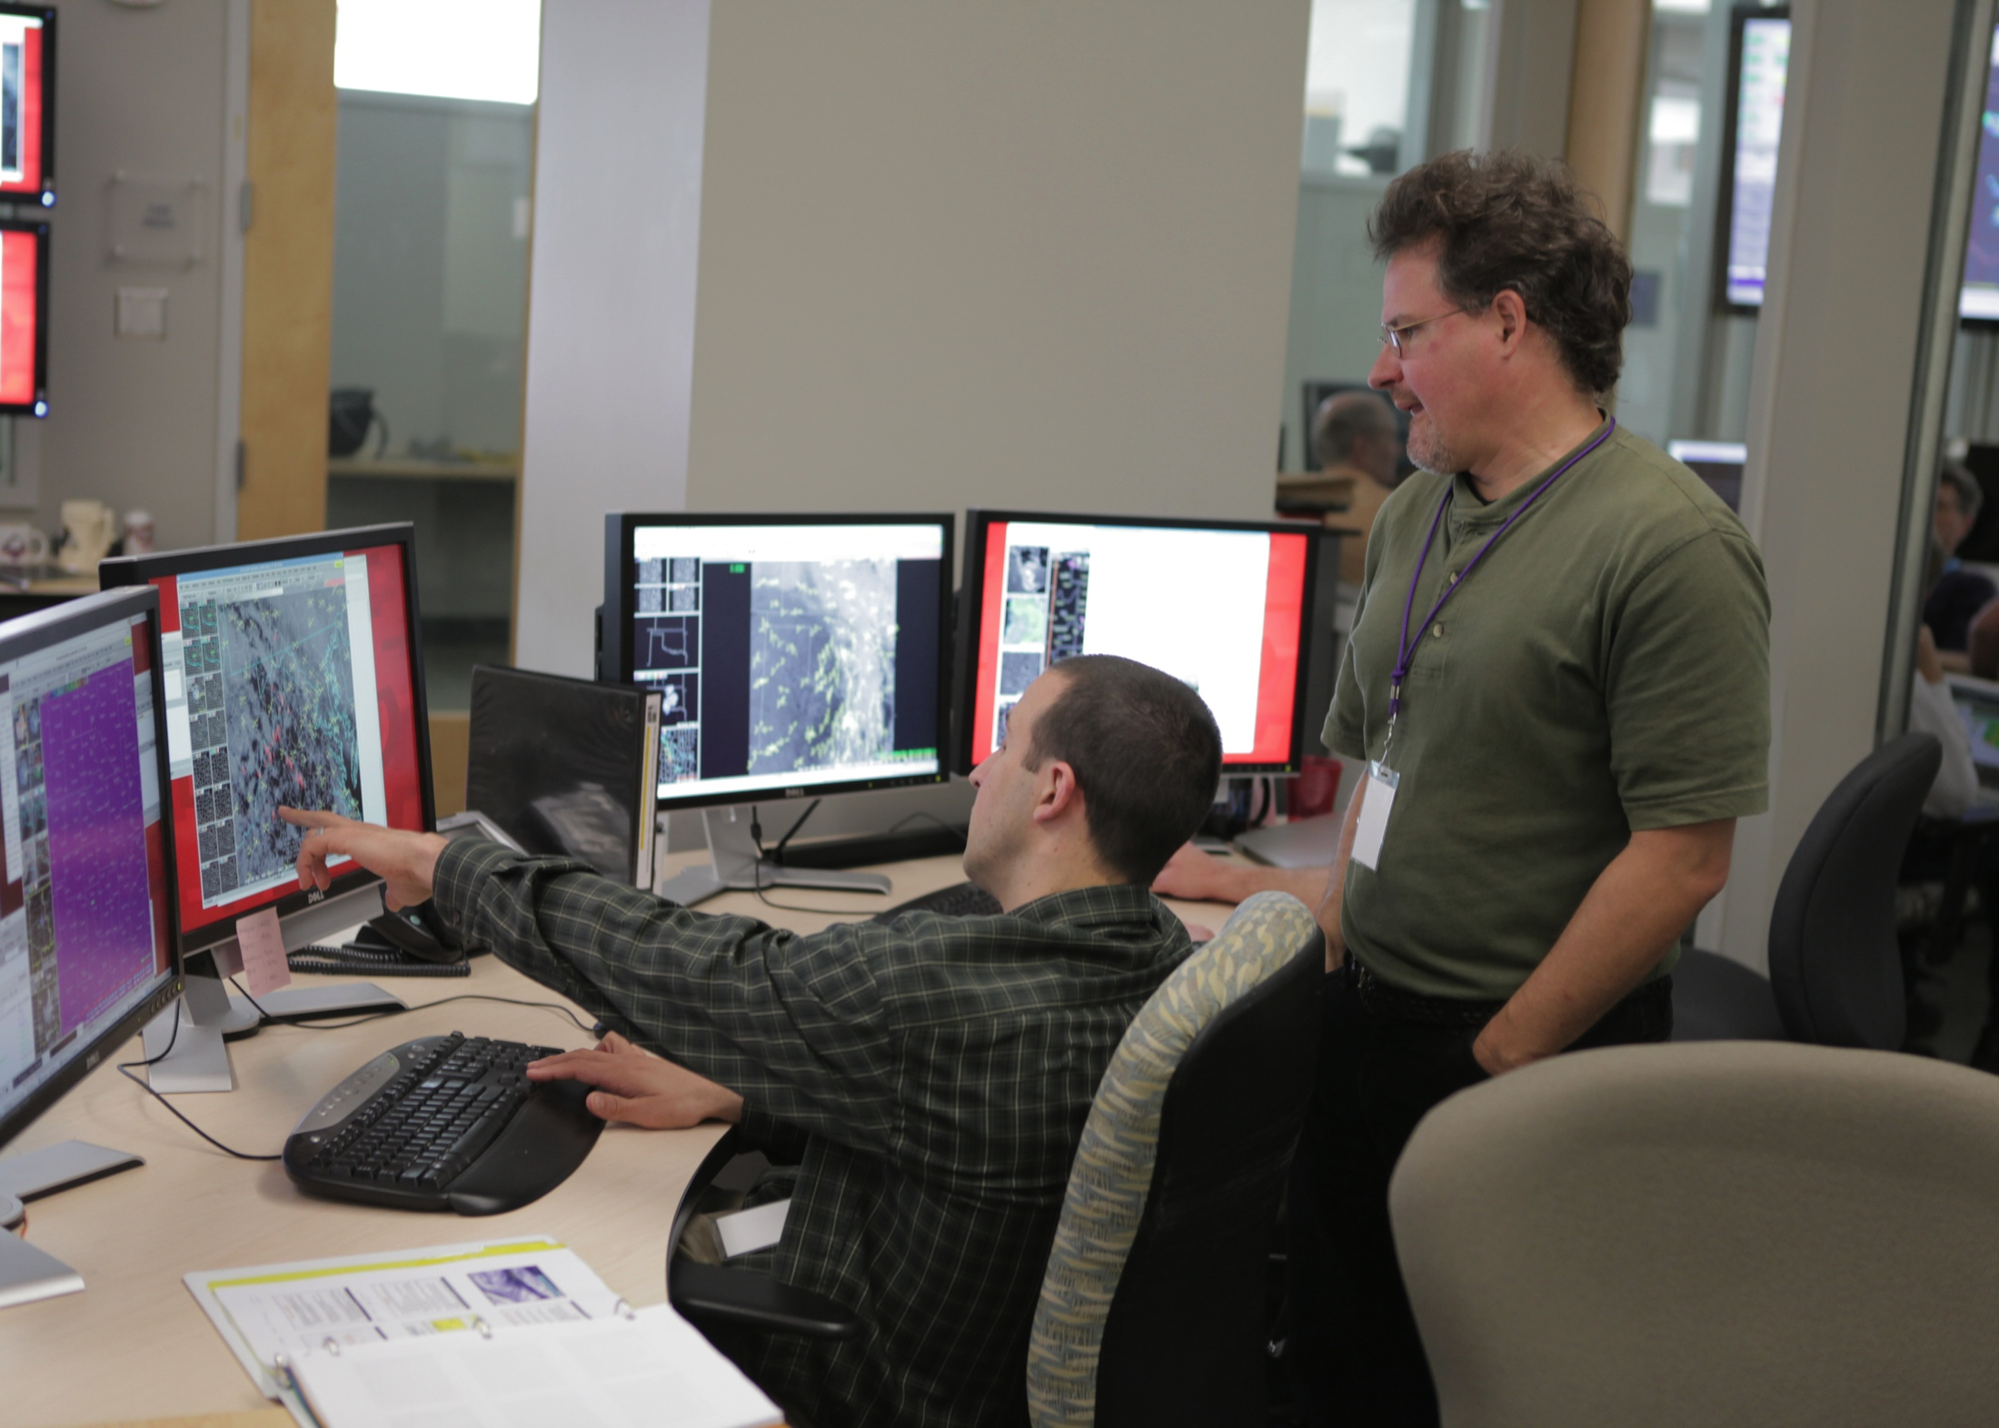
What are these people doing?
Notes:
University Professors/Scientists both far and near.

Slide 33
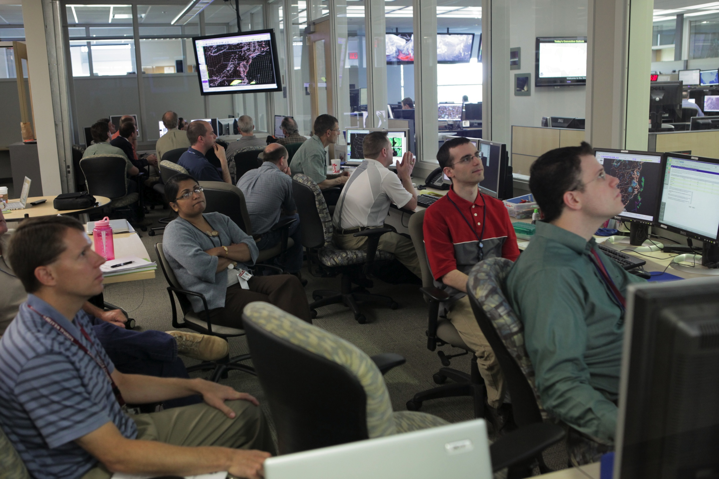
What are these people doing?
Notes:
This is the ‘small’ side of the HWT. Just another light day in the HWT.
“Only” two projects running simultaneously this year… (VORTEX)

Slide 34
What tools do they use?
Phased Array Radar
  Incredible network requirements
ARRC’s Teaching Radar
Research NEXRAD Radar
Mobile Radars (different “types”)
Mobile Atmospheric Sounding equipment
  Standard data collection in unique locations
  Specialized Storm Electrification data collection
Unique on-site datasets
  Multi-radar composites, rainfall/runoff datasets, two different lightning research datasets
Incredibly fine-scale long-term, surface-based datasets
  Among others…

Slide 35
How do “we” do what we “do”?
One Physical Network
  2 external networks (University and Federal)
  Multiple internal networks
    Some route among themselves
    Some pass traffic inside and outside through a firewall vsys
    Some are entirely self-contained ‘sandboxes’
2 Operationally separate* forecast networks
Additionally, one of NOAA’s Webfarms is located in the NOAA data center running on a separate IP space
Notes:
One infrastructure
The Federal aspect of the external networks will change dramatically as the Trusted Internet Connection initiative is completed.

Slide 36
The Veins
Located in 250,000 square feet on 5+ floors are:
Over 50 km of Speed Bundle
  4-10GigE+4-50μm fiber to each Data Access Point
1800 Edge Ports at move-in
600+ VoIP phones
120 Wireless Access Points
300+ network ports in NOAA Data Center (3000 sq ft)
120+ network ports in OU Data Center (1500 sq ft)
48 VLANs – 21 Campus, 27 Internal, 10 non-routable

Slide 37
The Heart and Brains
MDF
  Dual-homed Route Core
    Non-blocking 10G service
  HA Firewalls with Stateful Failover
IDFs (10)
  16-slot Chassis-based switch w/10G uplinks with cross-connects
Notes:
Post-911 Federal Networking requirements are becoming less “exceptional” and more “uniform”. In the area of Firewalls and Security, sooner rather than later, these networks will begin to diverge.
TIC point for the Norman NOAA folks will either be in Boulder or Fort Worth, requiring high cost circuits to backhaul data to a TIC.

Slide 38
Growing pains
NWCNOC advised by Information Technology Counsel
  “Too much documentation” / “not enough documentation”
Staff churn results in loss of corporate knowledge
  Yet, this brings new staff and new ideas
Data, and data needs, like entropy, always increases
Unforeseen needs have required equipment relocations
With few exceptions, 5 year old hardware meeting needs
  However, 82 months since our initial RFP, we are in early stages of R&R.
Needed: more power, cooling, floorspace
  If you have time, ask me about ‘raised computer floors’

Slide 39
Meteorology: Math, Physics, and Computer Science all in a blender
Especially the “data” part of Computer Science
Data is crunched, mangled, and mutilated using many different initial conditions and algorithms with the result being “a lot of data’.
  I can’t name one research scientist who has ever deleted a data set.
    YEA for de-duping SANs!
Storage: external hard drives, workstation multi-terabyte RAIDS, networked many multi-terabyte RAIDS, SANS, along with a few datasets on tape.
  NSSL and OCS host several unique datasets which have multiple copies in multiple places.

Slide 40
How Do I Get This Job?
What I look for in a resume… (the basics)
  College diploma in a relevant field
  Experience
  Certifications
  I never look at salary (that’s up to HR)
What I look for in a resume… (under the hood)
  Someone who doesn’t change jobs every 1 to 2 years (probably won’t last long)
  Someone who understands the “lingo”
  Someone who knows how to keep it “brief” but “relevant”

Slide 41
How Do I Get This Job?
A Brief Note About Resumes…
  Keep it brief!
    No more than 2 pages (3 at most).
    You don’t need to write a novel, because we won’t read it.
  Keep it relevant!
    Tailor your resume to match the job you are targeting.
    Leave out extraneous details. These will come out in the interview process.
  Sell yourself…. Yourself!
    Don’t let a recruiter/headhunter sell you.

Slide 42
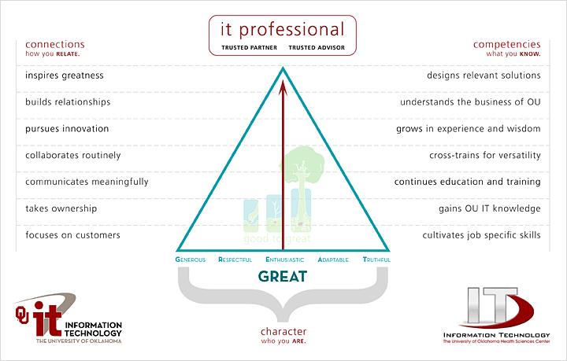
How Do I Get This Job? (“The Interview”)

Slide 43
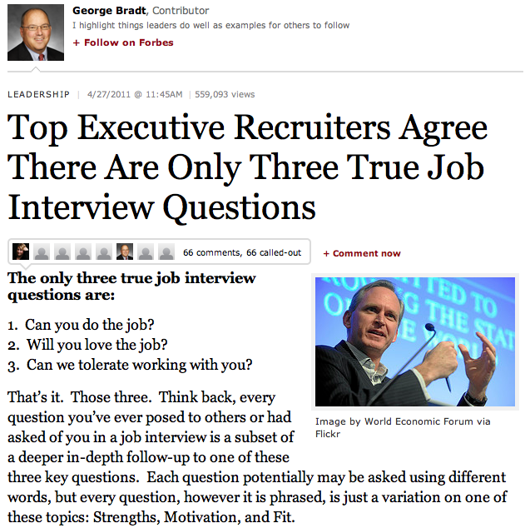
How Do I Get This Job? (“The Interview”)
  Can you do it?
  Will you love it?
  Will we like you?

Slide 44
How Do I Get This Job?
What you should do before then…
  College diploma in a relevant field… this is worth up to 5 years of relevant experience!
  Experience… internships during college can be applied toward this (kill two birds at the same time).
  Certifications… start small, and work your way up. Do this during college, or even during high school.
  Build relationships… sometimes, it isn’t WHAT you know, it’s WHO you know.

Slide 45
How Do I Get This Job?
What you should do… (cont.)
  Be positive.
  Have a back-up plan.
  Have someone else critique your resume.
  Pass the interview.
    Be honest during the interview.
    Practice the interview
    Thank the interviewer both in person, and later in writing.

Slide 46
What Do I Look For in a Job?
What to look for…
  Money isn’t everything. There are sometimes trade-offs for higher salaries
    More hours
    More travel
    Fewer benefits
  Reputation. Find a place that everyone is talking about. Ask the people that work there if it is worth it!
  Family friendly environment. Flexible work hours can be important.

Slide 47
What Do I Look For in a Job?
What to look for… (cont.)
  Look at the “whole package”
    Dress code?
    Distance to work?
    Free parking?
    Starbucks (or pub) nearby?
    Shared office space?
    Time-off policy?
    Condition of office?
    Training and learning opportunities!

Slide 48
What Do I Look For in a Job?
What to look for… (cont.)
  Interview the interviewer.
    Don’t be scared. This is a two-way partnership.
    Ask for a guided tour.
    Ask to meet your “team”.
    Ask the interviewer how they like the job.
  This is a long-term commitment!
    Trust your instincts! If your gut says “no”, then turn down the job.
    Keep that back out plan in place until the probationary period is over.

Slide 49
I GOT THE JOB! Now what?
Suggestions for success…
  Never compromise your morals.
  Be honest… it’s hard to remember all of the lies you’ve told, and who you told them to.
  Be there for other people… and they will be there for you.
  Be positive! It’s contagious.

Slide 50
I GOT THE JOB! Now what?
Suggestions for success… (cont.)
  Don’t take things personally… in the grand scheme of things, it’s just a job!
  Rule your destiny.
  Step outside of your comfort zone. (ref. Office Space, the movie)
  Nothing in your job is worth getting angry over.
  Your customer is why you are where you are. Be there for them.

Slide 51
I GOT THE JOB! Now what?
Suggestions for success… (cont.)
  Change is inevitable… just roll with it!
  Document everything! It really will save you time in the long run.
  Ask for the cool toys!
  You will never have enough time or money… have a backup plan.
  Technology changes fast! Try to keep pace, and don’t wait for ‘futures’…

Slide 52
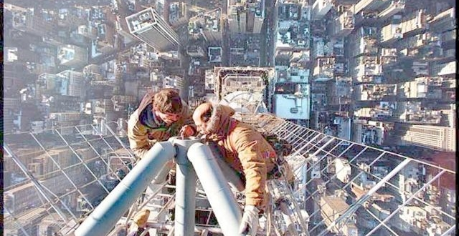
I have one of the best jobs in the world!

Slide 53
Other Opportunities/Resources
Jobs at OU
  http://jobs.ou.edu
Jobs at OneNet
  http://www.okhighered.org/job-opportunities/

Slide 54
Questions?

Slide 55
Evaluations
  Please take a moment to fill out the evaluations
  or NOT! The evaluations are completely optional.
  No personal or personally identifiable data is collected.
  Data is used by the grant providers to gauge success.

Slide 56
Come Visit Us
Gary Skaggs
Operations Manager, National Weather Center Network Operations Center & Manager, Research Campus IT
120 David L. Boren Blvd.
Norman, OK 73072
405-325-6440
gskaggs@ou.edu | gary.skaggs@noaa.gov
Skype: gaskaggs
http://nwc.ou.edu
Notes:
My Thanks to Dr. Kevin Kloesel, Associate Dean of the College of Atmospheric and Geographic Sciences for referring the organizing committee to me when he was approached by them, and my thanks to the Committee for the kind invitation. We do regular tours at the NWC , but if you are in Norman on your own, don’t hesitate to contact me – I’ll give you the cook’s tour of the facility.

