Slide 1
A Day in the Life of a
Network Professional
Jim Glover
Network Manager
Oklahoma Department of Corrections
Notes:
1

Slide 2
What is the OITMP?
The Oklahoma IT Mentorship Program (OITMP) is an outreach initiative that connects networking professionals from Oklahoma institutions with students who are studying IT at Oklahoma academic institutions.
The OITMP is established under Oklahoma's National Science Foundation Inter-Campus and Intra-Campus Cyber Connectivity (C2) grant, “Oklahoma Optical Initiative.”
Notes:
2

Slide 3

OITMP Goal
Official Goal: Expose Oklahoma security/networking students to the practical day-to-day life of security/networking professionals.
Hidden Secret Goal: Identify, develop and recruit talent!
Slide courtesy of Dr. Henry Neeman and OU IT Mentoring Program staff
3

Slide 4
Job Shadowing
On-Site
  Schedule a time with us to see what we do!
  E-mail the project leader, Henry Neeman (hneeman@ou.edu) to set up a time.
Virtual
  E-mail us at network@ou.edu
  Facebook: oknetworkmentor@groups.facebook.com
Slide courtesy of Dr. Henry Neeman and OU IT Mentoring Program staff
4

Slide 5
Other Opportunities/Resources
Cisco Academy
  Francis-Tuttle
  OU IT internal for now
IT Internships at OU
  Contact Jennifer Pike (jpike@ou.edu)
Jobs at OU
  http://jobs.ou.edu
Jobs at OneNet
  http://www.okhighered.org/job-opportunities/
Slide courtesy of Dr. Henry Neeman and OU IT Mentoring Program staff
5

Slide 6
Who is Jim Glover?
BS Computer Science LA Tech University
30+ years in IT
  Computer Operator
  Mainframe System Programmer
  Server Sysadmin (web, mail, DNS, etc.)
  Network Manager
Hobbies: Computers, Amateur Radio & Photography
Notes:
6

Slide 7
Department of Corrections
Facts
Approximately 4,000 employees
Approximately 500 network devices
Approximately 100 sites
  17 Minimum, Medium, Maximum Security
  7 Community Corrections Centers
  15 Community Work Centers
  Probation and Parole Offices, etc.
Notes:
7

Slide 8
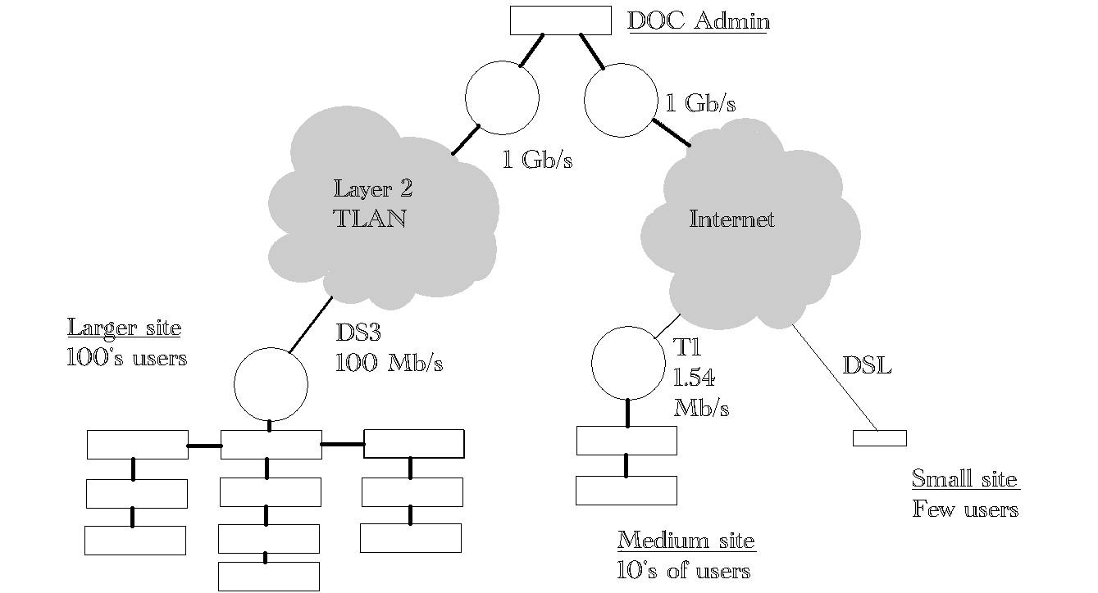
DOC Network Organization
Notes:
8

Slide 9
Department of Corrections
Unique Challenges
Culture of independence
Facilities widespread, isolated
Movement through facilities slow, restricted
Chronic budget woes
  Legislative and public ambivalence
  “Beans 'n' bullets”
Chronic understaffing
Notes:
9

Slide 10
Department of Corrections
Strengths
Culture of independence
Experienced, motivated staff
Offenders provide inexpensive labor
Notes:
10

Slide 11
Department of Corrections
IT Status
IT recently centralized
Much network cabling substandard
Network usage patterns in flux
  VMware virtualization
  Active Directory
  Video conferencing
  Remote host access
Notes:
11

Slide 12
Department of Corrections
IT/Network Goals
Improve standards adherence
Increase network stability
Paperwork
  Develop and follow policy
  Develop and follow formal procedures
  Document
Achieve excellence
Notes:
12

Slide 13
Network Certifications to Consider
BICSI
  Building Industry Consulting Service International
  Standards and training for cabling
CCNA
  Cisco Certified Network Associate
  Concepts and practices of Cisco network device configuration
Notes:
13

Slide 14
My Professional Duties
Network device configuration
  Routers, switches, security devices
Cabling management
Network design
Network maintenance
Security
Troubleshooting
Notes:
14

Slide 15
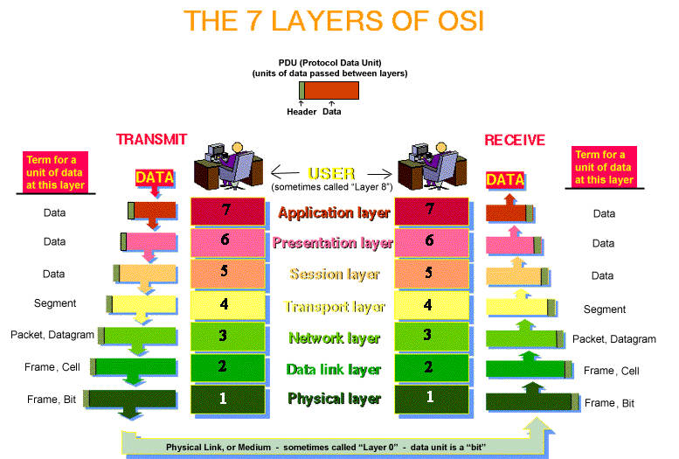
Network Professional
Essential Knowledge
Notes:
15

Slide 16
Network Professional
Essential Knowledge
TCP/IP
  TCP vs UDP; how connections are made
  Logical ports
  Subnets and masks
Internet Protocols
  HTTP, HTTPS, SMTP, FTP, DNS, DHCP, POP, NTP, SSH, etc.
Notes:
16

Slide 17
Network Professional
Essential Skills
Project Management
Troubleshooting
  OSI model layers in order: 1, 2, 3 …
  Packet Sniffing (e.g. WireShark)
Notes:
17

Slide 18
Network Group
Quest for Excellence
Design: Plan for the future
Cabling: Do it right; do it once.
Procedures
  Benefits
    Documentation
    Flexibility
    Repeatability
    Consistency
Notes:
18

Slide 19
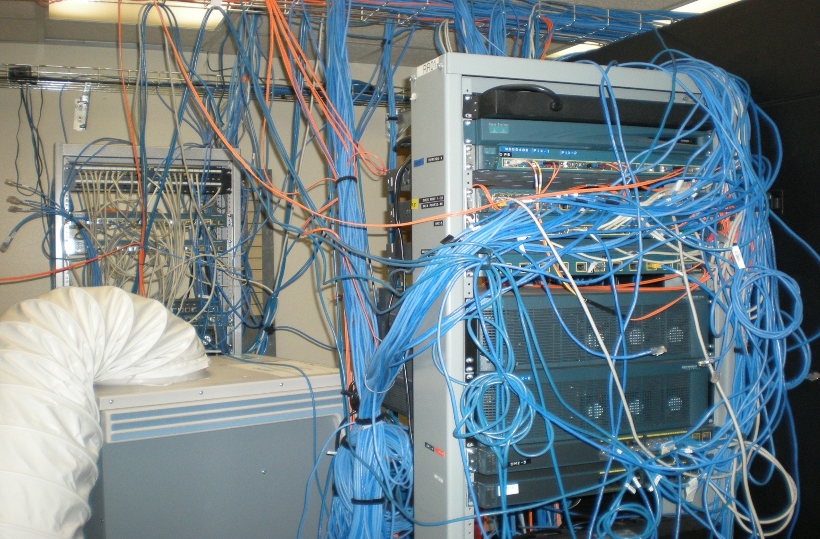
Before
Notes:
19

Slide 20
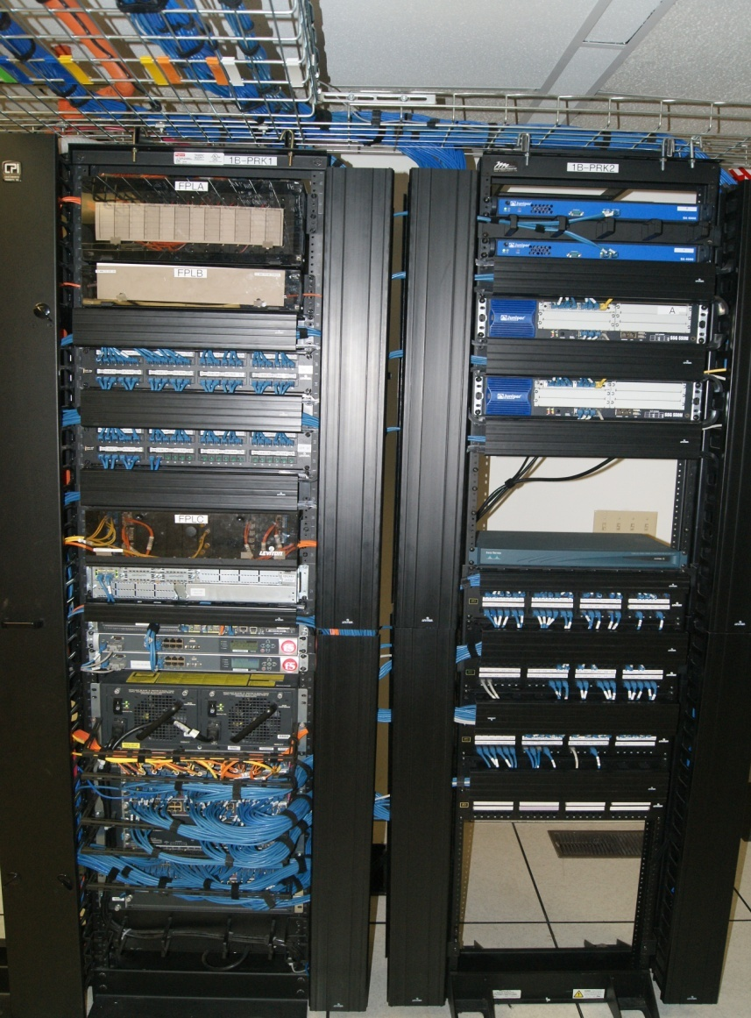
After
Notes:
20

Slide 21
Questions?
Contact Information
  Jim Glover
    Jim.Glover@doc.state.ok.us
Slides with OU logo courtesy of Dr. Henry Neeman and the OU network staff
Notes:
21

