Slide 1
Oklahoma Network Mentorship Program

Slide 2
About Me
Zane Gray:
B.S. Chemical Engineering (OU 1996)
USAF network deployments (1996-2001)
OU computer networking (2001-present)
Self-proclaimed Apple Fanboy
Married since 1993 to an OSSM alumn!
Eight (yes, “8”) kids (and #9 due in December)
Addicted to chocolate (peanut M&M’s are my favorite)

Slide 3
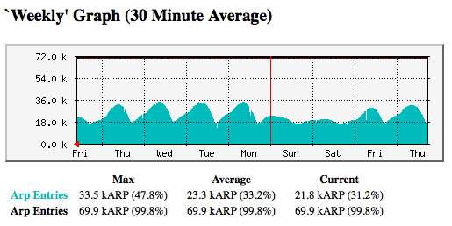
About Us
OU IT Network Services:
Support 8000+ wireless users
Support 15000+ network users
Support ~25000 host devices
Support ~1300 wireless access points
Support ~850 security cameras
Support ~1250 network switches and routers
Over 200 physical and virtual servers

Slide 4
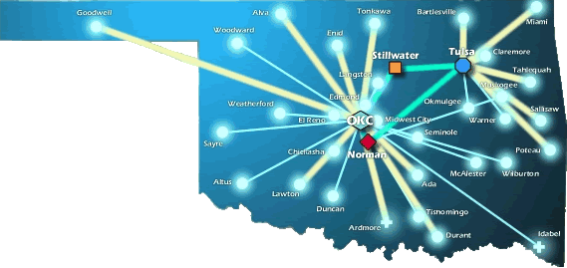
About Us (cont.)
OneNet Services:
Support K-12 in Oklahoma
Support Higher Ed’s in Oklahoma
Support State Agencies
State-wide Optical Network (DWDM)
10-Gig Connectivity to Research and Education Networks
VoIP, VTC, E-Mail and Web Hosting Services

Slide 5
What is the ONMP?
The Oklahoma Networking Mentorship Program is an educational outreach connecting networking professionals from OU and OneNet with students in the technology field
It is part of an NSF grant to enhance Oklahoma’s educational and research capability through network improvements
The goal: identify, develop, and recruit talent
Activities include:
Presentations to students throughout OK
Job shadowing opportunities (on-site & virtual)

Slide 6
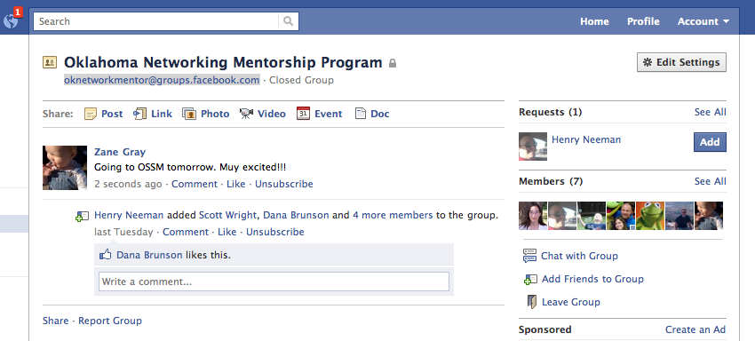
Job Shadowing
On-Site
Schedule a time with us to see what we do!
Virtual
e-mail us at network@ou.edu (OU IT Network Team)
Facebook: oknetworkmentor@groups.facebook.com
More to come…

Slide 7
Other Opportunities/Resources
Cisco Academy at OU
OU IT internal for now… maybe public next year!
Regional Cisco Academy is at Francis Tuttle
IT Internships at OU
E-mail Jennifer Pike → tops@ou.edu
Jobs at OU
http://jobs.ou.edu
Jobs at OneNet
http://www.okhighered.org/job-opportunities/

Slide 8
So, what’s it like?
Warning… PG-13 material ahead!

Slide 9
National Research & Education Networks (World-Wide)

Slide 10
National Research & Education Networks (Internet2)

Slide 11
National Research & Education Networks (RONs)

Slide 12
OneNet

Slide 13
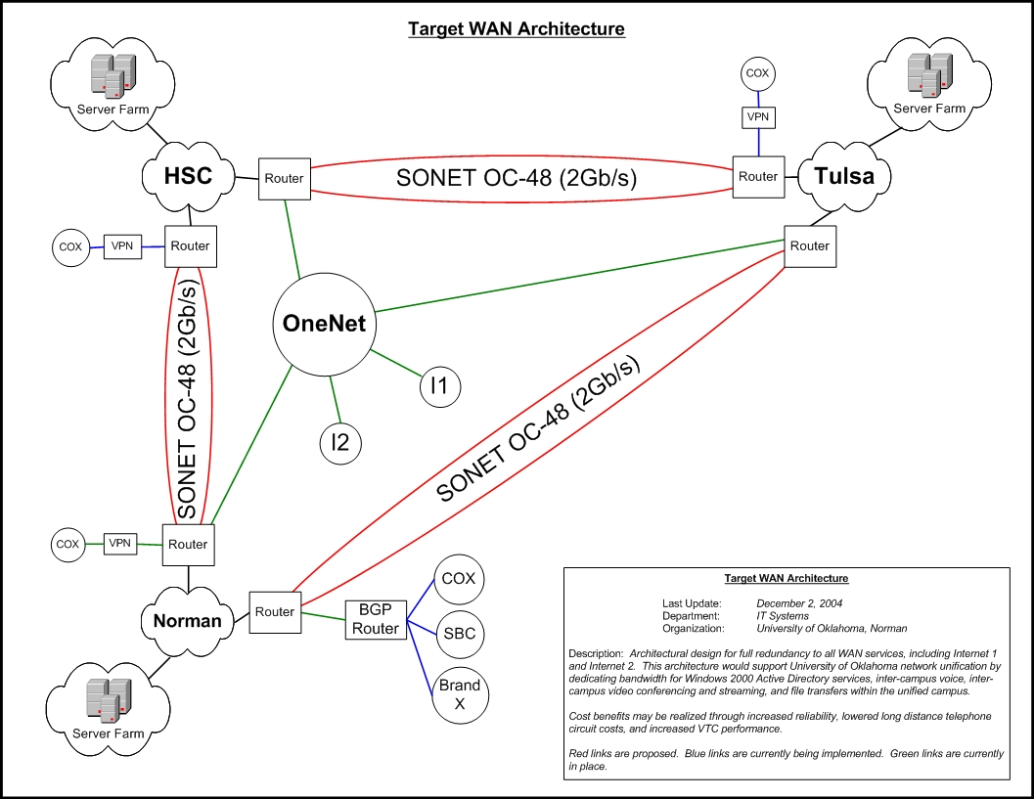
The OU WAN Network

Slide 14
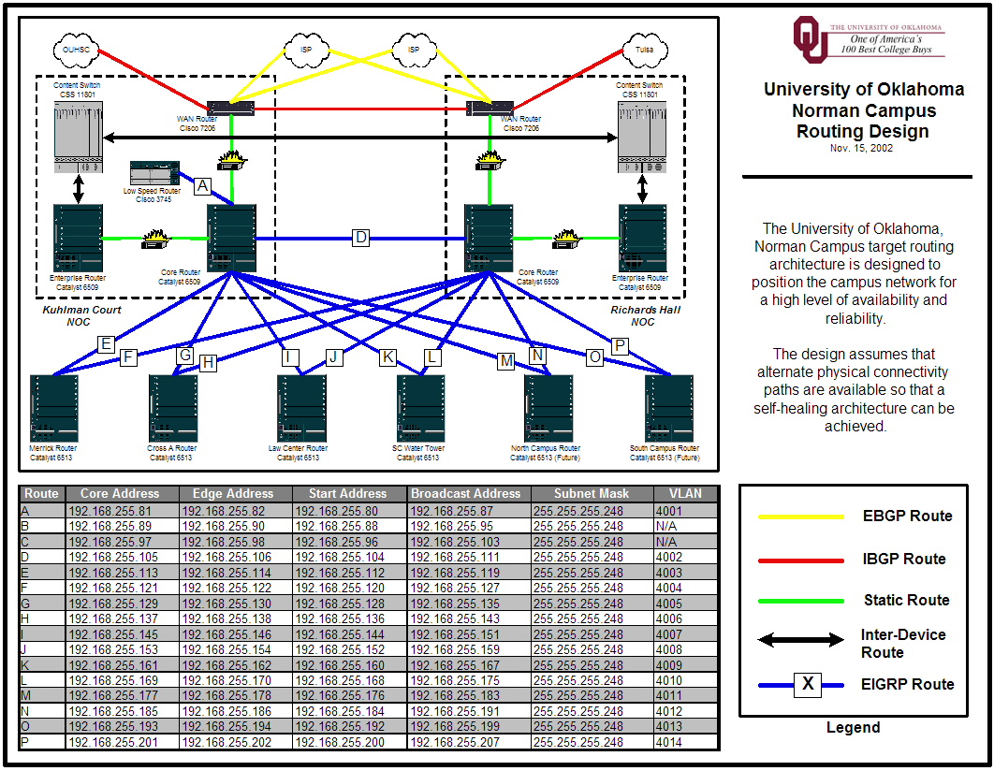
The OU Norman LAN

Slide 15
How Do We Manage It All?

Slide 16
Operations & Maintenance

Slide 17
Tools of the Trade

Slide 18
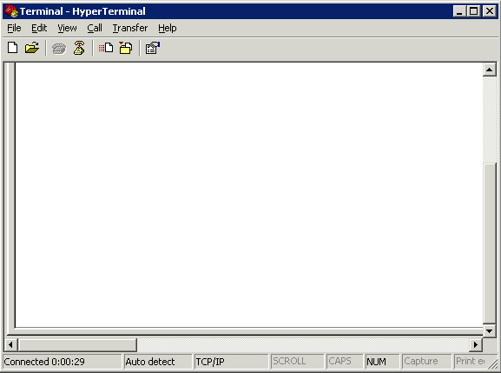
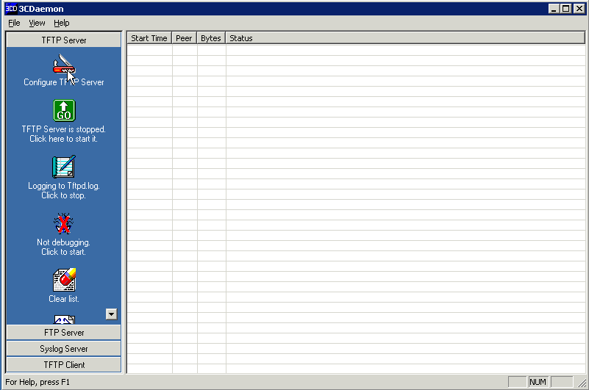
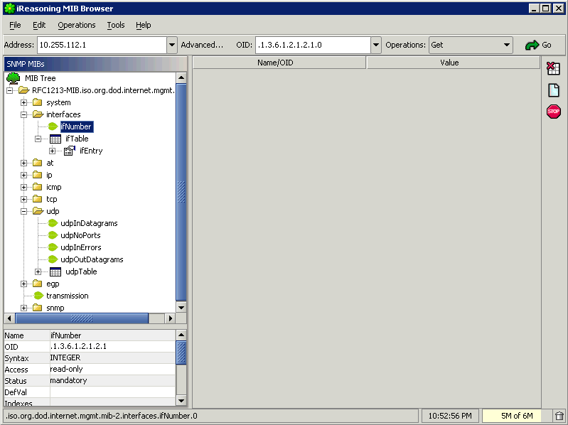
Tools of the Trade

Slide 19
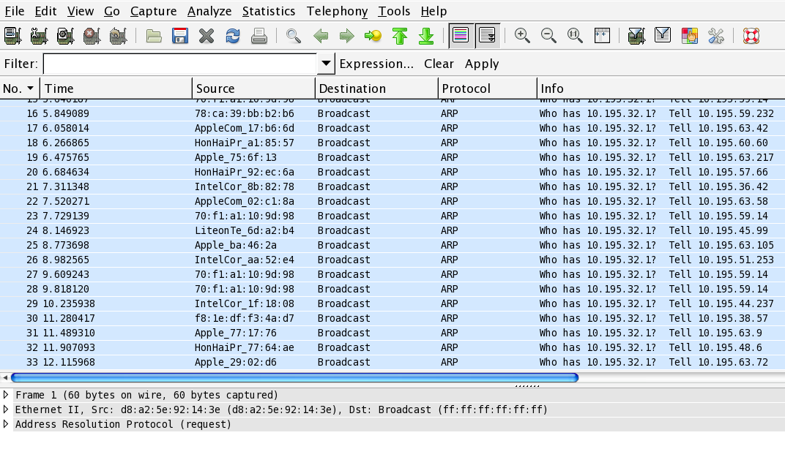
Tools of the Trade

Slide 20
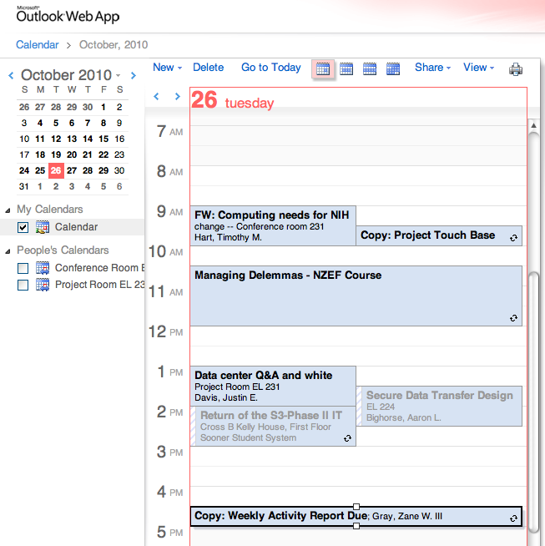
A Day in My Life…

Slide 21
A Day in My Life…
Prioritize!
Know what is important
Don’t let the “immediate” overshadow the “important”
Delegate!
Know when to ask for help
Build a circle of trust
Give credit where it is due

Slide 22
A Day in My Life…

Slide 23
A Day in My Life…
Get to know your customer
Get out from behind the desk
Don’t be afraid to drop in on someone
Follow up on issues
Overcome fears
Step out of the “comfort zone”
Take charge when things are going wrong
Be accountable (it’s OK to be wrong)

Slide 24
A Day in My Life…
Be the trusted advisor
Subject matter expert in your field
Know both the “trees” as well as the “forest”

Slide 25
A Day in My Life…
Have fun!
Breaks can get you out of a rut (not too frequent…)
Make your office the place you enjoy being at.
Be that person everyone wants to be around
Lead by example!

Slide 26
How Do I Get This Job?!
What I look for in a resume… (the basics)
College diploma in a relevant field
Experience
Certifications
I never look at salary (that’s up to HR)
What I look for in a resume… (under the hood)
Someone who doesn’t change jobs every 1 to 2 years (probably won’t last long)
Someone who understands the “lingo”
Someone who knows how to keep it “brief” but “relevant”

Slide 27
How Do I Get This Job?!
A Brief Note About Resumes…
Keep it brief!
No more than 2 pages (3 at most).
You don’t need to write a novel, because we won’t read it.
Keep it relevant!
Tailor your resume to match the job you are targeting.
Leave out extraneous details. These will come out in the interview process.
Sell yourself…. Yourself!
Don’t let a “headhunter” sell you.

Slide 28
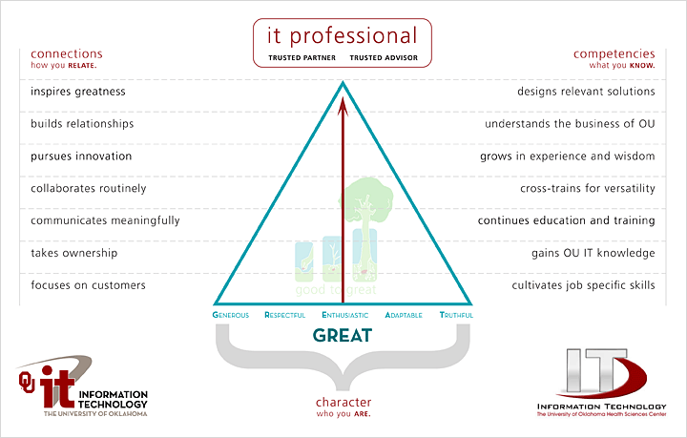
How Do I Get This Job?! (“The Interview”)

Slide 29
How Do I Get This Job?!
What you should do before then…
College diploma in a relevant field… this is worth up to 5 years of relevant experience!
Experience… internships during college can be applied toward this (kill two birds at the same time).
Certifications… start small, and work your way up. Do this during college, or even during high school.
Build relationships… sometimes, it isn’t WHAT you know, it’s WHO you know.

Slide 30
How Do I Get This Job?!
What you should do… (cont.)
Prayer never hurts!
Be positive.
Have a back-up plan.
Have someone else critique your resume.
Pass the interview.
Be honest during the interview.
Practice the interview
Thank the interviewer both in person, and later in writing.

Slide 31
What Do I Look For in a Job?
What to look for…
Money isn’t everything. There are sometimes trade-offs for higher salaries
More hours
More travel
Fewer benefits
Reputation. Find a place that everyone is talking about. Ask the people that work there if it is worth it!
Family friendly environment. Flexible work hours can be important.

Slide 32
What Do I Look For in a Job?
What to look for… (cont.)
Look at the “whole package”
Dress code?
Distance to work?
Free parking?
Starbucks (or pub) nearby?
Shared office space?
Time-off policy?
Condition of office?
Training and learning opportunities!

Slide 33
What Do I Look For in a Job?
What to look for… (cont.)
Interview the interviewer.
Don’t be scared. This is a two-way partnership.
Ask for a guided tour.
Ask to meet your “team”.
Ask the interviewer how they like the job.
This is a long-term commitment!
Trust your instincts! If your gut says “no”, then turn down the job.
Keep that back out plan in place until the probationary period is over.

Slide 34
I GOT THE JOB! Now what?
Suggestions for success…
Never compromise your morals.
Be honest… it’s hard to remember all of the lies you’ve told, and who you told them to.
Be there for other people… and they will be there for you.
Be positive! It’s contagious.

Slide 35
I GOT THE JOB! Now what?
Suggestions for success…
Don’t take things personally… in the grand scheme of things, it’s just a job!
Rule your destiny.
Step outside of your comfort zone.
Nothing in your job is worth getting angry over.
Your customer is why you are where you are. Be there for them.

Slide 36
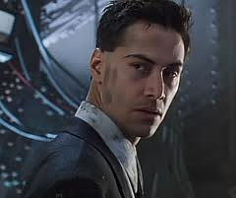
I GOT THE JOB! Now what?
Suggestions for success…
Change in inevitable… just roll with it!
Johnny Mnemonic
320GB of memory*
*(with memory doubler)

Slide 37
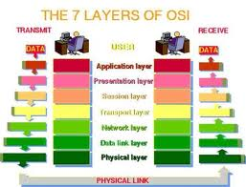
I GOT THE JOB! Now what?
Technical Stuff for Network Engineers…
Know the OSI model. It will save you days of troubleshooting time!

Slide 38
I GOT THE JOB! Now what?
Technical Stuff… (cont.)
Document everything! Trust me, it will save you time in the long run.

Slide 39
I GOT THE JOB! Now what?
Technical Stuff… (cont.)
Ask for the cool toys!

Slide 40
I GOT THE JOB! Now what?
Technical Stuff… (cont.)
You will never have enough time or money… always have a backup plan.

Slide 41
I GOT THE JOB! Now what?
Technical Stuff… (cont.)
Technology changes fast! Try to keep pace, and don’t wait for “futures”…

Slide 42
Q&A

Slide 43
Contact Information
AIM: zgray3
Yahoo!: zanewgray
Mobile Me: zane.gray
Skype: zanewgray
Gizmo: zanegray
Google: zanewgray
Facebook: zanewgray@gmail.com
Twitter: zanewgray
Fring: zanewgray
Facetime: zgray@ou.edu
Movi: zgray@ou.edu
E-Mail: zgray@ou.edu

