Slide 1
Oklahoma Network Mentorship Program
Scott Wright, Senior Network Architect
University of Oklahoma, Norman Campus
University of Oklahoma-Tulsa, 09 Nov 2010

Slide 2
What is the ONMP?
The Oklahoma Networking Mentorship Program (ONMP) is an outreach initiative that connects networking professionals from Oklahoma institutions with students who are studying networks at Oklahoma academic institutions.
The ONMP is part of a National Science Foundation grant whose purpose is to boost Oklahoma’s education and research capability through network improvements.

Slide 3
ONMP Goal
Official Goal: Expose Oklahoma networking students to the practical day-to-day life of networking professionals.
Hidden Secret Goal: Identify, develop and recruit talent!

Slide 4
ONMP Activities
Presentations to students throughout Oklahoma –visiting 13 institutions in Fall 2010:
Eastern Oklahoma County Technology Center, Choctaw
Eastern Oklahoma State College, Wilburton
Gordon Cooper Technology Center, Shawnee
Langston University, Langston
Oklahoma Christian University, OKC
Oklahoma City University
Oklahoma Panhandle State University, Goodwell
Oklahoma School of Science and Mathematics, OKC
Oklahoma State University-OKC
Oklahoma State University, Stillwater
Southern Nazarene University, Bethany
University of Oklahoma, Norman
University of Oklahoma, Tulsa
Job shadowing opportunities (on-site and virtual)

Slide 5
Job Shadowing
On-Site
Schedule a time with us to see what we do!
E-mail the project leader, Henry Neeman (hneeman@ou.edu) to set up a time.
Virtual
E-mail us at network@ou.edu
Facebook: oknetworkmentor@groups.facebook.com

Slide 6
Other Opportunities/Resources
Cisco Academy
Francis-Tuttle
OU IT internal for now
IT Internships at OU
Contact Jennifer Pike (jpike@ou.edu)
Jobs at OU
http://jobs.ou.edu
Jobs at OneNet
http://www.okhighered.org/job-opportunities/

Slide 7
About Me
Scott Wright -
B.B.A. Management Info. Systems (OU 1997)
M.S. Telecom Management (OSU 2010)
Phillips Petroleum (Novell/NT) (Bartlesville, 1997 - 2000)
Hilti, Inc. (Networking) (Tulsa, 2000 – 2006)
Tinker FCU (Networking) (OKC, 2006 – 2007)
OU (ITRep/Networking) (Norman, 2007 – Present)
CISSP
My favorite quote:
Things may come to those who wait, but only the things left by those who hustle. -Abraham Lincoln
Notes:
Brief overview of my career
Be intentional (long term) but flexible (short term)

Slide 8
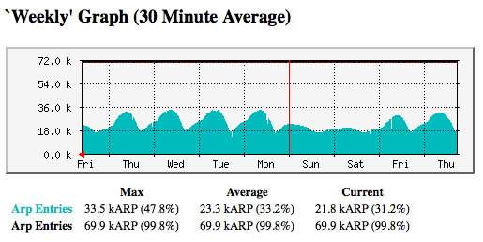
About OU
OU IT Network Services:
Support 8000+ wireless users
Support 15000+ network users
Support ~25000 host devices
Support ~1300 wireless access points
Support ~850 security cameras
Support ~1250 network switches and routers
Over 200 physical and virtual servers

Slide 9
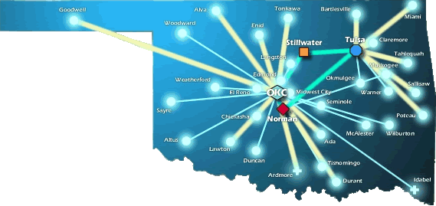
About OneNet
OneNet Services:
Support K-12 in Oklahoma
Support Higher Ed’s in Oklahoma
Support State Agencies
State-wide Optical Network (DWDM)
10-Gig Connectivity to Research and Education Networks
VoIP, VTC, E-Mail and Web Hosting Services

Slide 10
A Day-in-the-life of a network professional

Slide 11
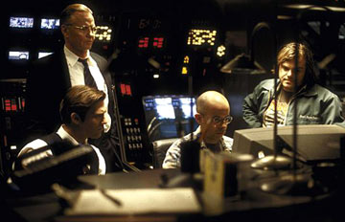
So, what’s it like?
Is it like the movies?
Some of my favorites are Sneakers, Enemy of the State, The Italian Job, Alias, 24
Or maybe Office Space?
Notes:
Super star individual
Doing really cool stuff with a few keystrokes
Knows everything about everything
Or a bunch of pointless hours spent in a cubicle?

Slide 12
Network Pro’s typically…
Work in a team environment
Participate in projects
Provide “Tier 3” support
Manage -
Routers
Switches
IP, other protocols
Circuits & cable plant
Specialty devices (wireless, security, voice, etc.)
Network services such as DNS, DHCP, NTP, etc.

Slide 13
Also, expect to…
Multi-task
Sit in the the hot seat
Be the “instant expert” on lots of topics
Work nights, weekends, and other off hours
Be “on call”

Slide 14
You’ll spend time…
Logged into network devices…
Configuring
Troubleshooting
Testing
Learning
The picture at the right is a screenshot of Cisco IOS, which is very common

Slide 15
You’ll spend time…
In meetings
Leading
Participating
Listening
It pays to develop skills
Listening
Presention
Negotiation
Conflict resolution
Whiteboarding

Slide 16
You’ll spend time…
Documenting the network
Static documents like Visio diagrams
Living documents like HP Openview, MRTG, DNS, etc.

Slide 17
You’ll spend time…
Setting up new stuff
Circuits
Hardware
Software
Processes
Cleaning up old stuff
Cable management
Configurations
Processes
Know your organization’s change management process

Slide 18
Responsibilities include…
http://www.accuracyandaesthetics.com/
Notes:
Network professionals spend their time on these sorts of things.
Technology management life cycle

Slide 19
Planning
A goal without a plan is just a wish.
-Antoine de Saint-Exupery
Planning is indispensible
Create contingency plans
Prioritize planning
Avoid “Plan M”
“Make it up as you go”
Communicate your plans
Foster understanding & buy-in
Notes:
Planning encompasses designing, testing, justifying, documenting
You have to prioritize it – it can easily take a back seat to more pressing issues

Slide 20
Procurement
As a network professional, you will buys things like…
Equipment
Circuits
Labor / Services
You will spend time with vendors
Product evals / design
Negotiations
Competitive bidding
Understand your company’s policies on vendor relations and avoid unethical conduct
Spend money as if it is your own – be a good steward
Notes:
Vendors want information – splits in team, funding, pricing. You have to decide where to draw the line.
Present united front.

Slide 21
Deployment
Plans are only good intentions unless they immediately degenerate into hard work.
-Peter Drucker
Deployment is about executing the plan
It is often what you get graded on
You’ll be in the hot seat - stay cool!
You’ll have to live with your work for a while, so do it right
Planning and preparation are vital

Slide 22
Management
Availability monitoring
Performance baselining
Asset management & tracking
Change management
Notes:
Tracking availability and performance provide important input into other job functions

Slide 23
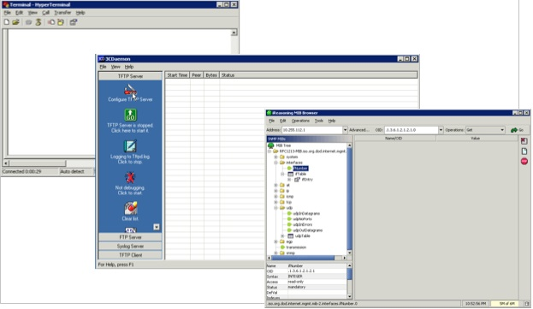
Support
Support and troubleshooting is usually URGENT!
It can also be time consuming
It is important to be both an effective and efficient – don’t waste time
Notes:
Broad experience, OSI can help

Slide 24
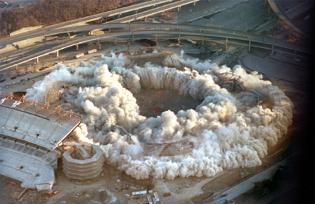
Disposition
The network is always in transition – some new, some old
Retiring systems requires planning and commitment
Can be complicated
Make it simple for users
Minimize downtime
Be persistent
Notes:
A word about modular design

Slide 25
Time Management
Time management is a key issue for network professionals. Daily operational needs can disrupt long-term planning and design efforts.
A few suggestions –
Make sure your goals are aligned with the business
Discuss priorities with your boss
Set realistic expectations (time & effort estimates)
Know who generates revenue and how they depend on you
Automate when possible
Delegate when possible
Notes:
Planning v Management v. Support

Slide 26
Strategies for Success

Slide 27
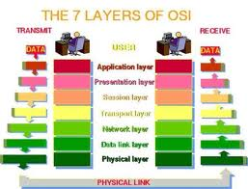
Hone Technical Skills
Know the OSI model
Pursue Education & Training
Use certifications to motivate and validate

Slide 28
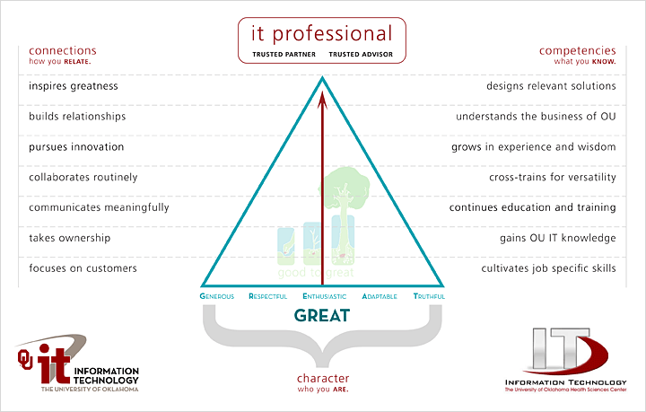
Be Balanced
Notes:
Early career will likely be tech oriented
Career progression usually requires development of soft skills (leadership, managerial, presentation, etc.)
You have to decide how, when, and to what extent to pursue soft skills

Slide 29
Be Proactive
Be Proactive - act in anticipation of future problems, needs, or changes
About your tasks
About projects
About your education
About your career
About your life
Research shows a high correlation between proactivity and success
“Proactivity consistently produces better results than reactivity or inactivity.” [1]
[1] Kouzes and Posner. The Leadership Challenge 4th Edition. 2007. John Wiley & Sons.

Slide 30
Know the Business
Knowing the technology isn’t enough
To make meaningful contributions to your organization, you have to understand the business
Your ability to get things done will be limited by your knowledge of business processes
Requires spending time with customers, peers, leadership, etc.
Ask questions

Slide 31
Choose Your ‘Tude
http://www.frozenropes.com
Notes:
Frozen ropes is a baseball/softball training facility. I just like their slogan.

Slide 32
Put Customers First
Recognize that without customers, you don’t have a job
Make sure you leave things better than you found them
Make sure the customer is satisfied before claiming victory
Don’t cast blame on the customer
Use language your customer can understand
Make it easy for people to reach you for follow-up
Trusted advisor

Slide 33
Be a Team Player
Be a good teammate
Get involved
Pitch-in and be helpful
Build relationships
Say “we” and “us” and work as “we” and “us”
Develop a circle of trust
Give credit for success / take credit for mistakes

Slide 34
Learn and Grow
Learn and Grow
Both technical and non-technical
Experience is a great teacher
When you make a mistake, learn from it
Be a lifetime learner
Leave your comfort zone and try new things
Self-efficacy – belief in one’s ability to do a task [1]
Developed through experience
[1] Krietner and Kinicki. Organizational Behaviour 8th Edition. 2008. McGraw-Hill.

Slide 35
Practice Self-Responsibility
Take responsibility for yourself
You are responsible for…
Staying informed
Getting the job done
Your successes & failures
Your skill development
Your career

Slide 36
Find a Mentor
Find a mentor (formal or informal)
Mentors can help you
Understand the organization
Develop your perspective
Provide a sounding board for your ideas
Mentoring can also improve your career prospects [1]
Higher compensation
More job opportunities
Higher job satisfaction
[1] Krietner and Kinicki. Organizational Behaviour 8th Edition. 2008. McGraw-Hill.

Slide 37
Finding a Job

Slide 38
Differentiate Yourself
These things are great…
College diploma in a relevant field… this is worth up to 5 years of relevant experience!
Experience… internships during college can be applied toward this (kill two birds at the same time).
Certifications… start small, and work your way up.
Extra curricular activities…they say something about who you are

Slide 39
Know Your Values
What is important to you?
Understand how your values impact your job prospects – location, industry, work/life balance, etc.
Make sure your values are congruent with the organization where you go to work
Find out what the company’s reputation is (internal & external)
Trust your gut
If you get a bad vibe from a company, turn down the job

Slide 40
Job Search
Know what your parameters are – location, salary requirement, area of interest, benefits, etc.
Career Services, job fairs, etc. here
Local newspapers
Online search engines – indeed.com
Target individual organizations – check their websites
Build relationships with your instructors and peers
Network (with people)! Don’t pass up opportunities on campus to meet alumni, donors, guest speakers, etc.

Slide 41
Your Resume
What I look for in a resume… (the basics)
College degree in a relevant field
Experience
Certifications
What I look for in a resume… (under the hood)
Someone who doesn’t change jobs every 1 to 2 years (probably won’t last long)
Someone who understands the “lingo”
Someone who knows how to keep it “brief” but “relevant”

Slide 42
Your Resume
A Brief Note About Resumes…
Use “targeted” resumes
Customize to the position you are applying for
Include a cover letter
Make it easy to read and error free
Format should focus attention where you want it
Proof read it
Proof read it, again
Have someone you trust critique it
What impression does your resume make?

Slide 43
A Word About Certifications
Certifications indicate a basic grasp of subject
For networking professionals, the Cisco certs are the most popular
CCNA for starters, CCNP as you gain experience
There are specialties such as voice, security, wireless, service provider
Cisco Network Academy @ Francis Tuttle is one option for pursuing CCNA

Slide 44
Interviewing
Relax
Be positive
Be honest
Think about how you are presenting yourself
Connect with interviewer
Be generous with information about you
Ask smart questions
Spend time thinking about potential questions and answers

Slide 45
Starting Your New Job

Slide 46
First things…
Build credibility
DWYSYWD
Ask for advice
Foster trust
Show trust
Be honest
Clarify expectations
“What are your expectations for…”
Focus on small wins
Start with the intent of building long-term relationships

Slide 47
Contact Information
Me – sw@ou.edu
Job shadowing – hneeman@ou.edu
Facebook - oknetworkmentor@groups.facebook.com

