Slide 1
A Day in the Life of a Network Professional
Jim Glover
Network Manager
Oklahoma Department of Corrections
Notes:
1

Slide 2
What is the OITMP?
The Oklahoma IT Mentorship Program (OITMP) is an outreach initiative that connects networking professionals from Oklahoma institutions with students who are studying IT at Oklahoma academic institutions.
The OITMP is established under Oklahoma's National Science Foundation Inter-Campus and Intra-Campus Cyber Connectivity (C2) grant, “Oklahoma Optical Initiative.”
Notes:
2

Slide 3
OITMP Goal
Official Goal: Expose Oklahoma security/networking students to the practical day-to-day life of security/networking professionals.
Hidden Secret Goal: Identify, develop and recruit talent!
Slide courtesy of Dr. Henry Neeman and OU IT Mentoring Program staff
3

Slide 4
Job Shadowing
On-Site
Schedule a time with us to see what we do!
E-mail the project leader, Henry Neeman (hneeman@ou.edu) to set up a time.
Virtual
E-mail us at network@ou.edu
Facebook: oknetworkmentor@groups.facebook.com
Slide courtesy of Dr. Henry Neeman and OU IT Mentoring Program staff
4

Slide 5
Other Opportunities/Resources
Cisco Academy
Francis-Tuttle
OU IT internal for now
IT Internships at OU
Contact Jennifer Pike (jpike@ou.edu)
Jobs at OU
http://jobs.ou.edu
Jobs at OneNet
http://www.okhighered.org/job-opportunities/
Slide courtesy of Dr. Henry Neeman and OU IT Mentoring Program staff
5

Slide 6
Who is Jim Glover?
BS Computer Science LA Tech University
30+ years in IT
Computer Operator
Mainframe System Programmer
Server Sysadmin (web, mail, DNS, etc.)
Network Manager
Hobbies: Computers, Amateur Radio & Photography
Notes:
6

Slide 7
Department of Corrections Facts
Approximately 4,000 employees
Approximately 500 network devices
Approximately 100 sites
17 Minimum, Medium, Maximum Security
7 Community Corrections Centers
15 Community Work Centers
Probation and Parole Offices, etc.
Notes:
7

Slide 8
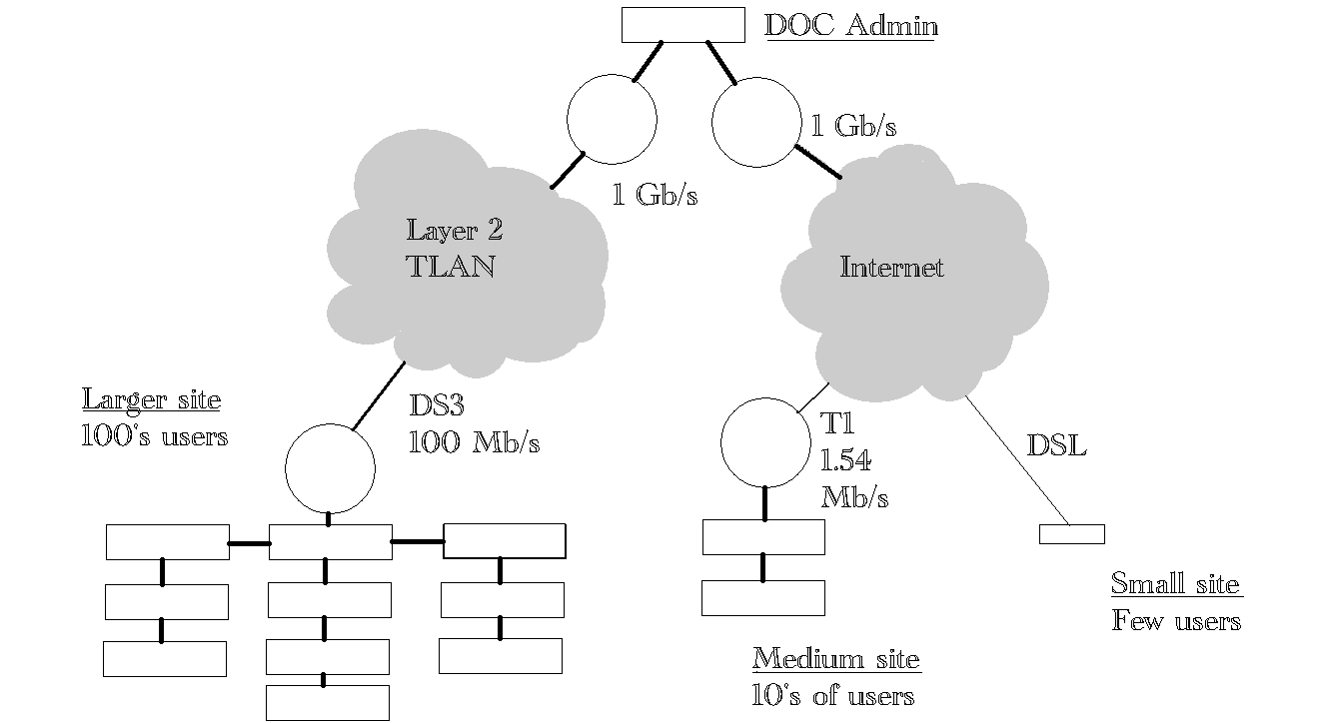
DOC Network Organization
Notes:
8

Slide 9
Department of Corrections Unique Challenges
Culture of independence
Facilities widespread, isolated
Movement through facilities slow, restricted
Chronic budget woes
Legislative and public ambivalence
“Beans 'n' bullets”
Chronic understaffing
Notes:
9

Slide 10
Department of Corrections Strengths
Culture of independence
Experienced, motivated staff
Offenders provide inexpensive labor
Notes:
10

Slide 11
Department of Corrections IT Status
IT recently centralized
Much network cabling substandard
Network usage patterns in flux
VMware virtualization
Active Directory
Video conferencing
Remote host access
Notes:
11

Slide 12
Department of Corrections IT/Network Goals
Improve standards adherence
Increase network stability
Paperwork
Develop and follow policy
Develop and follow formal procedures
Document
Achieve excellence
Notes:
12

Slide 13
Network Certifications to Consider
BICSI
Building Industry Consulting Service International
Standards and training for cabling
CCNA
Cisco Certified Network Associate
Concepts and practices of Cisco network device configuration
Notes:
13

Slide 14
My Professional Duties
Network device configuration
Routers, switches, security devices
Cabling management
Network design
Network maintenance
Security
Troubleshooting
Notes:
14

Slide 15
Network Professional Essential Knowledge
Notes:
15

Slide 16
Network Professional Essential Knowledge
TCP/IP
TCP vs UDP; how connections are made
Logical ports
Subnets and masks
Internet Protocols
HTTP, HTTPS, SMTP, FTP, DNS, DHCP, POP, NTP, SSH, etc.
Notes:
16

Slide 17
Network Professional Essential Skills
Project Management
Troubleshooting
OSI model layers in order: 1, 2, 3 …
Packet Sniffing (e.g. WireShark)
Notes:
17

Slide 18
Network Group Quest for Excellence
Design: Plan for the future
Cabling: Do it right; do it once.
Procedures
Benefits
Documentation
Flexibility
Repeatability
Consistency
Notes:
18

Slide 19
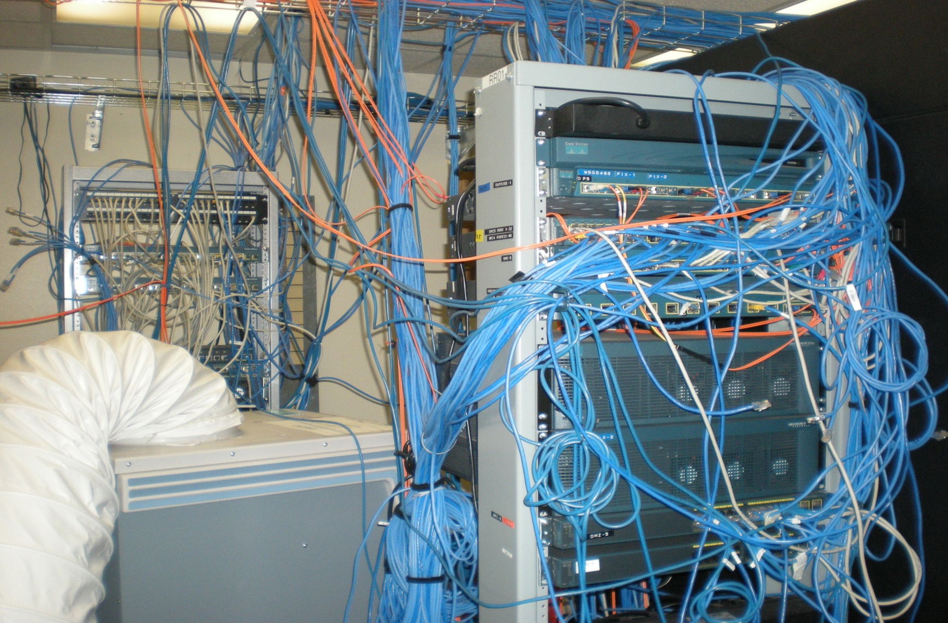
Before
Notes:
19

Slide 20
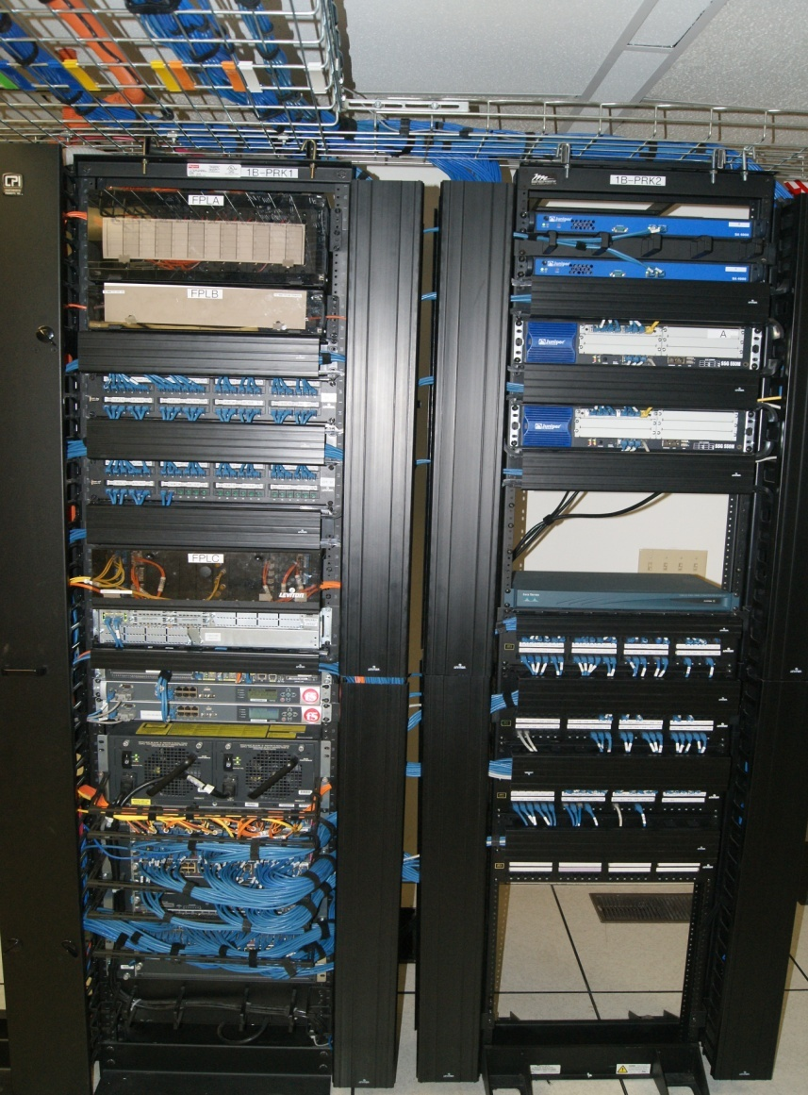
After
Notes:
20

Slide 21
Questions?
Contact Information
Jim Glover
Jim.Glover@doc.state.ok.us
Slides with OU logo courtesy of Dr. Henry Neeman and the OU network staff
Notes:
21

