Slide 1





Oklahoma Information Technology Mentorship Program

Slide 2
What is the OITMP?
The Oklahoma Information Technology Mentorship Program is an educational outreach connecting networking professionals from OU, OneNet, and other institutions with students in the technology field
It is part of an NSF grant to enhance Oklahoma’s educational and research capability through network improvements
The goal: identify, develop, and recruit talent
Activities include:
  Presentations to students throughout OK
  Job shadowing opportunities (on-site & virtual)

Slide 3
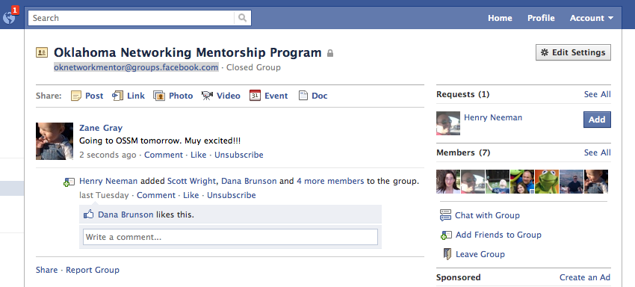
Job Shadowing
On-Site
  Schedule a time with us to see what we do!
Virtual
  e-mail us at network@ou.edu (OU IT Network Team)
  Facebook: oknetworkmentor@groups.facebook.com

Slide 4
Other Opportunities/Resources
Cisco Academy at OU
  OU IT internal for now… maybe public “soon”!
  Regional Cisco Academy is at Francis Tuttle
Jobs at OU
  http://jobs.ou.edu
Jobs at OneNet
  http://www.okhighered.org/job-opportunities/

Slide 5
About Me
Zane Gray:
  B.S. Chemical Engineering (OU 1996)
  USAF network deployments (1996-2001)
  OU computer networking (2001-present)
  Self-proclaimed Apple Fanboy
  Married since 1993 to an OSSM alumn!
  Nine (yes, “9”) kids
  One ball python (I hate snakes!)
  One psychotic cat (adopted stray)

Slide 6
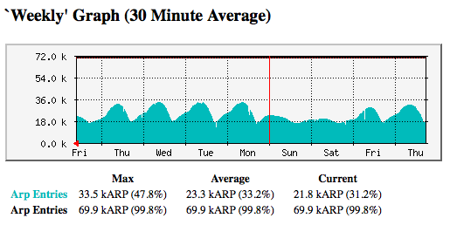
About My Job
OU IT Network Services:
  Support 18000+ wireless users
  Support 15000+ “wired” users
  Support ~35000 host devices
  Support ~1500 wireless access points
  Support ~1000 security cameras
  Support ~1250 network switches and routers
  Support ~8000 telephony devices (VoIP and analog)
  Over 200 physical and virtual servers
  Migrating to a single datacenter that spans three cities

Slide 7
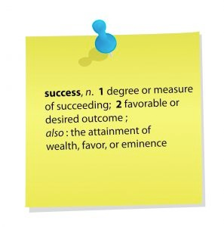
About This Presentation
What do I do in the IT field?
Lessons learned for getting this job.
Recommendations for keeping the job.
Being successful in this field.

Slide 8

So, what’s it like?
Warning… PG-13 material ahead!

Slide 9

National Research & Education Networks (World-Wide)

Slide 10
National Research & Education Networks (Internet2)

Slide 11
National Research & Education Networks (RONs)

Slide 12
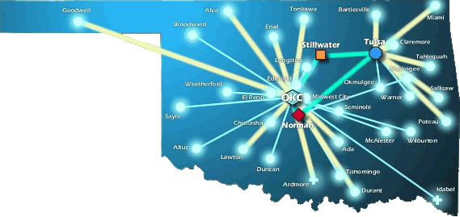
OneNet

Slide 13
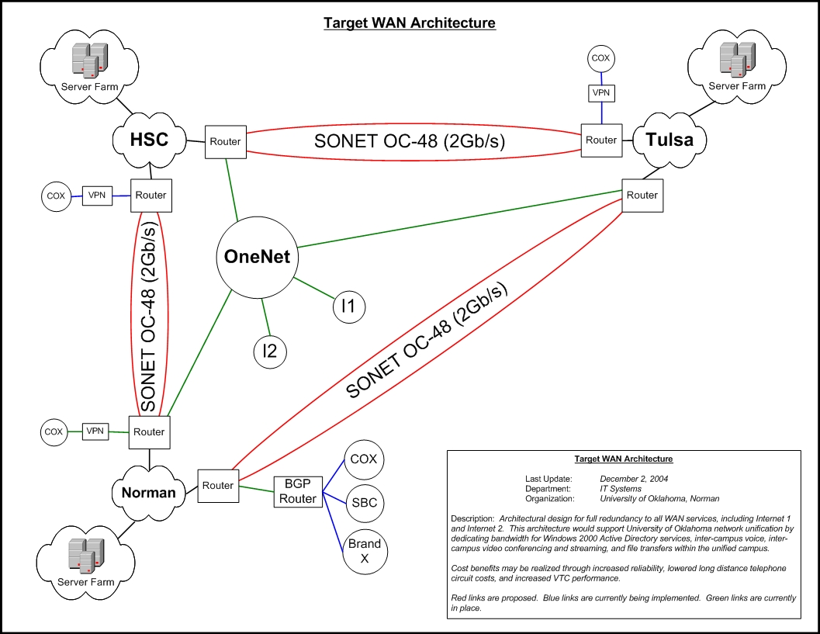
The OU WAN Network

Slide 14
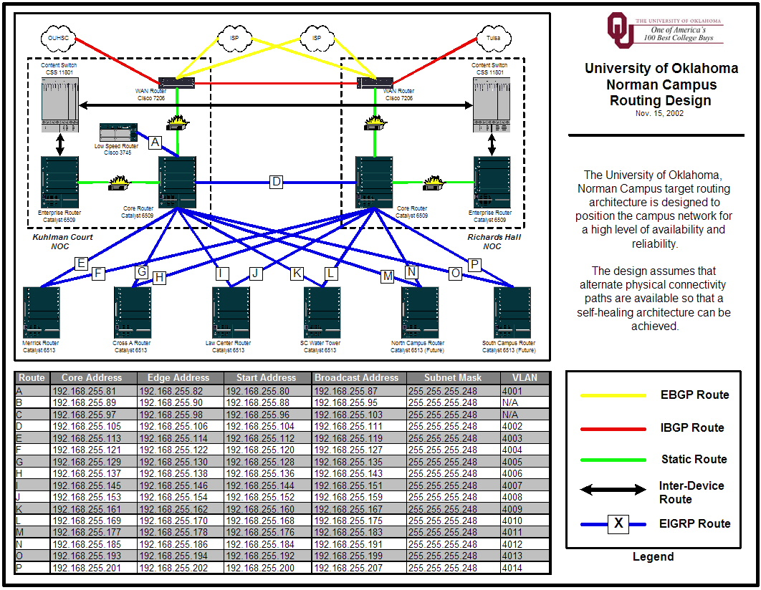
The OU Norman LAN

Slide 15

How Do We Manage It All?

Slide 16
Tools of the Trade

Slide 17
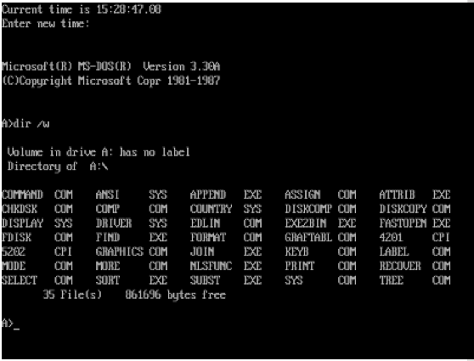
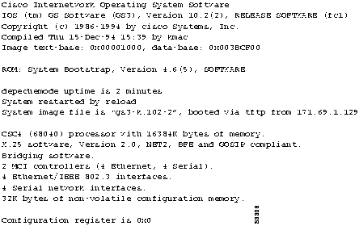
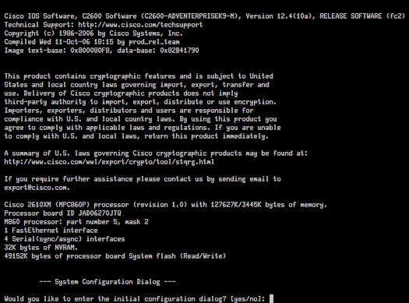
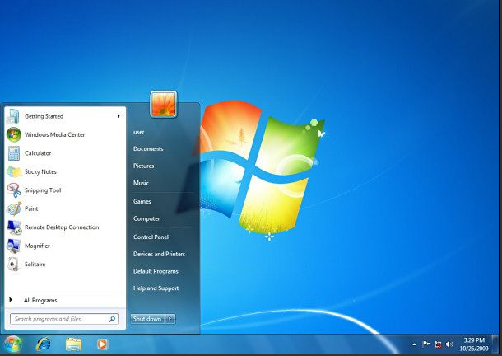
Tools of the Trade
Client OS’ (1980’s and Today)
Network OS’ (1980’s and Today)

Slide 18
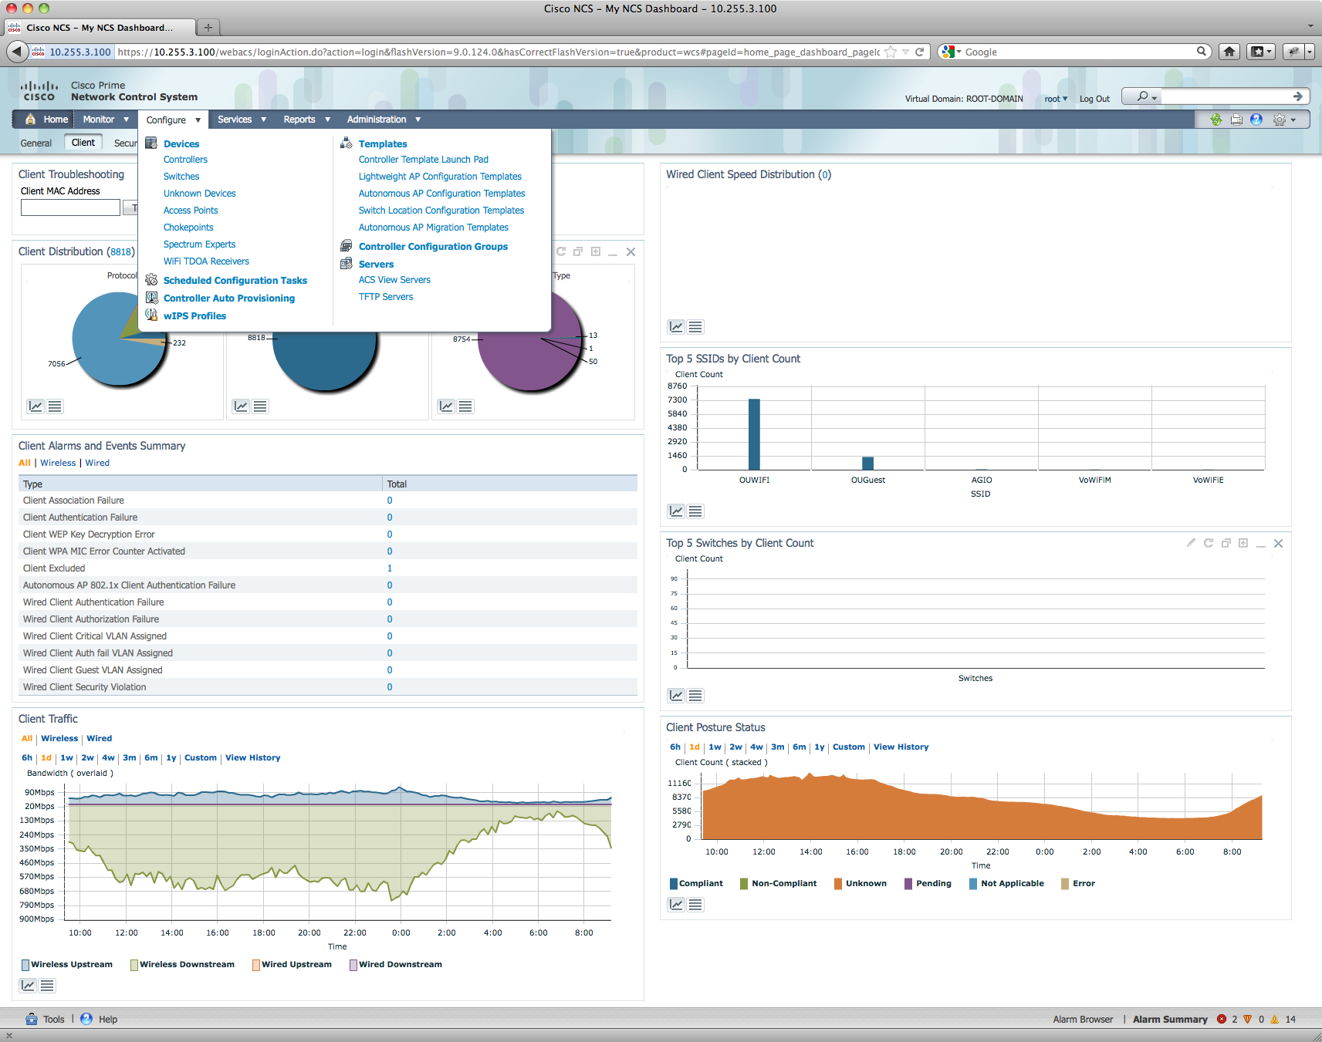
Tools of the Trade
But that’s changing!
  TRILL
  OpenFlow
  CAPWAP
  ~50% Parity

Slide 19
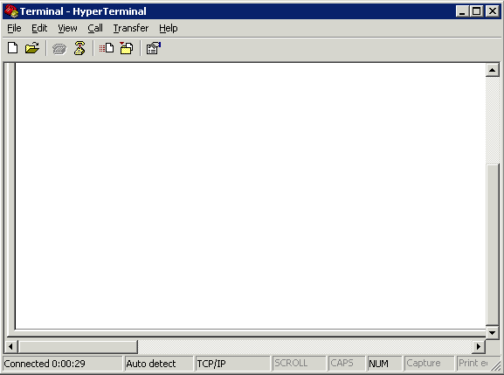
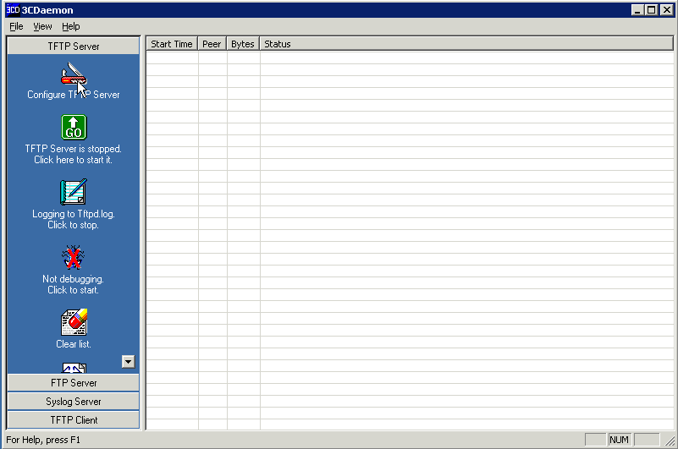
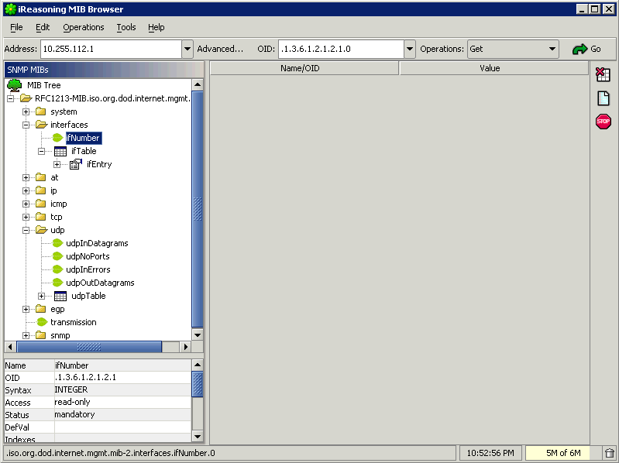
Tools of the Trade

Slide 20
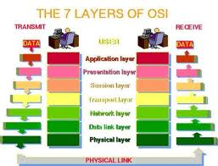
Troubleshooting
Technical Stuff for Network Engineers…
  Know the OSI model. It will save you days of troubleshooting time!

Slide 21
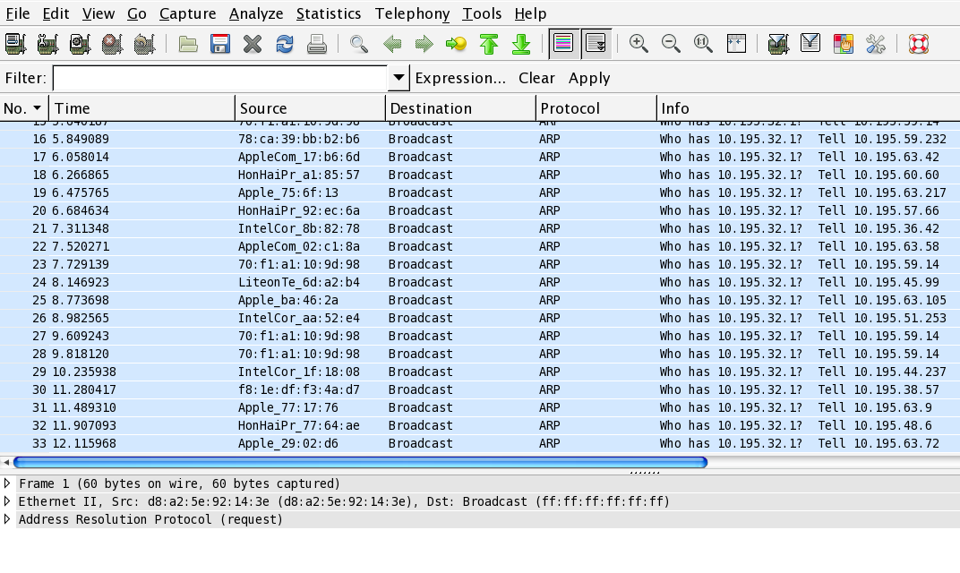

Troubleshooting

Slide 22
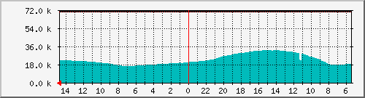
Operations & Maintenance

Slide 23
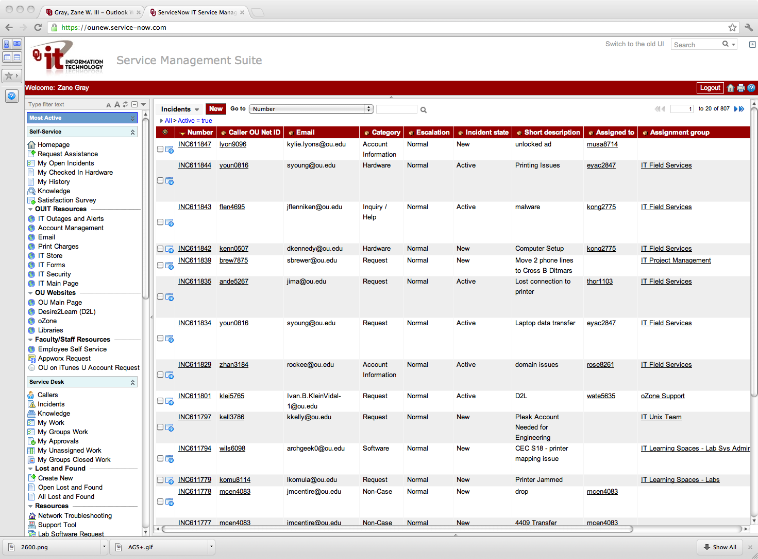
Change Management
Change Management and Control is a Necessary Evil
  Process
  Compliance
  Knowledge
  Audit Trail

Slide 24
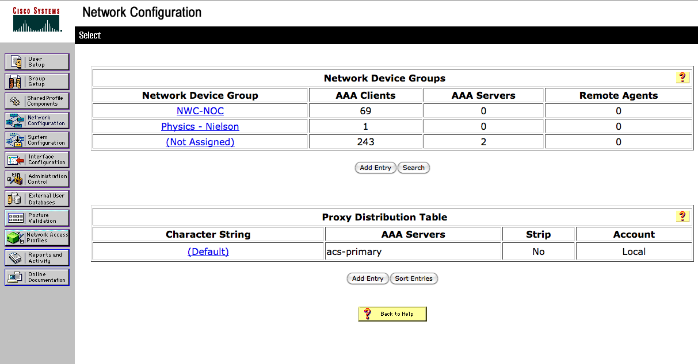
Change Control
AAA
  Authentication
  Authorization
  Accounting

Slide 25
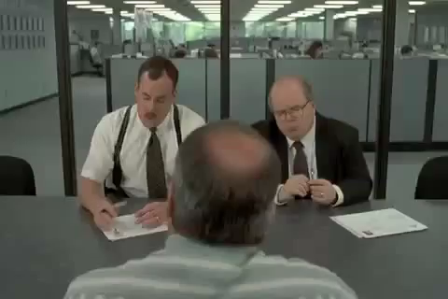
So, What is it Like to be Me?

Slide 26
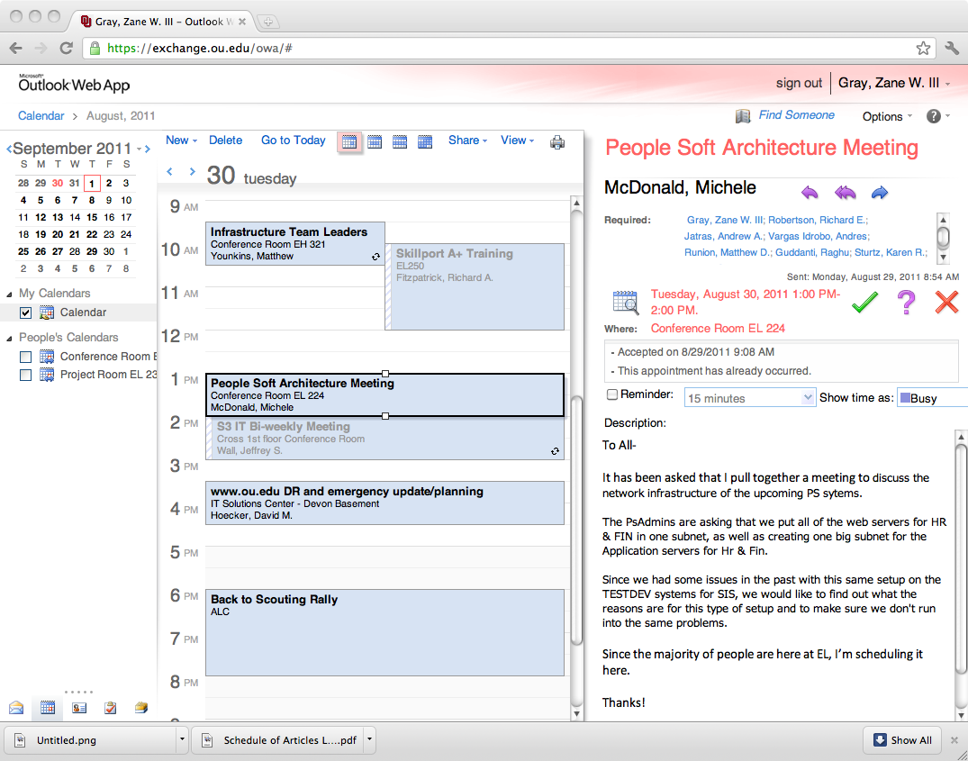
A Day in My Life…

Slide 27
A Day in My Life…
Prioritize!
  Know what is important
  Don’t let the “immediate” overshadow the “important”
Delegate!
  Know when to ask for help
  Build a circle of trust
  Give credit where it is due

Slide 28
A Day in My Life…
Get to know your customer
  Get out from behind the desk
  Don’t be afraid to drop in on someone
  Follow up on issues
Overcome fears
  Step out of the “comfort zone”
  Take charge when things are going wrong
  Be accountable (it’s OK to be wrong)

Slide 29

A Day in My Life…
Be the trusted advisor
  Subject matter expert in your field
  Know both the “trees” as well as the “forest”

Slide 30

A Day in My Life…
Have fun!
  Breaks can get you out of a rut (not too frequent…)
  Make your office the place you enjoy being at.
  Be that person everyone wants to be around
  Lead by example!

Slide 31

How Do I Get This Job?!

Slide 32
How Do I Get This Job?!
What I look for in a resume… (the basics)
  College diploma in a relevant field
  Experience
  Certifications
  I never look at salary (that’s up to HR)
What I look for in a resume… (under the hood)
  Someone who doesn’t change jobs every 1 to 2 years (probably won’t last long)
  Someone who understands the “lingo”
  Someone who knows how to keep it “brief” but “relevant”

Slide 33
How Do I Get This Job?!
A Brief Note About Resumes…
  Keep it brief!
    No more than 2 pages (3 at most).
    You don’t need to write a novel, because we won’t read it.
  Keep it relevant!
    Tailor your resume to match the job you are targeting.
    Leave out extraneous details. These will come out in the interview process.
  Sell yourself…. Yourself!
    Don’t let a recruiter/headhunter sell you.

Slide 34
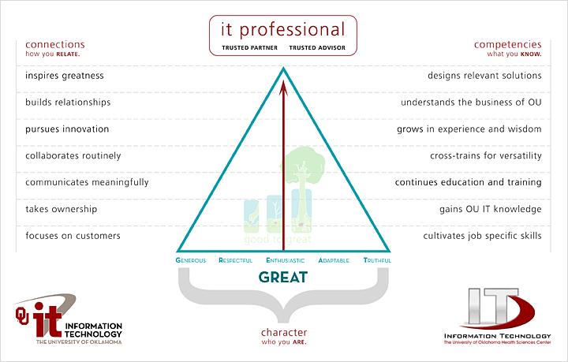
How Do I Get This Job?! (“The Interview”)

Slide 35
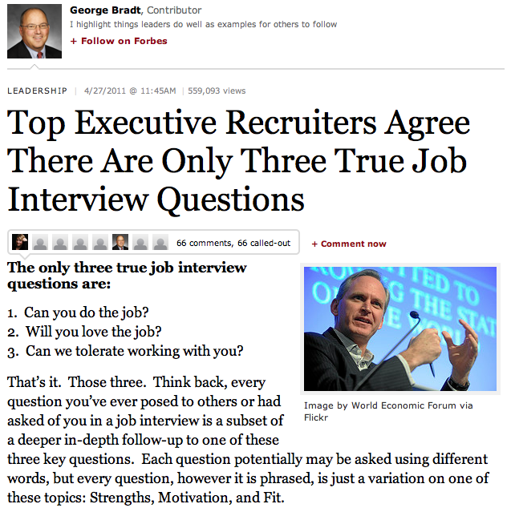
How Do I Get This Job?! (“The Interview”)
  Can you do it?
  Will you love it?
  Will we like you?

Slide 36
How Do I Get This Job?!
What you should do before then…
  College diploma in a relevant field… this is worth up to 5 years of relevant experience!
  Experience… internships during college can be applied toward this (kill two birds at the same time).
  Certifications… start small, and work your way up. Do this during college, or even during high school.
  Build relationships… sometimes, it isn’t WHAT you know, it’s WHO you know.

Slide 37
How Do I Get This Job?!
What you should do… (cont.)
  Prayer never hurts!
  Be positive.
  Have a back-up plan.
  Have someone else critique your resume.
  Pass the interview.
    Be honest during the interview.
    Practice the interview
    Thank the interviewer both in person, and later in writing.

Slide 38
What Do I Look For in a Job?
What to look for…
  Money isn’t everything. There are sometimes trade-offs for higher salaries
    More hours
    More travel
    Fewer benefits
  Reputation. Find a place that everyone is talking about. Ask the people that work there if it is worth it!
  Family friendly environment. Flexible work hours can be important.

Slide 39
What Do I Look For in a Job?
What to look for… (cont.)
  Look at the “whole package”
    Dress code?
    Distance to work?
    Free parking?
    Starbucks (or pub) nearby?
    Shared office space?
    Time-off policy?
    Condition of office?
    Training and learning opportunities!

Slide 40
What Do I Look For in a Job?
What to look for… (cont.)
  Interview the interviewer.
    Don’t be scared. This is a two-way partnership.
    Ask for a guided tour.
    Ask to meet your “team”.
    Ask the interviewer how they like the job.
  This is a long-term commitment!
    Trust your instincts! If your gut says “no”, then turn down the job.
    Keep that back out plan in place until the probationary period is over.

Slide 41

I GOT THE JOB! Now what?
Suggestions for success…
  Never compromise your morals.
  Be honest… it’s hard to remember all of the lies you’ve told, and who you told them to.
  Be there for other people… and they will be there for you.
  Be positive! It’s contagious.

Slide 42
I GOT THE JOB! Now what?
Suggestions for success… (cont.)
  Don’t take things personally… in the grand scheme of things, it’s just a job!
  Rule your destiny.
  Step outside of your comfort zone. (ref. Office Space, the movie)
  Nothing in your job is worth getting angry over.
  Your customer is why you are where you are. Be there for them.

Slide 43

I GOT THE JOB! Now what?
Technical Stuff… (cont.)
  Document everything! Trust me, it will save you time in the long run.

Slide 44
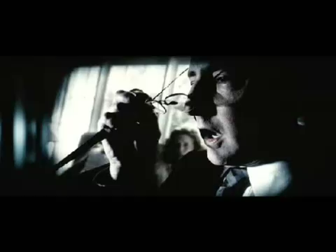
I GOT THE JOB! Now what?
Technical Stuff… (cont.)
  Ask for the cool toys!

Slide 45

I GOT THE JOB! Now what?
Technical Stuff… (cont.)
  You will never have enough time or money… always have a backup plan.

Slide 46
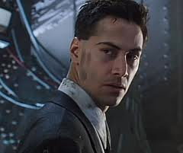
I GOT THE JOB! Now what?
Technical Stuff… (cont.)
  Change is inevitable… try to stay current!
  Today’s technology is obsolete in 3-5 years.
Johnny Mnemonic
320GB of memory*
*(with memory doubler)

Slide 47

I GOT THE JOB! Now what?
Technical Stuff… (cont.)
  Technology changes fast! Try to keep pace, and don’t wait for “futures”…

Slide 48
Q&A

Slide 49
Evaluations
Please take a moment to fill out the evaluations…
or NOT! The evaluations are completely optional.
No personal or personally identifiable data is collected.
Data is used by the grant providers to gauge success.
Please take a moment to fill them out…
or NOT! These are completely optional

Slide 50
Contact Information
AIM: zgray3
Yahoo!: zanewgray
Skype: zanewgray
Google: zanewgray
Facebook: zanewgray@gmail.com
Twitter: zanewgray
Facetime: zgray@ou.edu
Movi: zgray@ou.edu
LinkedIn: http://www.linkedin.com/pub/zane-gray/44/895/678
E-Mail: zgray@ou.edu

Slide 51
THANK-YOU!

