Slide 1
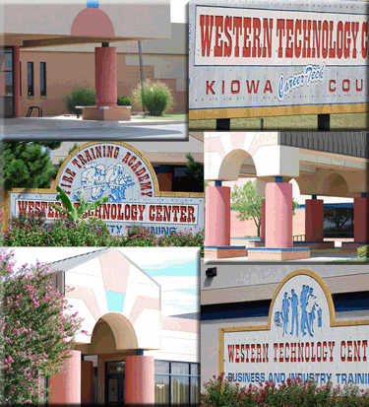
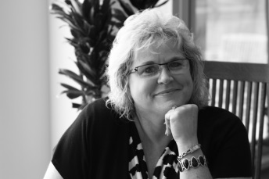
You are cordially invited to
A Day in the Life of
a IT Professional
Kim Thomas
Sr. Technology Strategist
University of Oklahoma IT
Oklahoma Information Technology Mentorship Program
Partially supported by the National Science Foundation
under Oklahoma’s NSF EPSCoR RII Cyber Connectivity (C2) grant (EPS-1006919)
Monday November 10, 2014
10am-10:30am & 12:30-1pm
Western Technology Center
Your
Photo
What is it like to be a IT professional? What are the day to day experiences? What issues of professionalism, customer service, project management and career growth does a IT professional encounter? How can you prepare yourself to be a more attractive job candidate, and what do IT professionals look for in prospective employees?
As Senior Technology Strategist with the University of Oklahoma IT, Academic North, Kim focuses on building and maintaining partnerships between OU IT and the Academic North Colleges. Kim has been recognized for her exceptional leadership, self motivation and her ability to communicate effectively with people of diverse backgrounds.
“Our primary mission is to build our team to be a strategic partner with the Academic North Colleges by offering our insight and expertise to streamline processes and technology, while partnering with other areas of the campus that are dealing with technology challenges.”
Before coming to OU IT in August of 2013, Kim worked as a results-driven leader, with extensive experience implementing technologies and processes in IT and enterprise environments. Her experience includes software implementation consulting, portfolio and project management, quality assurance and testing, business analysis, and process improvement.
As a native Oklahoman, Kim received her undergraduate degree at UCO, and she is looking forward to finishing her MBA at OU. She is married to her best friend, Paul. Together they enjoy all types of music, art, travel, and spending time with family and friends. Kim loves to cook. She is always trying new recipes, and inventing her own.

