Slide 1
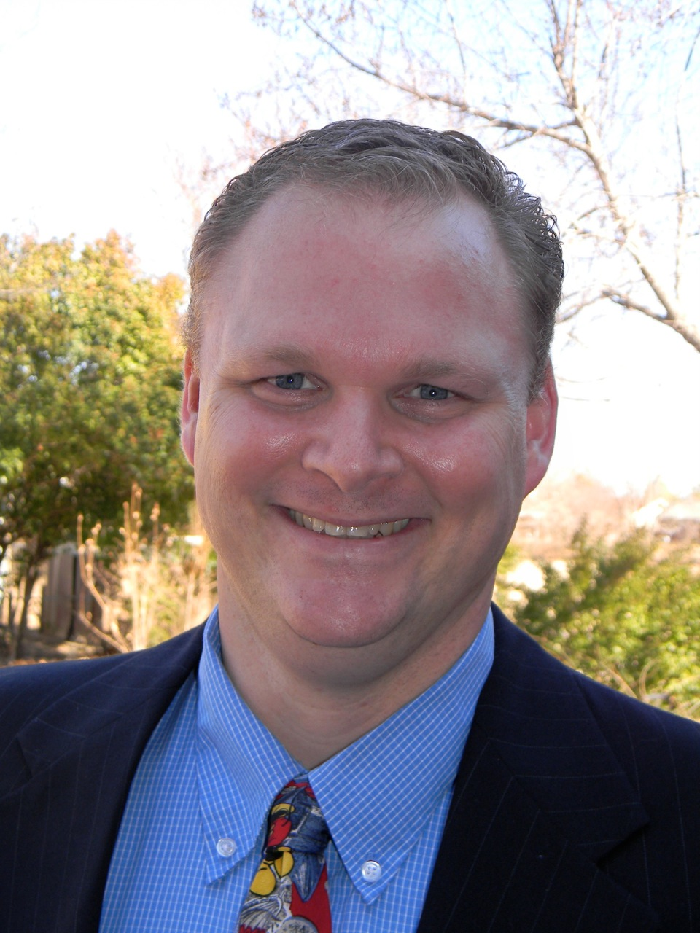
You are cordially invited to
A Day in the Life of
a Network Professional
Zane Gray Manager, Data and Telecommunications
UNIVERSITY OF OKLAHOMA
Partially supported by the National Science Foundation
under Oklahoma’s NSF EPSCoR CyberConnectivity Grant
Wednesday, March 6, 2013
Oklahoma City University,
Meinders School of Business 10AM
What is it like to be a network professional? What are the day to day experiences? What issues of professionalism, customer service, project management, and culture does a network professional encounter? How can you prepare yourself to be a more attractive job candidate, and what do network professionals look for in prospective employees? What is the structure of the network design at a large institution like at the University of Oklahoma?
Zane Gray is the Data and Telecommunications Manager for the University of Oklahoma’s Norman Campus. He received his Bachelor of Science in Chemical Engineering from the University of Oklahoma in 1996 . Before returning to the University of Oklahoma as a network engineer, he was employed as a civilian with the United States Air Force, and deployed computer networks throughout the United States. At the University of Oklahoma, he collaborates with a team of highly talented network associates, oversees the daily operations and maintenance of the campus computer network; charts the direction of a network design that supports tens of thousands of devices; interacts with other IT professionals, faculty, and students; and faces the day to day challenges of change with a smile. Outside of work, he spends quality time with his wife and nine children, and is putting to practice his experience with the Net Zero Energy Footprint initiative in hopes of making the world a better place for his grandchildren.

