Slide 1


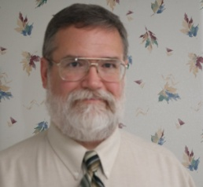
You are cordially invited to
A Day in the Life of
a Network Professional
Jim Glover
Network Manager
Oklahoma Department of Corrections
Partially supported by the National Science Foundation
under Oklahoma’s NSF EPSCoR CyberConnectivity Grant
Friday, November 5, 2010 3:00 PM
LOCATION
What is it like to be a network professional? What are the day to day experiences? What issues of professionalism, customer service, project management, security, planning, funding, and system monitoring does a network professional encounter? How can you prepare yourself to be a more attractive job candidate, and what do network professionals look for in prospective employees? What is the structure of the network design at a large institution like the Oklahoma Department of Corrections?
Jim Glover is the Network Manager at the Oklahoma Department of Corrections. He received his Bachelor of Science in Computer Science from Louisiana Tech University in 1990. Before coming to the Department of Corrections, he was a Server System Administrator at the Oklahoma Office of State Finance. At the Department of Corrections, he manages network cabling, design, configuration and daily management of network connectivity for an organization with nearly 100 remote sites, about 4,000 users, and unique, interesting challenges. Outside of work, he is Vice-President of the Aeronautical Center Amateur Radio club, and dabbles in photography.

