Slide 1


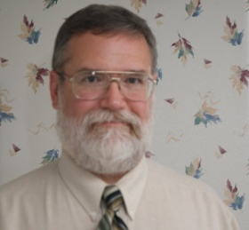
You are cordially invited to
A Day in the Life of
a Network Professional
Jim Glover
Network Manager
Oklahoma Department of Corrections
Oklahoma Information Technology Mentorship Program
Partially supported by the National Science Foundation
under Oklahoma’s NSF EPSCoR RII Cyber Connectivity (C2) grant (EPS-1006919)
12:30 PM,Tuesday, September 27, 2011
Department of Technology
Hamilton Hall, Room 111
What is it like to be a network professional? What are the day to day experiences? What issues of professionalism, customer service, project management and career growth does a network professional encounter? How can you prepare yourself to be a more attractive job candidate, and what do network professionals look for in prospective employees? What is the structure of the network design at a large institution like the Oklahoma Department of Corrections? What are the unique challenges?
Jim Glover is Network Manger at the Oklahoma Department of Corrections. He received his BS in computer science from Louisiana Tech University in 1990. He has been in IT since 1980, serving as a mainframe operator, then system administrator on systems ranging from microcomputers to mainframes, and now at the Department of Corrections, where he designs, maintains, and manages network connections for locations located across the state of Oklahoma. Outside of work, he is active in Amateur Radio, and likes to dabble in photography.

